Slide 2
Understanding Model Codes and Their Importance

Slide 3




Slide 4
Learning Objectives
Model Construction Codes Explained
History of Model Codes
Contemporary Model Building Codes
Necessity of Model Codes
Benefits of Model Codes
Model Code Development Process
How Model Codes Become Law
Enforcement of Jurisdictional Codes
Summary of Fire Alarm System Requirements

Slide 5

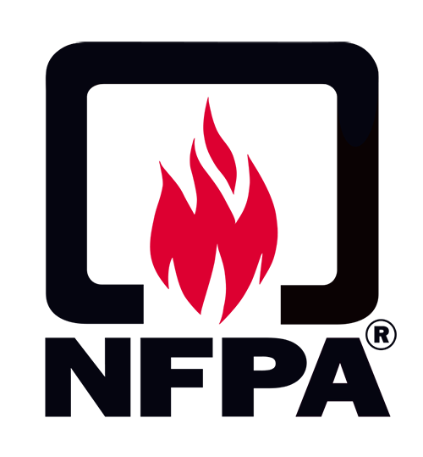
Presenter’s Disclaimer
Comments and opinions during the presentation are exclusively the presenter and do not reflect an official position of the International Code Council (ICC), National Fire Protection Association (NFPA), its employees, or any of the Technical Committees.
Highly recommend purchasing a copy of the ICC or NFPA Code or the Handbook for all the changes, requirements and details:
www.nfpa.org
www.iccsafe.org

Slide 6
Model Construction Codes Explained
Model construction codes (Model Codes) provide a minimum acceptable criterion used to regulate the design, construction, and maintenance of buildings for the purpose of protecting the health, safety and general welfare of the building’s users.
A model code specifies WHEN a fire protection system is required, and which type of system or product is required in a particular occupancy
An installation standard provides requirements for HOW the system or product is to be installed, tested, inspected, maintained, and monitored
A product listing standard specifies the construction, robustness, performance, and marking requirements for specific products

Slide 7
History of Model Codes
Model codes have been around (in some form) for thousands of years.
2000 B.C.: The code of Hammurabi dictated that if a dwelling collapsed and caused the death of the owner, the builder would be put to death.
1666: The Roman Empire instituted building codes after fatal building collapses, and a great fire that destroyed 15,000 buildings
1871: The Chicago fire killed 250 people, destroyed 17,000 structures and left nearly 100,000 people homeless. Four years later, that city enacted a new building code and fire-prevention ordinance.

Slide 8
Contemporary Model Codes
Contemporary model codes are:
Immersed in established scientific and engineering principles that have been thoroughly tested.
Rely on measurable performance requirements rather than the rigid specification of materials and methods
Evolved from tragic events to standards designed to prevent them.

Slide 9
Contemporary Model Codes
Contemporary model codes include but not limited to:
Building Code
Fire Code
Mechanical Code
Plumbing Code
Fuel Gas Code
Existing Building Code
Energy Conservation Code
Electrical Code

Slide 10
Necessity of Model Codes
Constructing homes and businesses according to model code requirements provide:
Uniformity that permits building and materials manufacturers to do business on a larger scale, passing any related cost savings on to the consumer.
Promote a level, predictable playing field for everyone involved in the development process – from designers, builders and suppliers to buyers, who are entitled to rely on construction of a safe, sound building.
Inspection during construction via a third-party verification that code compliance has been achieved.

Slide 11
Benefits of Model Codes
Studies have consistently shown the benefits of up-to-date building codes outweighing the increase in construction costs.
Buildings that meet current model code will withstand the forces of nature better than homes built to older codes.
Considerably more expensive to rebuild buildings than to build them right in the first place.
Better, smarter design and construction can reduce costs as well as operating costs.

Slide 12
Model Code Development Process
ICC and NFPA Development Process:
All interested parties permitted to participate
Transparency
Due Process
Consensus
Appeals

Slide 13
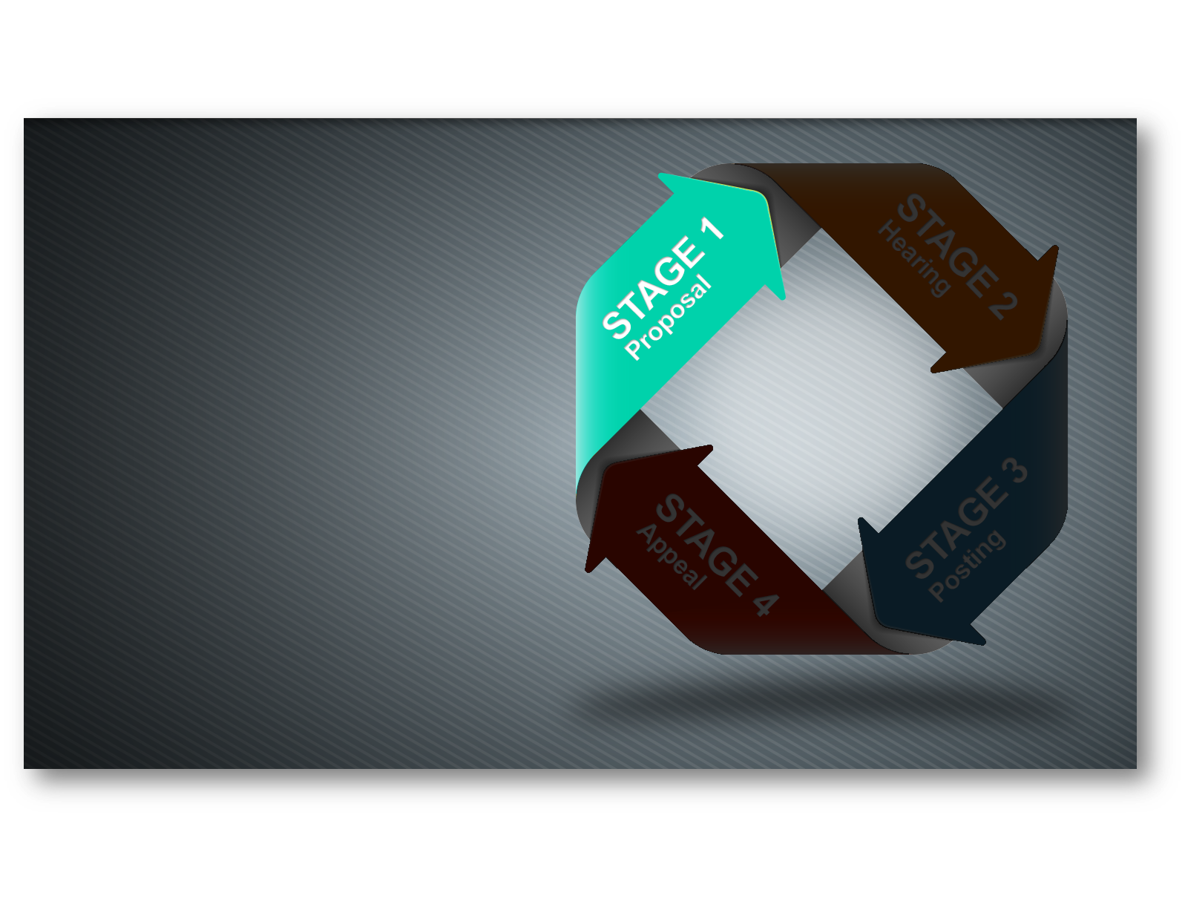
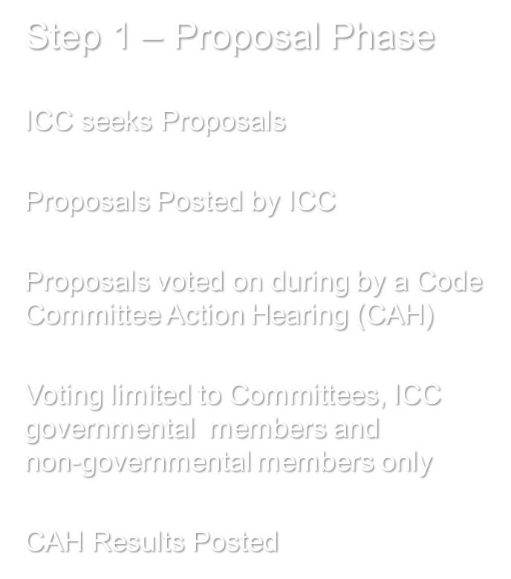
Model Code Development Process
International Code Council (ICC) Process

Slide 14

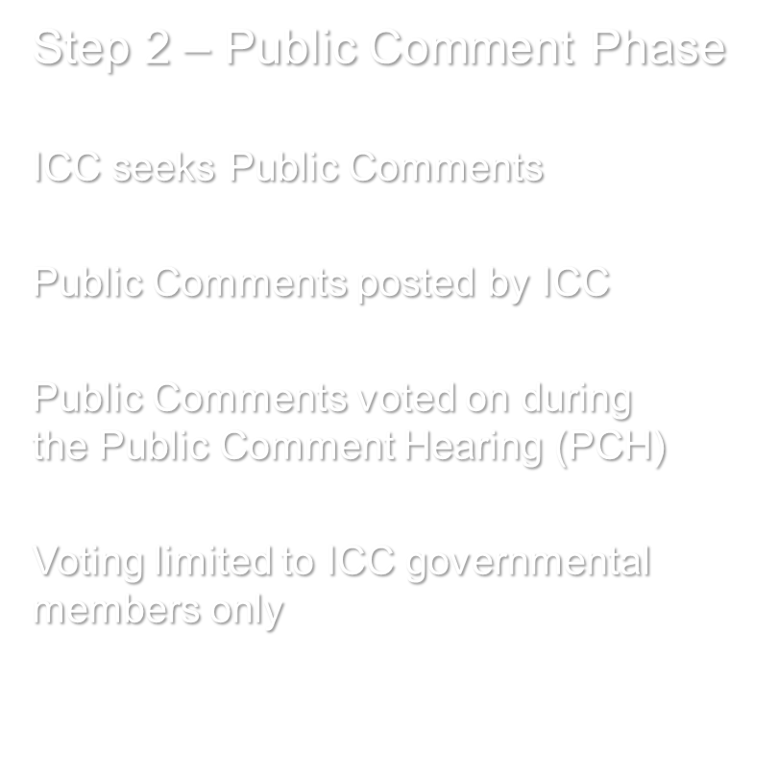
Model Code Development Process
International Code Council (ICC) Process

Slide 15

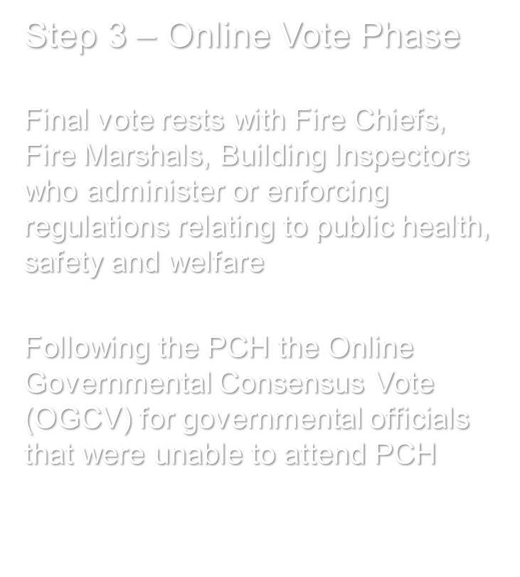
Model Code Development Process
International Code Council (ICC) Process

Slide 16
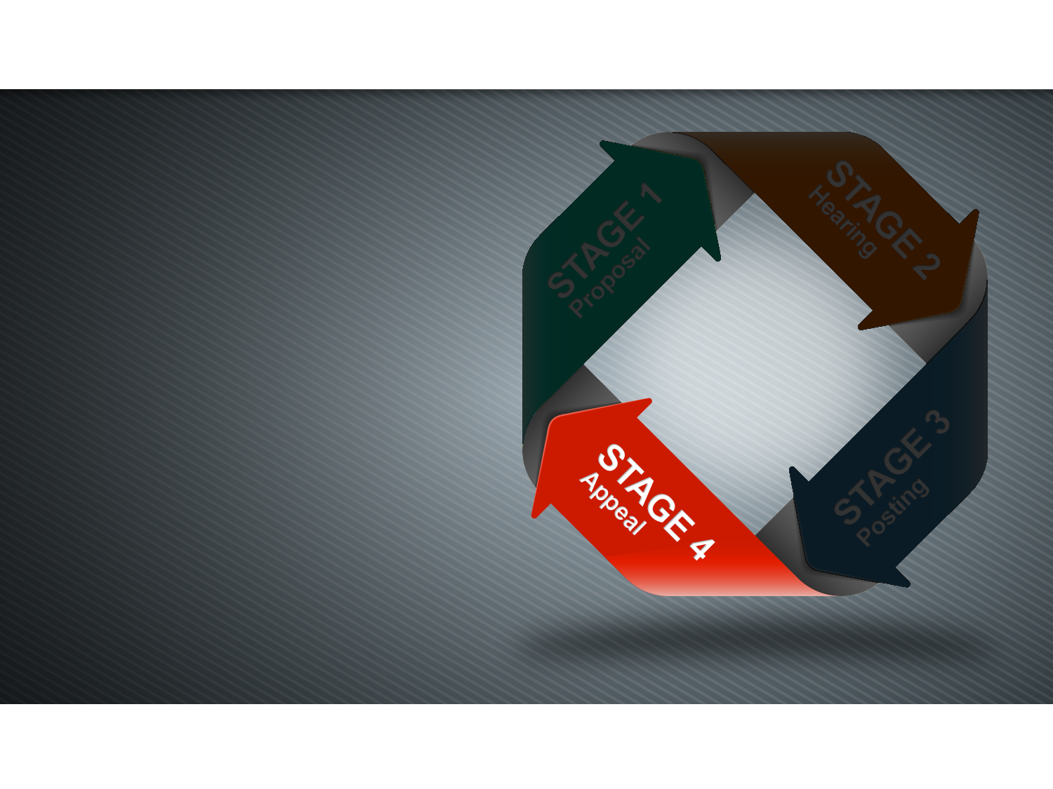

Model Code Development Process
International Code Council (ICC) Process

Slide 17
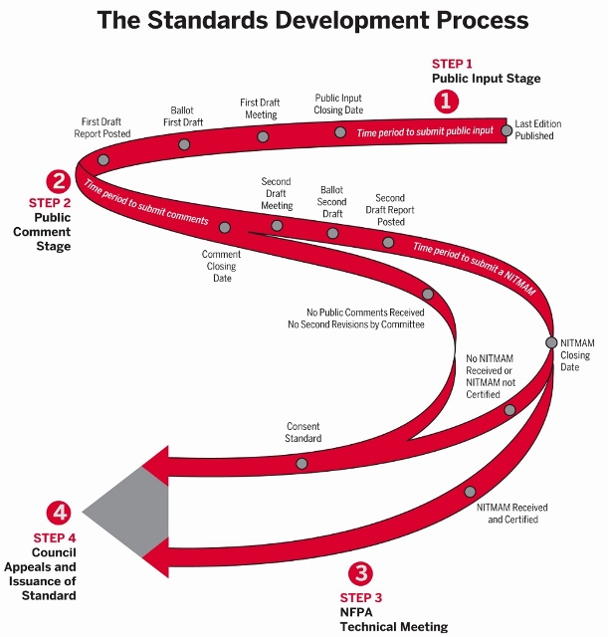
Model Code Development Process
National Fire Protection Association (NFPA) Process

Slide 18
How Model Codes Become Law
Model codes become law when they are adopted by national, state legislatures or local governments, thereby becoming the respective jurisdictions building/fire codes.
National, state, or local building codes are the primary mechanism for states and municipalities to assure new and existing buildings are up-to-date and safe.
ICC and NFPA allow public authorities and private users to adopt by reference and use their documents
NFPA and ICC do not waive their copyright rights.

Slide 19
Adoption of Model Codes
Jurisdictions are permitted to adopt model codes:
By reference
With no modifications
In part
Different editions
All changes, additions, or deletions by the adopting authority must be noted separately in the adopting instrument.

Slide 20
Enforcement of Jurisdictional Codes
Model codes are generally enforced at the local level and have little value until they are enforced by local authority having jurisdictions (AHJ).
AHJ: An agency, or individual responsible for enforcing the requirements of a code or standard, approving product, materials, an installation, or a procedure.
Local building/fire departments are often funded by permit fees, which average less than one percent of construction costs.
Plan reviewers and building inspectors are vital to the success of jurisdictional codes.
These functions must be adequately funded and staffed with qualified, trained, and certified personnel so the full value of model codes will not be realized.

Slide 21
Occupancy Classifications and Use
Assembly: Occupancies containing a gathering of 50 or more persons for deliberation, worship, entertainment, eating, drinking, amusement, awaiting transportation including but not limited to:
Assembly halls
Auditoriums
Bowling lanes
College and university classrooms, 50 persons and over
Drinking establishments and restaurants
Motion picture theaters and life performance theaters
Places of religious worship
Special amusement building (regardless of occupant load or similar uses)

Slide 22

Occupancy Classifications and Use
Apartment Buildings: Occupancies containing sleeping units or more than two dwelling units where the occupants are primarily permanent in nature, including, but not limited to:
Apartment houses
Vacation timeshare properties
Convents
Dormitories
Fraternities and sororities

Slide 23

Occupancy Classifications and Use
Hotels, and Motels: Occupancies containing sleeping units where the occupants are primarily transient in nature (length of stay is not more than 30 days) including nut not limited to:
Boarding houses (transient) with more than 10 occupants
Congregate living facilities (transient) with more than 10 occupants
Hotels
Motels

Slide 24
Occupancy Classifications and Use
Business: Occupancies containing the use of a building or structure, or a portion thereof, for office, professional or service-type transactions, including storage of records and accounts. Business occupancies shall include, but not be limited to, the following:
Airport traffic control towers
Animal hospitals, kennels and pounds
Banks
Barber and beauty shops
Professional services (architects, attorneys, dentists, physicians, engineers, etc.)
Dry cleaning and laundries

Slide 25
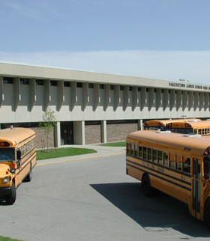
Occupancy Classifications and Use
Education: A building or structure, or a portion thereof, by six or more persons at any one time for educational purposes through the 12th grade. It is common for a school to also have cafeterias (Group A-2), gymnasiums (Group A-3), auditoriums (Group A-1), libraries (Group A-3) and offices (Group B).

Slide 26

Occupancy Classifications and Use
Mercantile: A building or a portion thereof for the display and sale of merchandise, and involves stocks of goods, wares or merchandise incidental to such purposes and where the public has access. Mercantile occupancies shall include, but not be limited to, the following:
Department stores
Drug stores
Markets
Retail or wholesale stores

Slide 27
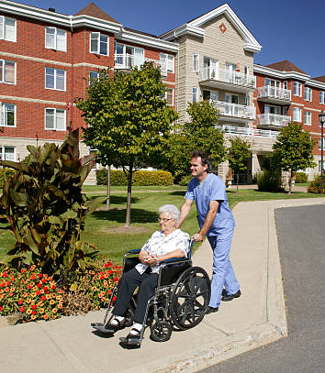
Occupancy Classifications and Use
Assisted Living Facilities: A buildings or portions thereof for more than 16 persons, excluding staff, who reside on a 24-hour basis in a supervised environment and receive custodial care.
Alcohol and drug centers
Congregate care facilities
Group homes Halfway houses
Residential board and care facilities
Social rehabilitation facilities

Slide 28
Occupancy Classifications and Use
Hospitals and Nursing Homes: Buildings used for medical care on a 24-hour basis for more than five persons who are incapable of self-preservation. This group shall include, but not be limited to, the following:
Foster care facilities
Detoxification facilities
Hospitals
Nursing homes

Slide 29
Presenter’s Disclaimer
The information contained in the following slides:
Do Not provide a comprehensive explanation of all the applicable requirements, and exceptions to the requirements.
Do not cover the differences between the ICC and NFPA model codes.
Do provide a high-level summary! Also, the requirements in NFPA 72, National Fire Alarm and Signaling Code®, are not covered.
Highly recommend purchasing a copy of the ICC or NFPA Code or the Handbook for all the changes, requirements and details:
www.nfpa.org
www.iccsafe.org

Slide 30
Applicable Model Codes – 2024 New Construction
International Fire Code (IFC)
International Building Code (IBC)
NFPA 1, Fire Code®
NFPA 101, Life Safety Code®
NFPA 5000, Building Construction and Safety Code®

Slide 31
Summary of Fire Alarm System Requirements
General Requirement: Fire alarm systems required by the code shall be installed, tested, and maintained in accordance with the applicable requirements of NFPA 70 and NFPA 72
Signal Initiation: Fire alarm system actuation shall occur by any or all the following means of initiation:
  Manual fire alarm initiation
  Automatic detection
  Extinguishing system operation
IFC/IBC Initiating Device Identification: The fire alarm system shall identify the specific initiating device address, location, device type, floor level where applicable and status including indication of normal, alarm, trouble and supervisory status, as appropriate.

Slide 32
Summary of Fire Alarm System Requirements
Occupant Notification: Upon activation of the fire alarm system, the system shall initiate occupant notification using audible and visual appliances to alert occupants of a fire or other emergency.
Audible Notification Requirements: Shall be used to notify the occupants of an alarm condition.
Visual (strobes) Requirements: Shall be provided in public use areas and common use areas including corridors, public restrooms, shared offices, classrooms, medical exam rooms, etc. Visible alarm notification appliances are to be installed in conjunction with the audible devices and located and oriented so that they will display alarm signals throughout a space.

Slide 33
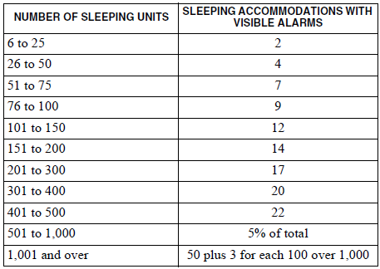
Summary of Fire Alarm System Requirements
TABLE 907.5.2.3.2 VISIBLE ALARMS
Visual Requirements: Habitable spaces in dwelling units and sleeping units in Group I-1 and R-1 occupancies in accordance with Table 907.5.2.3.2 shall be provided.

Slide 34
Summary of Fire Alarm System Requirements
Emergency Control Functions: Where required by another section of this Code, the following functions shall be actuated in accordance with NFPA 72:
Release of hold-open devices for doors or other opening protectives
Stairwell or elevator shaft pressurization
Smoke management or smoke control systems
Unlocking of doors
Elevator recall and shutdown
HVAC shutdown

Slide 35
Summary of Fire Alarm System Requirements
Annunciation: Initiating device status shall be annunciated at an approved on-site location and shall be as follows:
Each floor shall constitute a single zone
A single zone shall not exceed 22,500 square feet (2090 m2).
The length of any zone shall not exceed 300 feet (91 440 mm) in any direction.

Slide 36
Summary of Fire Alarm System Requirements
Initial Installation Acceptance Test: Upon completion of the installation, the fire alarm system and all fire alarm components shall be tested in accordance with NFPA 72.
Periodic Inspection, Testing and Maintenance: The maintenance and testing schedules and procedures for fire alarm systems shall be in accordance NFPA 72.
Emergency Forces Notification: Fire alarm system shall be monitored by an approved supervising station.

Slide 37
Summary of Fire Alarm System Requirements
Hotels and Motels: A fire alarm system that activates the occupant notification system is required in buildings three or more stories in height:
Pull stations
Smoke detectors in interior corridors, waiting areas open to corridors and habitable spaces other than kitchens
Smoke detection inside all sleeping rooms
The fire alarm system shall be monitored by a supervising station

Slide 38
Summary of Fire Alarm System Requirements
Apartment and Dormitory Buildings: A fire alarm system that activates the occupant notification system is required in buildings that are three or more stories in heigh. Below are the initiating and monitoring requirements:
Pull stations
Smoke detectors throughout all interior corridors serving sleeping units.
Smoke detection (smoke alarms or smoke detectors) inside all sleeping rooms
The fire alarm system shall be monitored by a supervising station

Slide 39

Summary of Fire Alarm System Requirements
Assembly: A fire alarm system that activates the occupant notification system is required in buildings with an occupant load of 300 or more, or where the assembly occupancy where an occupant load is more than 100 persons above or below the lowest level of exit discharge. Below are the initiating and monitoring requirements:
Pull stations that activates
  Pull stations are not required where the building is equipped throughout with an automatic sprinkler system and activates the occupant notification system upon sprinkler water flow.
The fire alarm system shall be monitored by a supervising station
Assembly occupancies with an occupant load of 1,000 or more shall utilize an emergency voice/alarm communications system (EVACS) for occupant notification.

Slide 40

Summary of Fire Alarm System Requirements
Business: A fire alarm system that activates the occupant notification system is required where one of the following conditions exists:
The combined occupant load of all floors is 500 or more persons.
The occupant load is more than 100 persons above or below the lowest level of exit discharge.
Initiation shall be provided by:
Pull Stations
Pull stations are not required where the building is equipped throughout with an automatic sprinkler system and activates the occupant notification system upon sprinkler water flow.
The fire alarm system shall be monitored by a supervising station

Slide 41
Summary of Fire Alarm System Requirements
Education: A fire alarm system that activates the occupant notification system utilizing an emergency voice/alarm communication system (EVACS) is required with an occupant load of 50 or less persons. Below are the initiating and monitoring requirements:
Pull stations. Pull stations are not required where:
  The building is equipped throughout with a sprinkler system and activates the EVACS occupant notification system upon sprinkler water flow.
  Interior corridors are protected by smoke detectors.
  Auditoriums, cafeterias, gymnasiums areas are protected by heat detectors or other approved detection devices.
  Shops & laboratories involving dusts or vapors are protected by heat detectors or other approved detection devices.
  The fire alarm system shall be monitored by a supervising station

Slide 42
Summary of Fire Alarm System Requirements
Mercantile: A fire alarm system that activates the occupant notification system is required where one of the following conditions exists:
The combined occupant load of all floors is 500 or more persons.
The occupant load is more than 100 persons above or below the lowest level of exit discharge.
Fire alarm system Initiation shall be provided by:
Pull stations
Pull stations are not required where the building is equipped throughout with an automatic sprinkler system and activates the occupant notification system upon sprinkler water flow.
The fire alarm system shall be monitored by a supervising station

Slide 43
Summary of Fire Alarm System Requirements
Assisted Living Facilities: A fire alarm system that activates the occupant notification system is required. Below are the initiating and monitoring requirements:
Pull stations
Smoke detection
  Required in corridors, waiting areas open to corridors and habitable spaces other than sleeping units and kitchens.
  Required in sleeping rooms
  Where patients care capable of self rescue, smoke detection is not required where the building is equipped throughout with an automatic sprinkler system and activates the occupant notification system upon sprinkler water flow.
The fire alarm system shall be monitored by a supervising station

Slide 44
Summary of Fire Alarm System Requirements
Hospitals and Nursing Homes: A fire alarm system that activates the occupant notification system is required. Below are the initiating and monitoring requirements:
Pull stations
Smoke detection
  Required in corridors, waiting areas open to corridors and habitable spaces other than sleeping units and kitchens.
  Required in sleeping rooms
  Where patients care capable of self rescue, smoke detection is not required where the building is equipped throughout with an automatic sprinkler system and activates the occupant notification system upon sprinkler water flow.
The fire alarm system shall be monitored by a supervising station

Slide 45
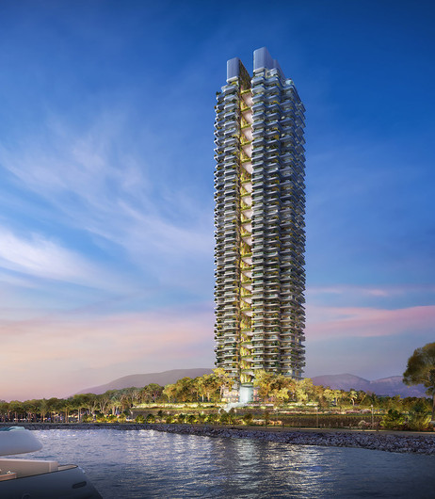
Summary of Fire Alarm System Requirements
High-Rise Buildings: High-rise buildings shall be provided with an automatic smoke detection system utilizes an emergency voice/alarm communication system (EVACS) for occupant notification.
In addition to pull station and smoke detection requirements specific for the specific occupancy classification smoke detectors shall be located as follows:
  In each mechanical equipment, electrical, transformer, telephone equipment or similar room that is not provided with sprinkler protection.
  In each elevator machine room, machinery space, control room and control space and in elevator lobbies.
  The fire alarm system shall be monitored by a supervising station

Slide 46
Applicable Model Codes – 2024 Existing Construction
International Fire Code (IFC)
  Chapter 11: Retroactive requirements
International Existing Building Code (IEBC)
  Scope covers the repair, alteration, change of occupancy, addition to and relocation of existing buildings.
NFPA 1, Fire Code®
NFPA 101, Life Safety Code®

Slide 47

Richard Roberts.
Senior Industry Affairs Manager
Honeywell Fire Safety
.
Richard.roberts@systemsensor.com
1-630-338-7025

