Slide 2

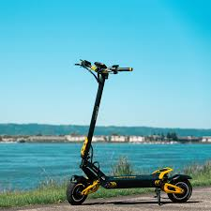
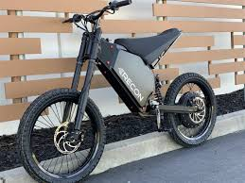
Electric Bicycles
Electric Scooters
Hoover Skateboards
Hand Tool Batteries
Battery Storage
Lighting Systems
Fan motors
Electromobility
A lot more than Electric Cars:
Electric Buses
Electric Trains
Battery Storage
Wheelchairs
Robotics
Cell Phones

Slide 3

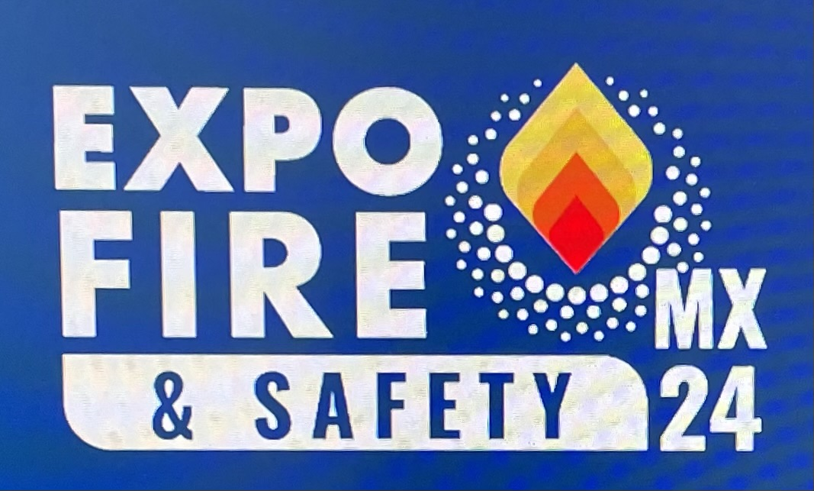
Bob Caputo, CFPS
AMERICAN FIRE SPRINKLER ASSOCIATION
Bob Caputo, president of the American Fire Sprinkler Association (AFSA), is chair of the NFPA 24 & NFPA 291 technical committees and a member of multiple NFPA technical committees, including NFPA 13 and NFPA 25. Caputo is a contributor to the NFPA 13 and NFPA 25 Handbooks, the NFPA Inspection Manual, and the 21st Edition of the Fire Protection Handbook. As a member of both NFPA and AFSA faculties, Caputo has written and presented seminars worldwide on fire protection and life safety systems and is a regular speaker at AFSA and NFPA conventions. Caputo is an instructor at the National Fire Academy and an advisory board member at Oklahoma State University School of Fire Protection Engineering & Safety. Caputo’s industry distinctions include “Fire Prevention Officer of the Year” from San Diego County in 1994, Fire Protection Contractor magazine’s “Man of the Year” in 1997, and AFSA’s Henry S. Parmelee award in 2017. Caputo attended the University of Albuquerque, New Mexico, and is a U.S. Navy veteran and former volunteer firefighter.
bcaputo@firesprinkler.org | P: +1 760 908 7753 | American Fire Sprinkler Association

Slide 4
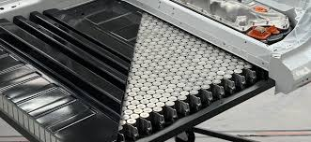
One Common Problem
EV fires are not as common as gas-powered vehicle fires, but they are more difficult to extinguish, due to how the batteries are protected from the elements. Batteries take a long time to cool, creating a risk of reignition.
Lithium-ion batteries are found in every electric vehicle, tool and cell phone and they share a common problem as it relates to fire and life safety… when they catch fire, they burn very hot and for a long time.
But, it’s not about the cars alone…
Notes:
Battery banks in an EV and other devices are made up of smaller batteries, typically about the size of a normal AA battery

Slide 5

Lithium-Ion Batteries Impact
Fire Service & the Community
2023 - New York City:
362 fires started by lithium-ion batteries
138 injuries
18 deaths
Lithium-ion batteries – driving a literal explosion of growth in consumer electronics, personal mobility, energy storage, and electric vehicles
Photo Credit: National Geographic

Slide 6
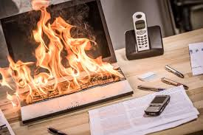
Lithium-ion Batteries:
Overheating is one of the main causes of lithium-ion battery failures.
Physical damage.
Excessive heat:
  using a faulty charger
  overcharging
  short circuits

Slide 7
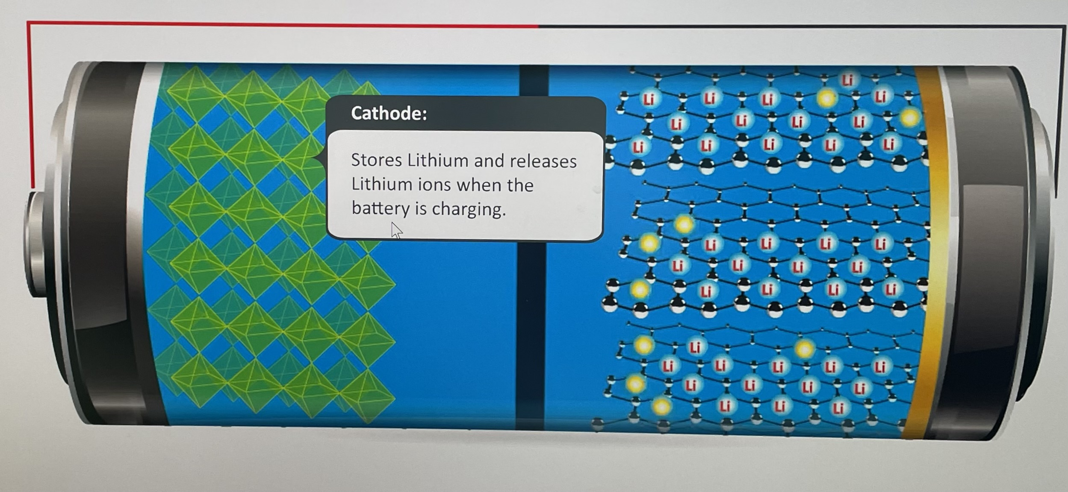
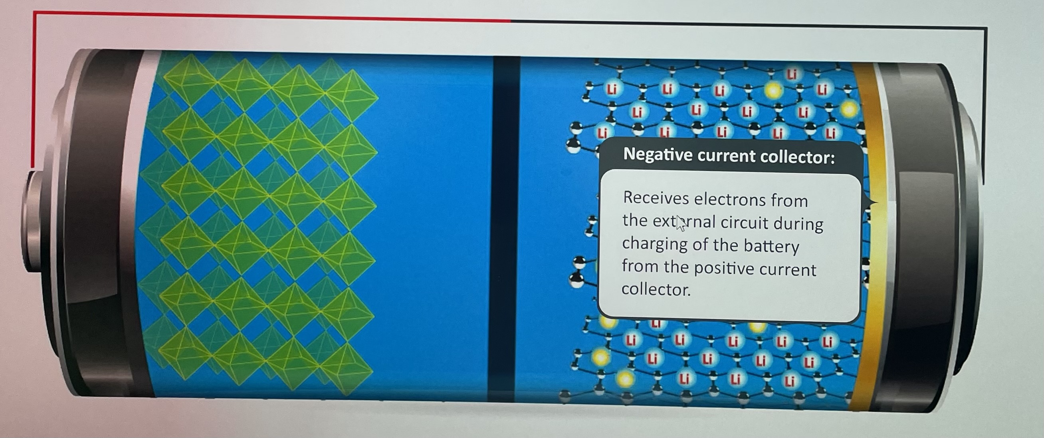
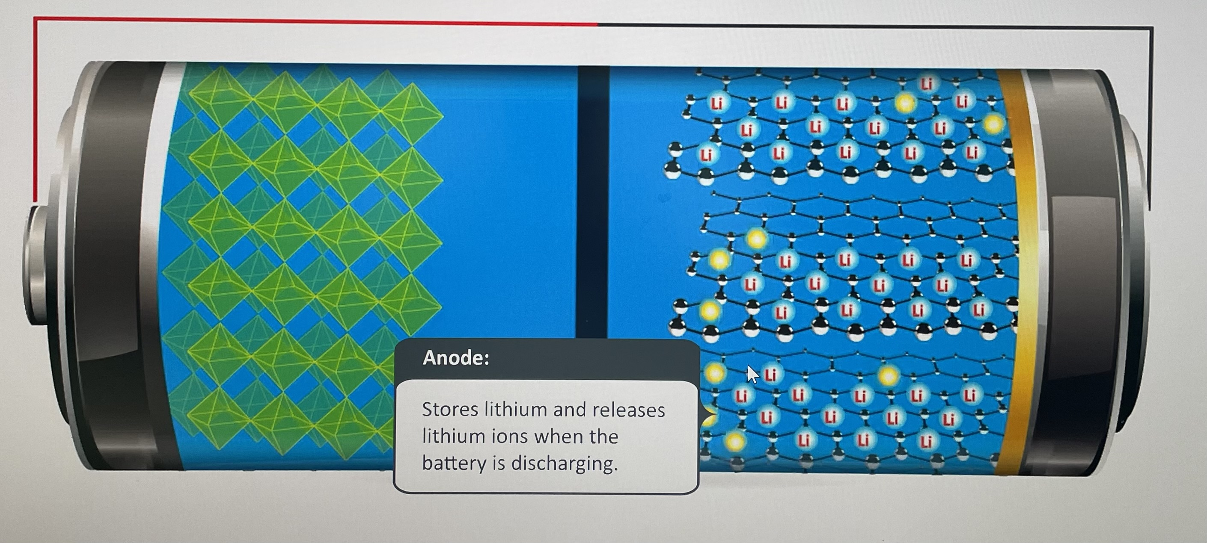
How lithium-ion batteries work
Flammable liquid or gel
Photo Credit: US Government DOE

Slide 8
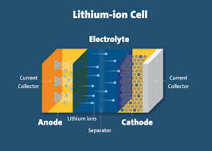
Overheating is a phenomenon known as thermal runaway.
The excessive heat promotes the chemical reaction that makes the battery work.
  creates more heat and more chemical reactions in a disastrous spiral.
Physical damage to battery cells allows the electrolyte inside to leak, creating another potential hazard risk.
Photo Credit: UL Labs

Slide 9
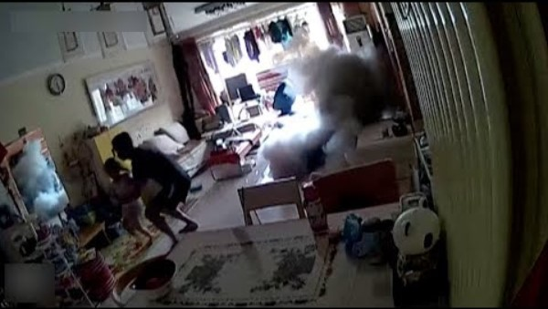

Slide 10
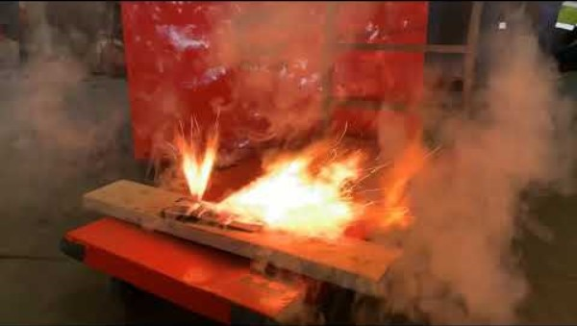

Slide 11

Most Batteries are Manufactured in China
Most Lithium is found in Asia
Manufacturing standards in China are inconsistent.
Quality controls vary greatly.
When shortcuts are taken in any manufacturing process, the results are never good
Photo Credit: CDC

Slide 12
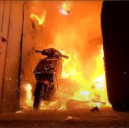
Contributing Factors:
People charge battery-operated devices overnight.
People often use charging devices that did not come with their product.
Batteries in scooters and bicycles are often damaged by use.
Charging scooters and bicycles in their home’s primary egress pathway
Photo Credit: The San Francisco Standard

Slide 13
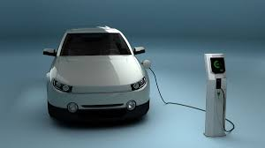
EV’s versus I.C.E. Vehicles
Combustion engine vehicles carry half of the fuel needed to operate the engine. The other half is the O2 needed for the process.
EV’s carry 100% of their fuel, as such, they are heavier, and fires burn three times hotter.
Photo Credit: Tesla

Slide 14

Robotics = Batteries
Storage & Distribution buildings are built so tall and with ASRS systems, neither NFPA Standards nor FM Global can tell us how to protect all of them.

Slide 15

Smart Cities

Slide 16

Let’s Talk About A.I.
What is artificial intelligence?
Modern AI is a system that can perceive its environment and take actions to maximize the chance of successfully achieving its goals as well as interpret and analyze data in such a way that it learns and adapts as it goes.
AI will reshape how we live, work, and do business.

Slide 17

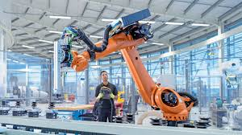
AI Will Change Our Lives:
Deep learning will provide efficiency, insight, and opportunity—but also deep-fakes and misinformation.
It will alter entire economies and ways of doing business. And it will happen faster than any technological revolution in human history.
  Human-centered innovation
  Ethics and regulatory regimes
  Job creation, transformation, and elimination
Photo Credit: Siemens

Slide 18
Artificial Intelligence has the potential to make positive changes in our lives:
AI can improve productivity for writing, programming, customer support, and consulting.
Healthcare: AI can help medical facilities function better, reduce costs, and improve monitoring and diagnostic capabilities. This could lead to personalized treatment plans and medication regimens, and increased access to data from multiple medical institutions.
Education: Endless pros and cons
Finance - AI will help banks and financial advisors engage with clients more efficiently, for tasks like credit score monitoring, fraud detection, financial planning, and customer service.

Slide 19

Solving the Battery Problem:
Public Education & Awareness
Use a reputable brand-name charger – not a cheap generic version available online.
Good quality chargers, made for the battery you are using, control the amount of charge going into the cell, and will cut off when fully charged.
Be very wary if a lithium-ion battery sustains any physical damage, such as being dropped or pierced by an object.
Do not purchase lithium-ion batteries second-hand, or online from unknown and potentially unregulated vendors.
Limit exposure to prolonged sunlight.

Slide 20
Solving the Problem:
Commercial Application - safeguards and best practices
Consider alternate rechargeable battery types – such as nickel-cadmium and even lead-acid which date back to the 19th century.
Lithium-ion batteries are more popular as they combine fast charging, long charge holding, and high-power density, for more battery life in a smaller package.
Future research is likely to produce different types of batteries with similar properties and fewer hazards than existing lithium-ion technology – such as solid-state electrolyte batteries which are currently very expensive to produce.

Slide 21
Solving the problem:
Following manufacturer guidelines
Lithium-ion battery packs feature a battery management system (BMS) designed to protect the battery cells and prevent failures from occurring.
The BMS tracks data including temperature, cell voltage, cell current, and cell charge to help ensure that each part of the battery is working correctly and safely. Cooling provisions can also be linked to a BMS to reduce the battery pack temperature if it is getting too hot.
Battery management systems should be monitored to ensure it is working correctly - failure of the BMS can lead to failure of the lithium-ion batteries themselves. (Smaller lithium-ion applications do not possess a BMS).
Additional education and training, especially for tradespeople, will help increase knowledge and understanding regarding the dangers of lithium-ion batteries and help to minimize risks to eliminate danger as much as possible.
Additional research and development will also address some fundamental questions regarding lithium-ion battery safety.

Slide 22

“Our need will be the real creator”
Plato
Future Smart Cities
As fire challenges continue to change, so will fire sprinkler technologies and system design applications as we continue to be the best solution for saving lives and protecting assets.

Slide 23


