Slide 2
Aspirating Smoke Detection for Lithium Battery Storage Applications

Slide 3

NOMBRE APELLIDO.
INSTITUCIÓN.
Tparrish@telgian.com
+1-248-467-6663
www.Telgian.com / www.afaa.org

Slide 4
Aspirating Smoke Detection for Lithium Battery Storage Applications
Comments and opinions are those of the presenter and do not necessarily reflect any official position of UL or employees, nor NFPA or employees or technical committees.
This presentation is not intended to cover all revisions, editorial changes, details, requirements or exceptions to any standards or codes.
It is always recommended to purchase and/or refer to relevant NFPA and UL publications. www.nfpa.org www.ul.com

Slide 5
Aspirating Smoke Detection for Lithium Battery Storage Applications
Key Points for this sesión:
  What is aspirating smoke detection ?
  What are the new maximuim sampling times allowed ?
  How do I apply these systems to Energy Storage ?

Slide 6
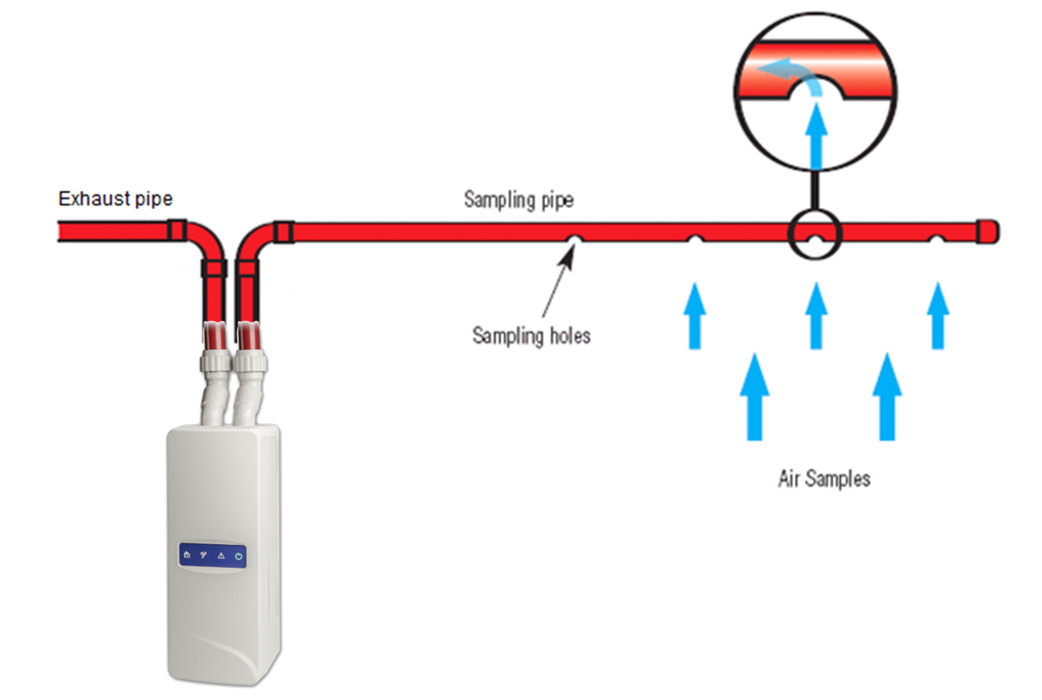
Aspirating Smoke Detection for Lithium Battery Storage Applications
A method of smoke detection, where a sample of air is continuously drawn from the protected area through a network of sampling pipes and passed through a high sensitivity laser detection chamber

Slide 7

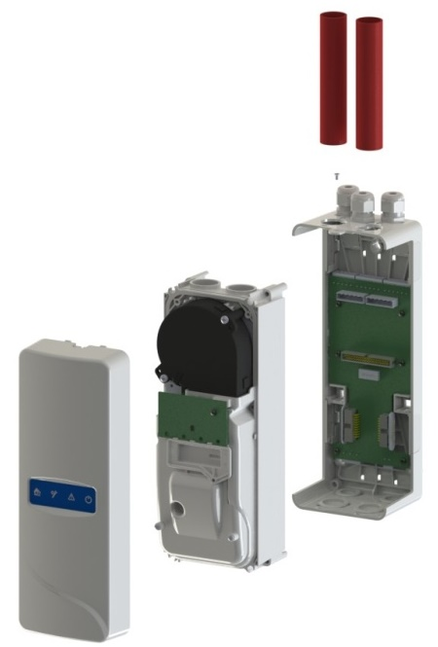
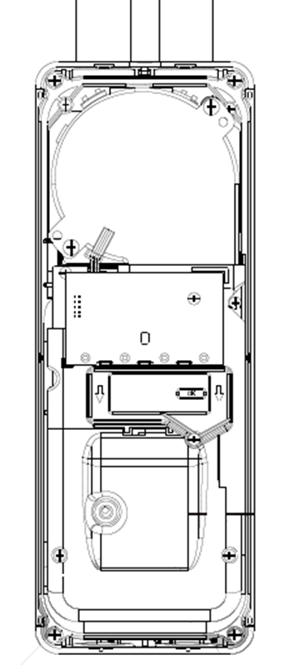
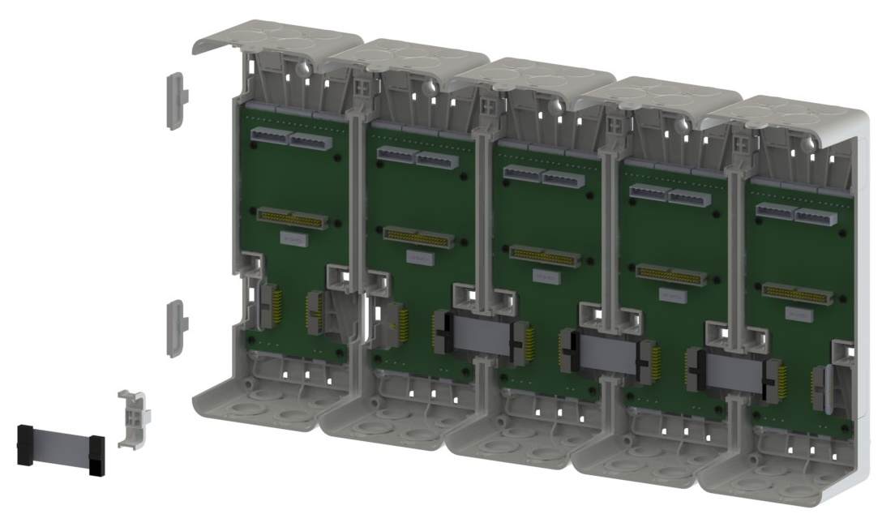
Aspirating Smoke Detection for Lithium Battery Storage Applications
Exhaust
Pipe Inlet
Aspirating Fan
Flow Sensors
Air Filter
Laser
Detection Chamber

Slide 8
Aspirating Smoke Detection for Lithium Battery Storage Applications
A sample of air is continuously drawn from the protected area through a network of sampling pipes and passed through a high sensitivity laser detection chamber. This active process provides greatly increased detection over passive spot detectors, making ASD ideal for EWFD and VEWFD applications.
NFPA 72 -2022 edition 17.7.4.6

Slide 9
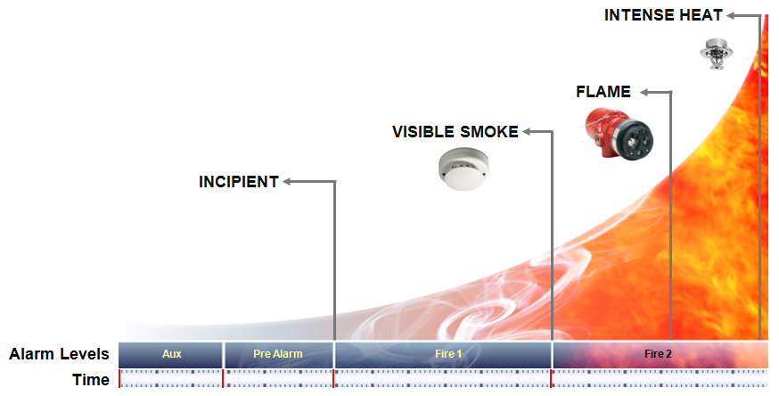
Aspirating Smoke Detection for Lithium Battery Storage Applications

Slide 10
Aspirating Smoke Detection for Lithium Battery Storage Applications UL 7th Edition Impacts
Requirements for Detectors started June 30th, 2024
Understand the requirements for design (open area vs. special application, additional requirements set by AHJ, etc.).
Ensure the use of the manufacturer’s UPDATED pipe calculation software to meet the required product performance.
To meet UL requirements for insurance purposes or if otherwise required by AHJ, ensure the selection of appropriate design options in the Manufacturer’s Updated Tool.

Slide 11
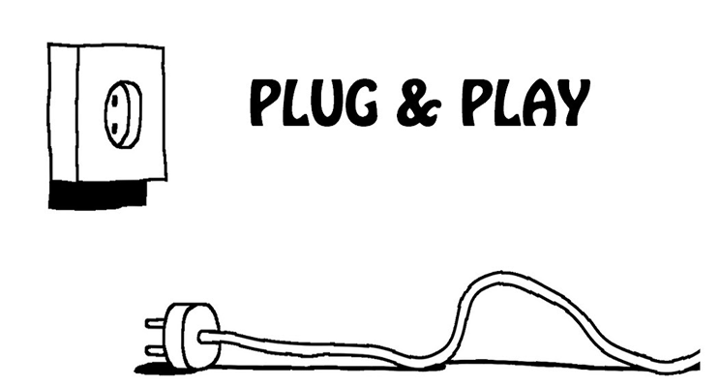
Aspirating Smoke Detection for Lithium Battery Storage Applications Retrofit older UL Edition sys.
Replacing a previous Edition UL 268 Listed detector with a 7th Edition Detector is NOT SIMPLY A ONE FOR ONE REPLACEMENT
Before replacing with a 7th Edition Detector, the pipe network must be re-calculated with the manufacturer’s current design software using the appropriate detector and application selections
When replacing with a 7th Edition Detector, the following scenarios are possible:
  Hole sizes may need to be modified
  Pipe length may need to be shortened
  Fan speed may need to be increased
  A higher performing model may need to be purchased
  One previous edition detector may need to be replaced with more than one 7th Edition detector if splitting the pipe network

Slide 12
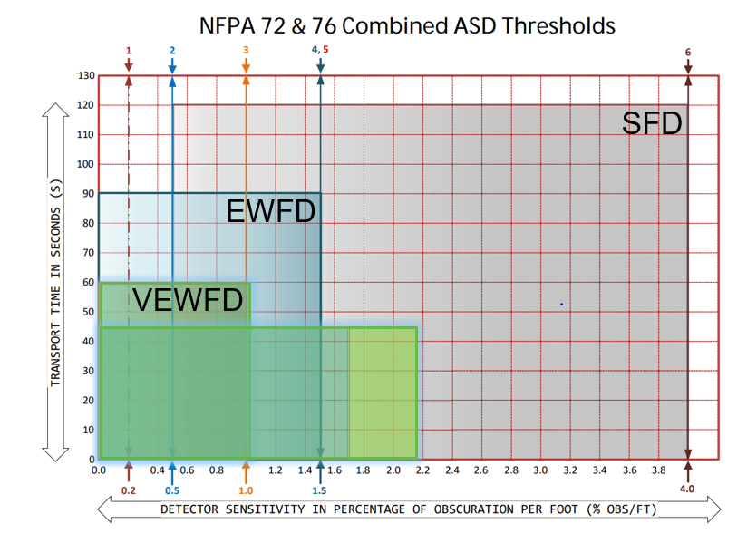
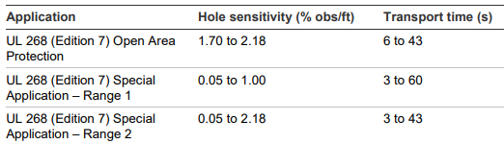
Aspirating Smoke Detection for Lithium Battery Storage Applications

Slide 13
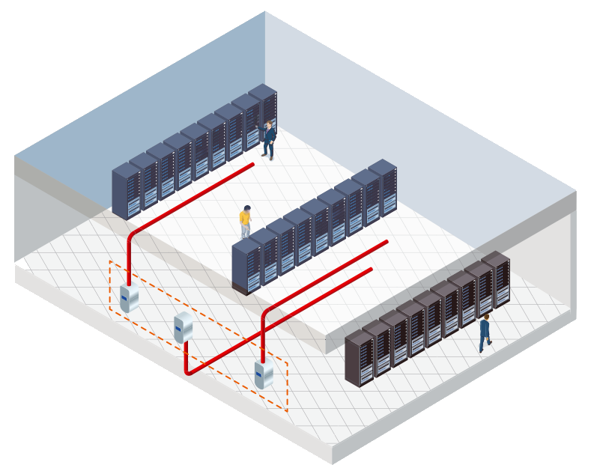
Aspirating Smoke Detection for Lithium Battery Storage Applications Data Centers
Plan for UL268 7th Edition now versus later
  Piping designs will be impacted
Transport time is NOT the only factor
  Review balance of piping design to reduce potential of nuisance alarms due to changes in flow and differential pressure
Don’t mix Hot Aisle and Cold Aisle detection in the same detector
Have system connected to critical power to reduce run-time requirements for batteries

Slide 14

Aspirating Smoke Detection for Lithium Battery Storage Applications
Questions
Special Thanks to Mark Anderson, CET. Edwards Safety / Kiddie Commercial for providing and permitting the use of some of the information and graphics used in this presentation.

Slide 15
NOMBRE APELLIDO.
INSTITUCIÓN.
Tparrish@telgian.com
+1-248-467-6663
www.Telgian.com / www.afaa.org

