Slide 2

Fire Risk Assessment for Mobility and Energy Storage Hazards
Chris Jelenewicz, PE, FSFPE
SFPE CEO

Slide 3

Introduction
Currently CEO at Society of Fire Protection Engineers (SFPE)
SFPE for 20 Years
BS from University of Maryland in FPE
PE in California
Chair NFPA 101 Fundamentals
Principle Member NFPA 550 & 551
Staff Liaison SFPE Risk Task Group
Volunteer Firefighter – 20 Years

Slide 4

About SFPE
Mission: To define, develop, and advance the use of engineering best practices; expand the scientific and technical knowledge base; and educate the global fire safety community, to reduce fire risk

Slide 5
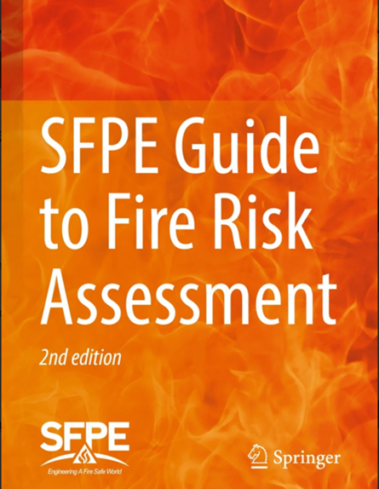
SFPE Guide to Fire Risk Assessment
SFPE Engineering Guide to Fire Risk Assessment, 2nd Edition (2022)
Developed by SFPE Fire Risk Task Group
Provides a Global Framework
Available at https://link.springer.com
  Print
  eBook
  Purchase Individual Chapters

Slide 6
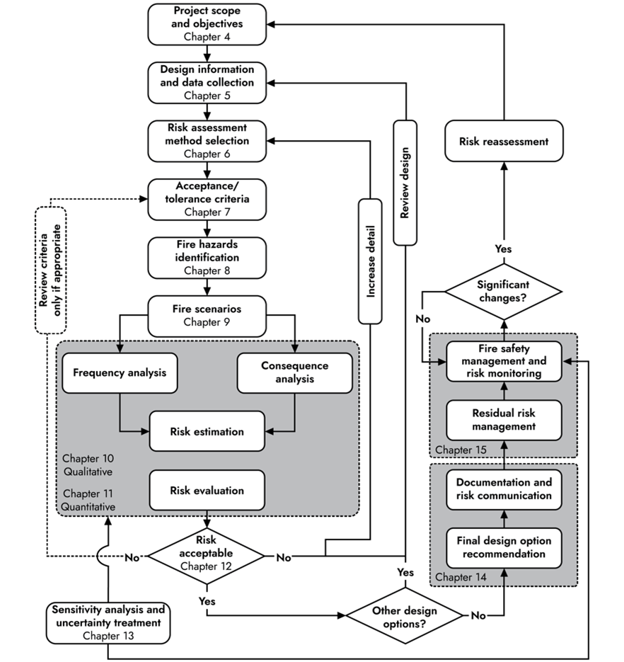
SFPE Framework

Slide 7
Key Terms
Risk
Potential for realization of unwanted adverse conditions, considering scenarios and their asso­ciated likelihoods and consequences.
Fire Risk
A quantitative or qualitative measure of fire incident loss potential for fire protection engineering applications.
Fire Risk Assessment
The process of estimating and evaluating risks associated with fires effecting, buildings, facilities or processes.

Slide 8
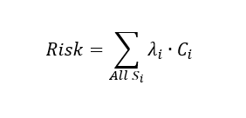
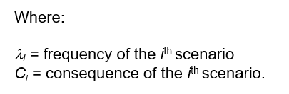
Concept of Risk
Notes:
Frequency is the ratio of the number of times an event occurs in a period of time, like the number of fires per year.
Examples of consequences include injuries or deaths, monetary loss, damaged floor area, and business downtime.

Slide 9
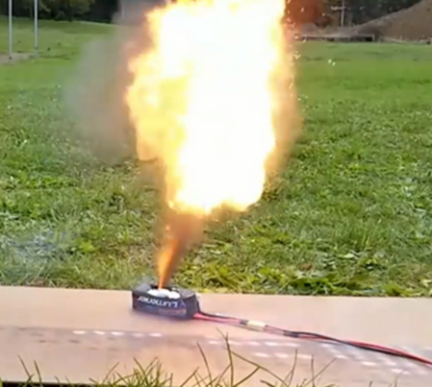
Thermal Runaway
Heat generated in a battery cell exceeds the amount it is dissipating
Leads to increasing battery temperature
Temperature rise will impact adjacent batteries
Could lead to a domino effect

Slide 10
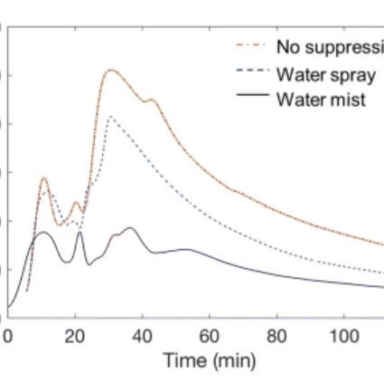
Fire Risk
Li-ion Batteries
From a fire risk assessment perspective, thermal runaway, can result in:
Overheating
Off-Gassing
Flaming
Explosion

Slide 11
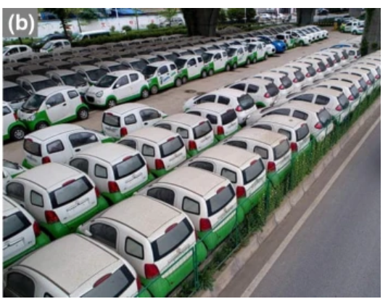
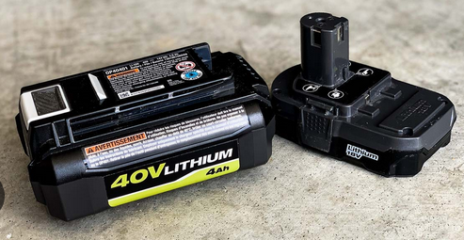
Types of Fires
Cell Phones
Laptops
Home/Garden Equipment
Hover Boards
E-bikes
E-cars
Energy Storage Systems
Utility scale

Slide 12
Why FRA?
Selecting an appropriate design considering the fire risk
Managing the fire risk in a building
When prescriptive solutions Do Not Exist

Slide 13
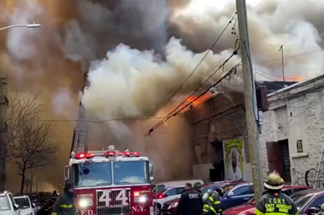
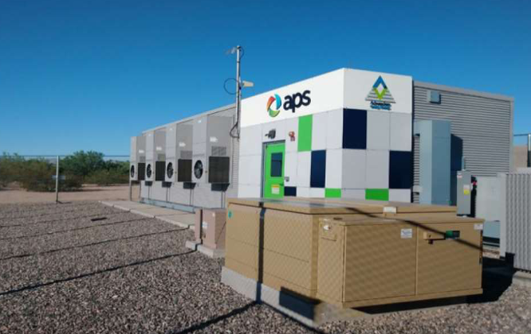
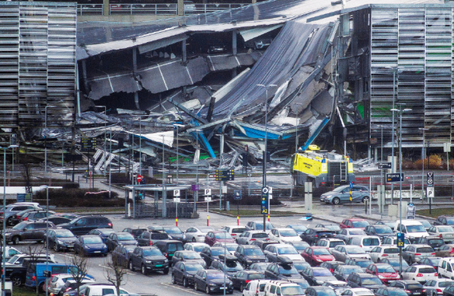
Occupancies/Use Groups to Consider for Risk Assessment
High-rise
Utility Installations
Residential
Transportation
Mercantile
Parking Garages
Everything

Slide 14
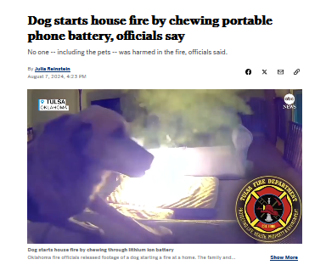
ABC News August 7, 2024

Slide 15

Stakeholders
Individuals who contribute to the project decision-making process
All stakeholders’ perspectives should be represented as a consistent threshold to allow risk decisions to be made and agreed upon.

Slide 16
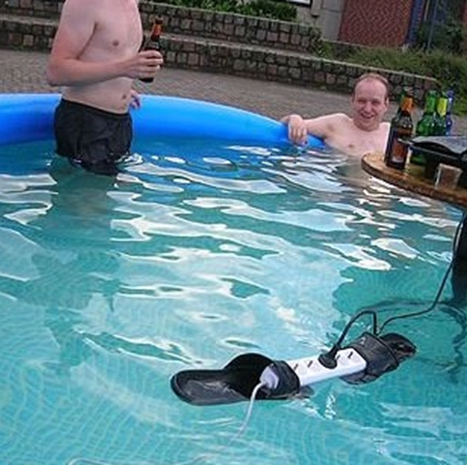
Risk Perception
Reflects the stakeholder’s needs, issues, knowledge, and values
Influences acceptability tolerability
The circumstances of loss may be viewed differently by the different stakeholders based on how they perceive risk.
Also, the risk tolerance chosen may not reflect stakeholder values due to risk aversion.

Slide 17
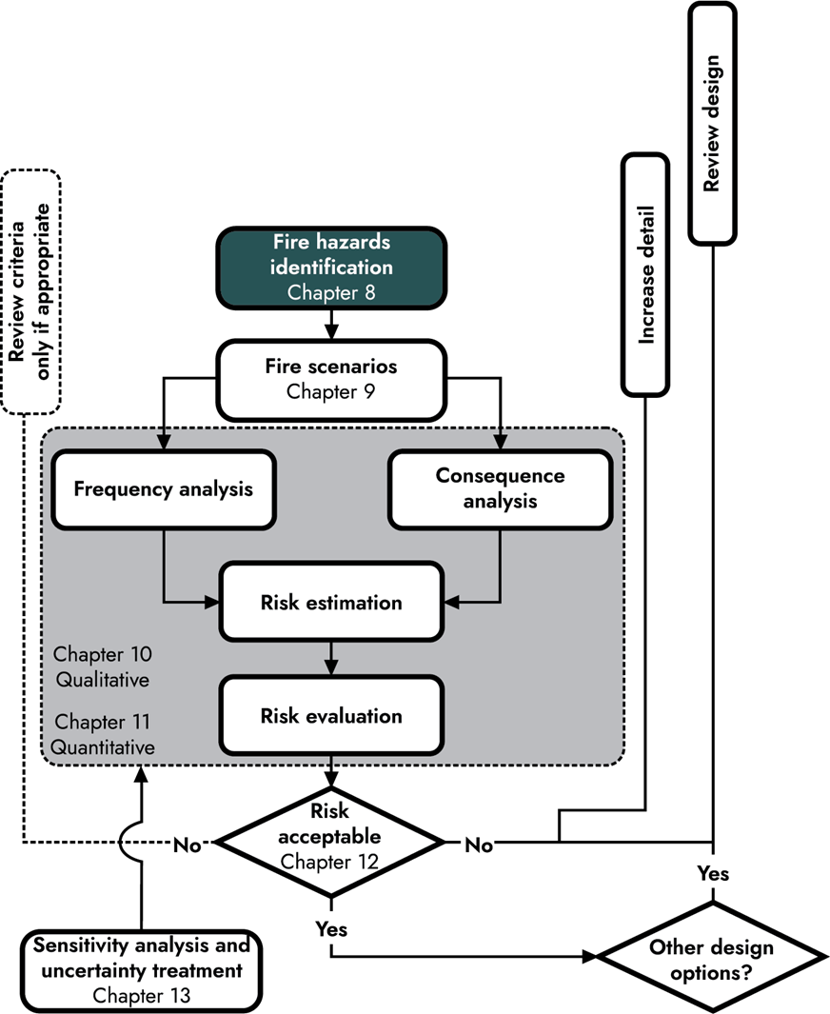
Execution

Slide 18
Hazard Identification
Hazard: A condition or physical situation with the potential for harm
Can relate to:
  Physical objects physical state or chemical properties
  A person or a group of persons
  The configuration of a facility
  Processes or activities within a facility
Notes:
Physical objects can be characterized by physical state (solid, liquid, or gas) or chemical properties (e.g., flammability range, volatility, density, miscibility, etc.).
A person or a group of persons, which can be characterized in terms of human factors characterizing:
The response or behavior to an event (e.g., failure to evacuate within a fixed time period, limited mobility, cognitive impairments, etc.)
The ability to initiate an event (e.g., arson, work-related activities leading to ignition or propagation, etc.)
The ability to set up precursor conditions amenable to ignition and fire propagation (e.g., improper procedure adherence, etc.)
Environmental conditions, such as lighting strikes, high winds, droughts, etc.
The configuration or operation of a facility (e.g., a complex building with a single exit, etc.)
Processes or activities within a facility (e.g., a process that creates a dust explosion hazard, etc.)

Slide 19
Determining Hazards
Hazard identification within an FRA should include:
A review of relevant drawings and facility documentation
A walk-through of the building or facility housing a given process or other space of concern
For facilities in design - an inspection of similar facilities
A review of relevant fire events in similar occupancies, facilities, or processes

Slide 20
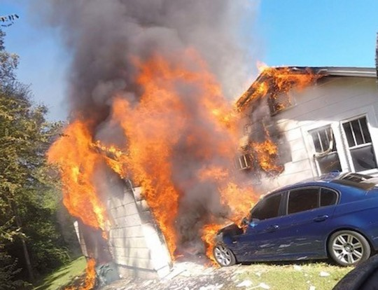
Selecting Fire Scenarios
A set of key elements characterizing a fire event:
Ignition (1st item)
Propagation
Fire protection
Consequences
Human Behavior

Slide 21
Causes of Thermal Runaway
Internal Cell Fault
Manufacturer Defect
Improper Use (overcharging, wrong charger)
Ageing
External Event
Thermal Event
Mechanical Abuse
Electrical Fault in Battey Management System

Slide 22
Identifying Fire Scenarios
There are 2 key questions that need answered when in the process of identifying fire scenarios.
How many fire scenarios should be included?
Which fire scenarios should be included?
Clustering?

Slide 23
Identifying Fire Scenarios
Use identified hazards as the starting point for the fire scenario identification process
Identify the available fire safety features including:
Fire prevention
Fire detection
Fire suppression
Passive fire protection features
Means of egress
Consider elements that may impact or be impacted by humans

Slide 24
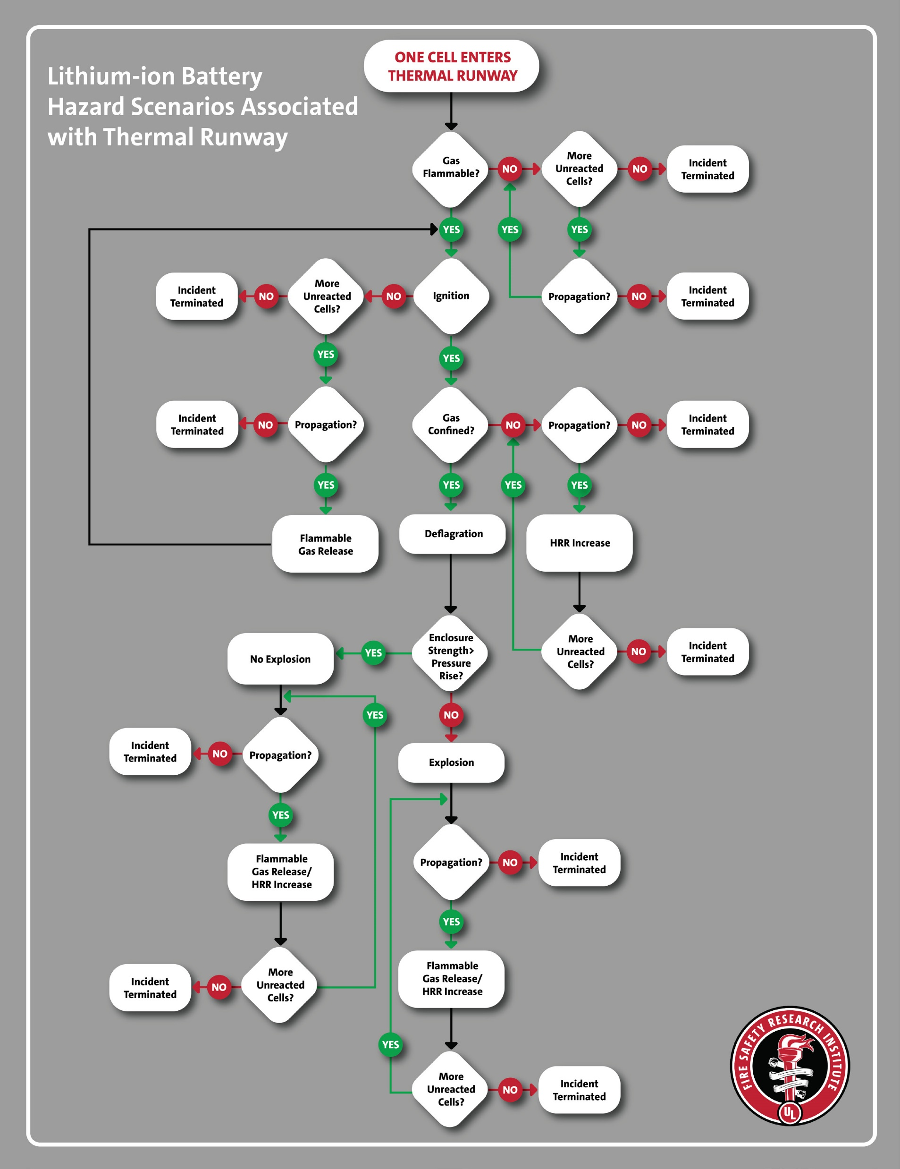
Selecting Scenarios
UL Fire Safety Research Institute
“The Science of
Fire and Explosion
Hazards from
Lithium-Ion
Batteries”
https://fsri.org/

Slide 25
Types of Risk Assessment
Qualitative -- Refers to the evaluation of risk without explicit numerical quantification
Semi-quantitative -- Evaluation of risk with simplified quantitative elements supporting assessment
Quantitative -- A complete explicit quantification of frequencies and consequences to produce numerical risk levels

Slide 26
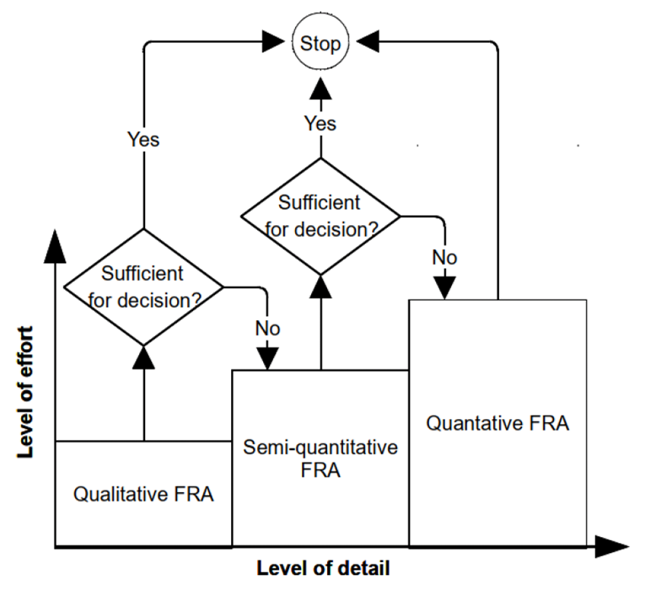
Selecting Type of Assessment

Slide 27
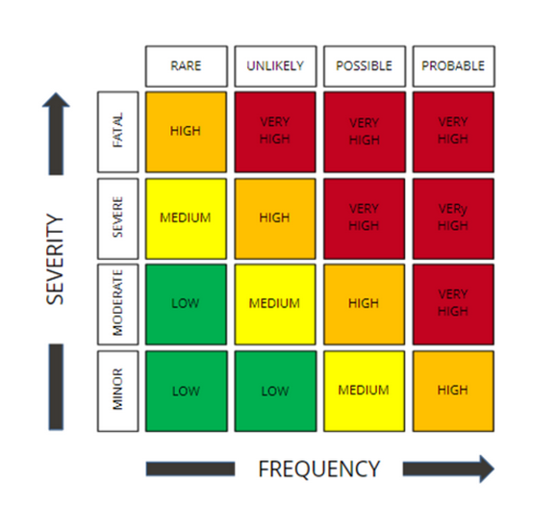
Qualitative Analysis
Risk Index

Slide 28
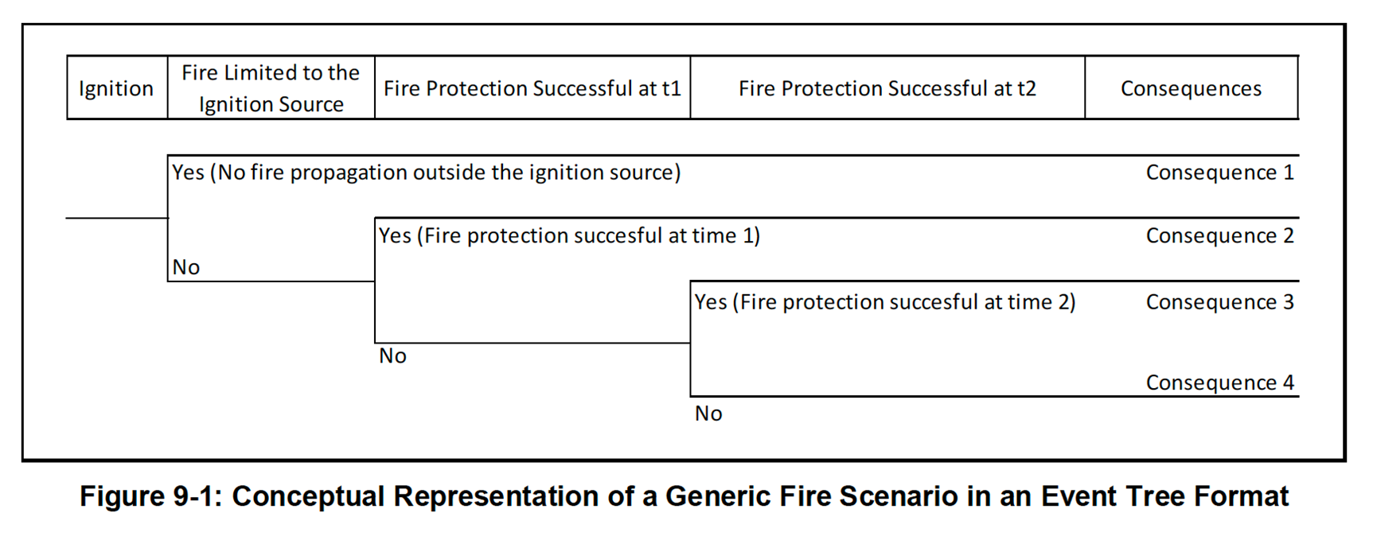
Quantitative Risk Estimation
Event Tree

Slide 29

Fire Safety & Risk Monitoring
After Construction -- Implement a monitoring program determines what elements are required to maintain the safety/risk at an acceptable level
Change in Use or Occupancy
Changes in Hazards
  Are Li-Ion Batteries Being Introduced
Start Process Again?
The frequency which individual elements are monitored my be determined by type-specific code required inspections, testing, and maintenance (ITM) frequency

Slide 30

Day 1 – Thermal Runaway and Hazards Fundamentals/Codes & Standards
Day 2 & 3 -- Bulk Storage of Battery Products and Hazards of Deployed Products including electric vehicles, micro mobility and energy storage systems.
On-Demand Recordings Are Available on SFPE Website : https://www.pathlms.com/sfpe/product_bundles/8503

Slide 31
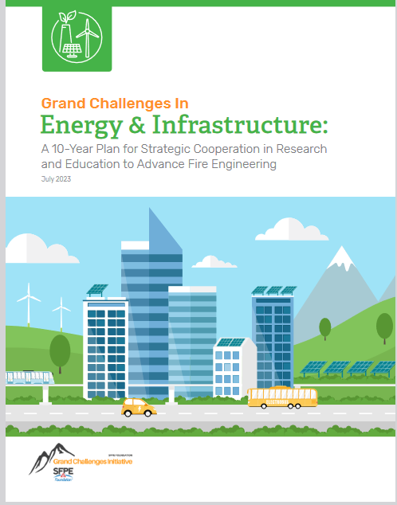
SFPE Foundation Grand Challenges Initiative
Free White Paper Available www.sfpe.org/foundation

Slide 32
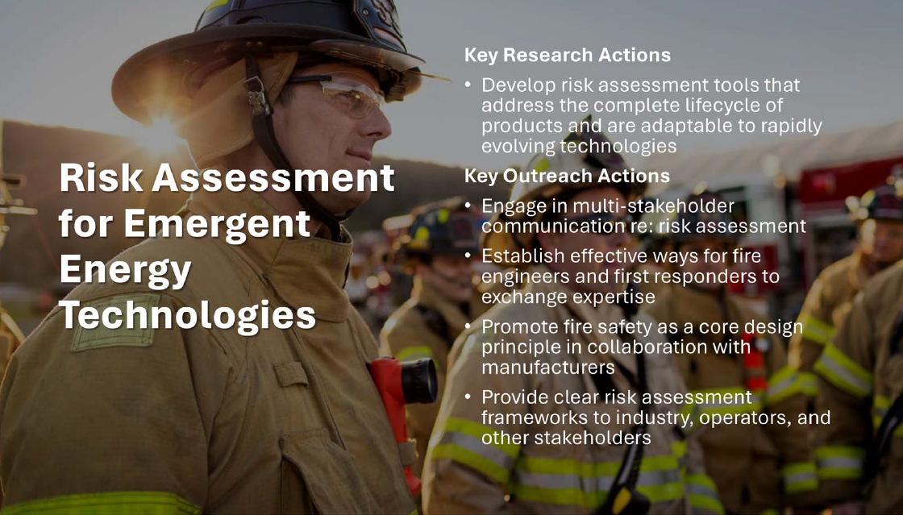

Slide 33
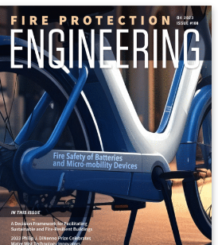
SFPEs Fire Protection Engineering Magazine
Quarter 4, 2023 -- Fire Safety of Batteries and Micro-mobility Devices. BY DANIEL MADRZYKOWSKI, PhD, PE, FSFPE, AND CRAIG WEINSCHENK, PhD
Quarter 2, 2022 -- TOWARD FIRE-SAFE ELECTRIC VEHICLES BY ROELAND BISSCHOP
Quarter 2, 2022 -- FIRE PROTECTION STRATEGIES FOR ENERGY STORAGE SYSTEMS BY JASON A. SUTULA, PhD, PE
More info at www.sfpe.org

Slide 34

Thanks
chris@sfpe.org
+1.301.661.598
www.sfpe.org

