Slide 1
Protection of Lithium-ion Battery Manufacturing & Storage
James Lake, IFSA

Slide 2
Learning Outcomes.
Discuss the hazards presented by Lithium-ion battery manufacturing and storage.
Navigate the current published protection guidance.
Identify the fire sprinklers that are approved to provide protection

Slide 3
Learning Outcomes.
Discuss the hazards presented by Lithium-ion battery manufacturing and storage.
Navigate the current published protection guidance.
Identify the fire sprinklers that are approved to provide protection

Slide 4

State of Charge
The real-time amount of energy stored in a system, compared to the rated capacity. Stated as a percentage.
  Most finished products in storage – 40%-60%
  DOT transportation limits – 30%
  In-use or charging – 100%+

Slide 5
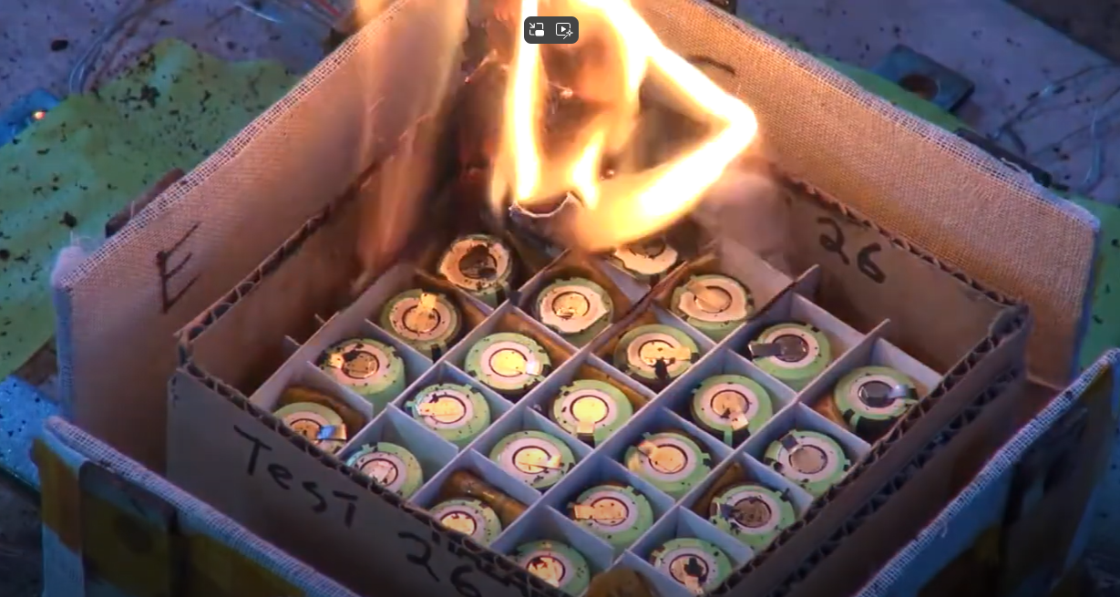
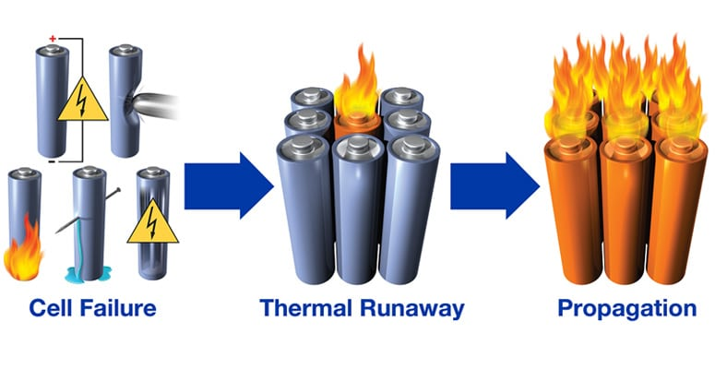
Thermal Runaway

Slide 6
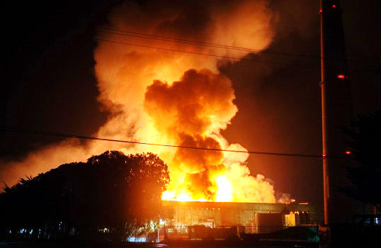
Thermal Runaway
Pressurized combustible electrolyte in cell
Damage to cell caused by:
  Thermal Abuse
  Electrical Abuse
  Mechanical Abuse
  Internal Short Circuit
Cascading Thermal Runaway

Slide 7
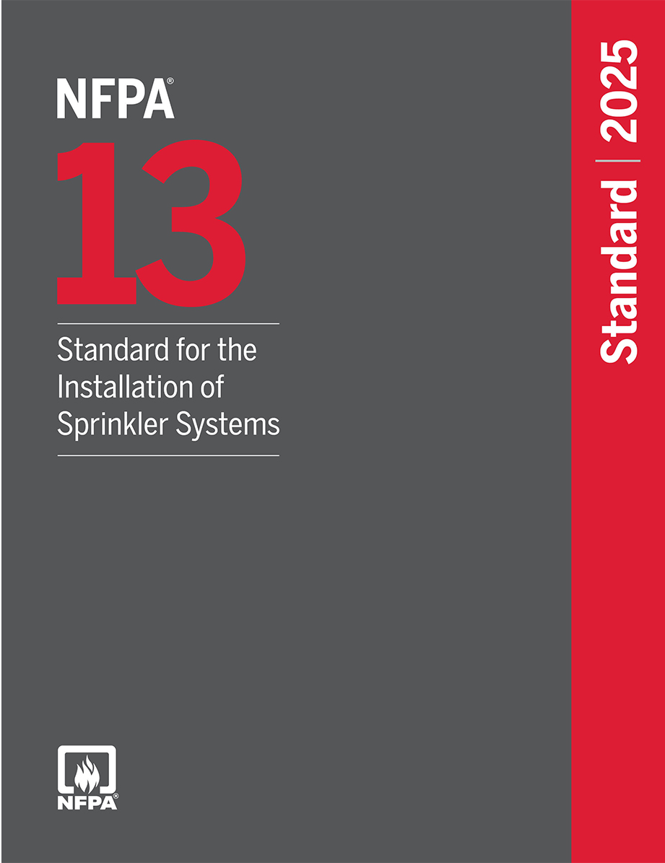
Protection Guidance
Table A.20.4(a) Items outside the Scope of NFPA 13 Batteries
- Lithium and other similar exotic metals
- Lithium-ion and other rechargeable batteries that contain combustible electrolyte

Slide 8
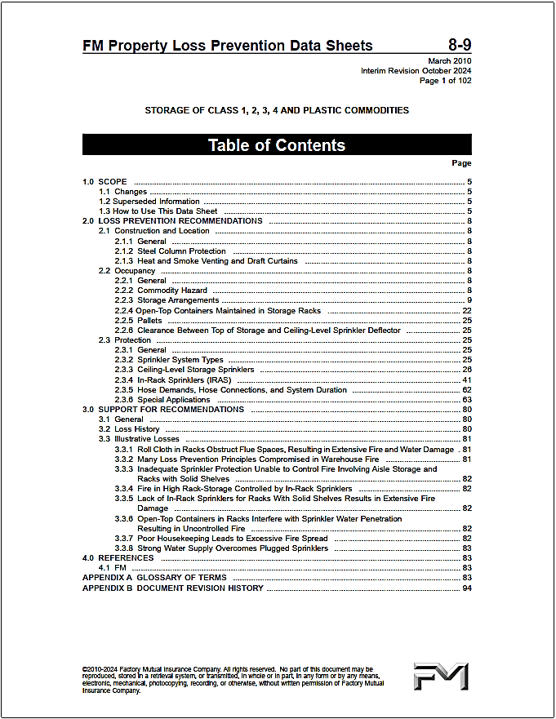
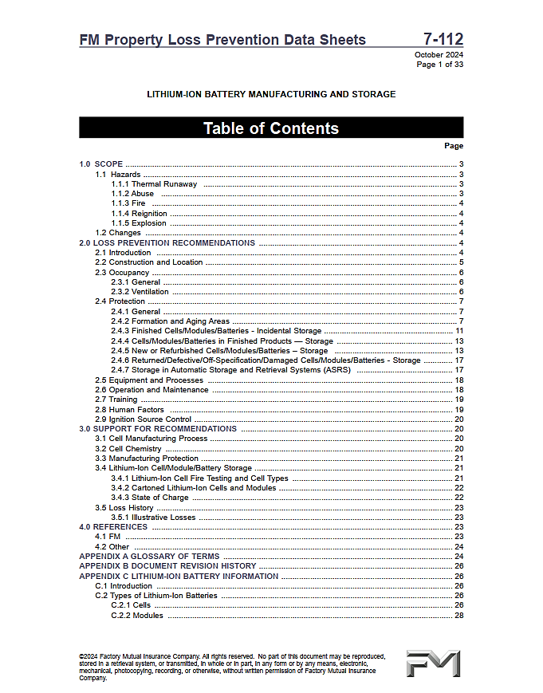
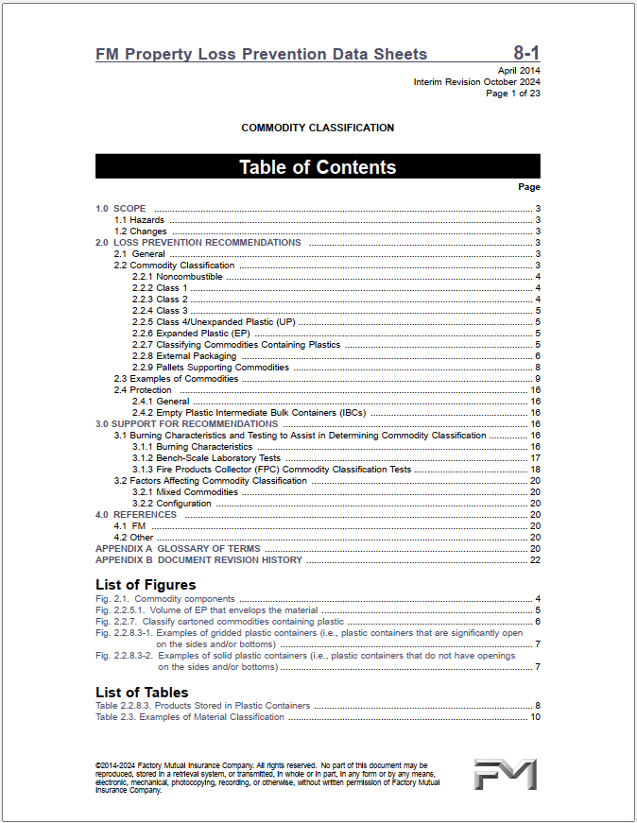
Protection Guidance

Slide 9
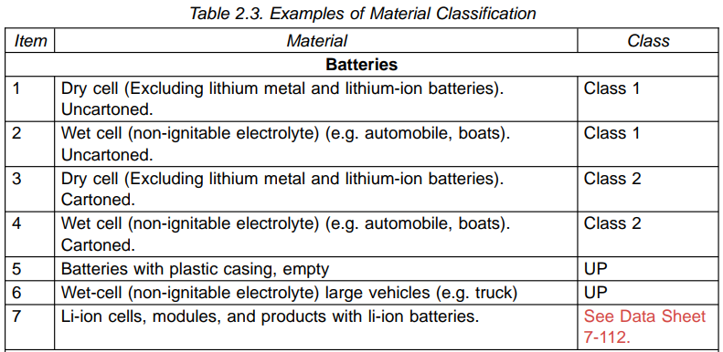
FMDS 8-1 Commodity Classifications

Slide 10
FMDS 7-112 Protection
General Requirements
Formation & Aging Areas
          Open-Frame Rack Arrangements
          In-Rack Sprinkler Location & Design
          Bin-box or Enclosed Chamber Arrangements
Finished Cell/Modules/Batteries – Incidental Storage
Cells/Modules/Batteries in Finished Products – Storage
Storage
ASRS Storage

Slide 11

General Requirements
Manufacturing Areas
        Per Hazards Present
Cell/Electrode Assembly
  HC3
Formation and Aging
  Section 2.4.2
Installation Guidance
  FMDS 2-0

Slide 12
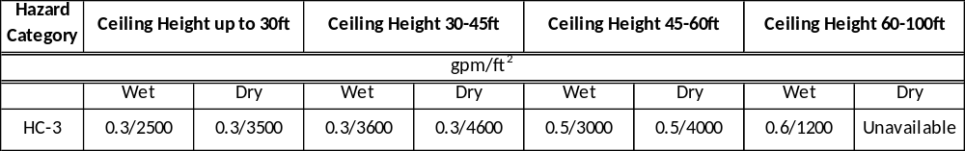
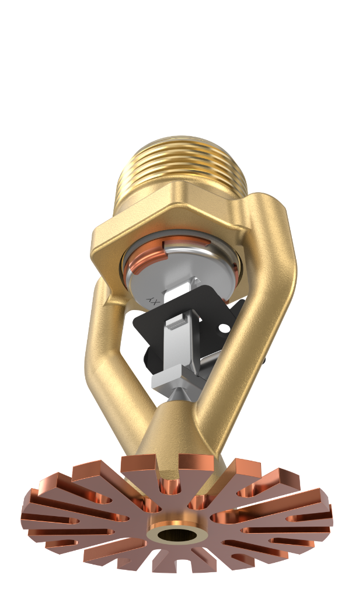
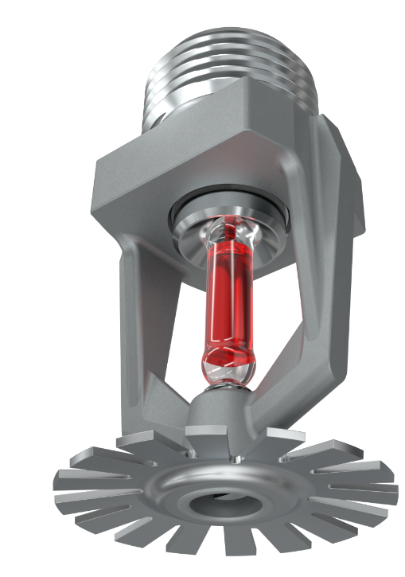
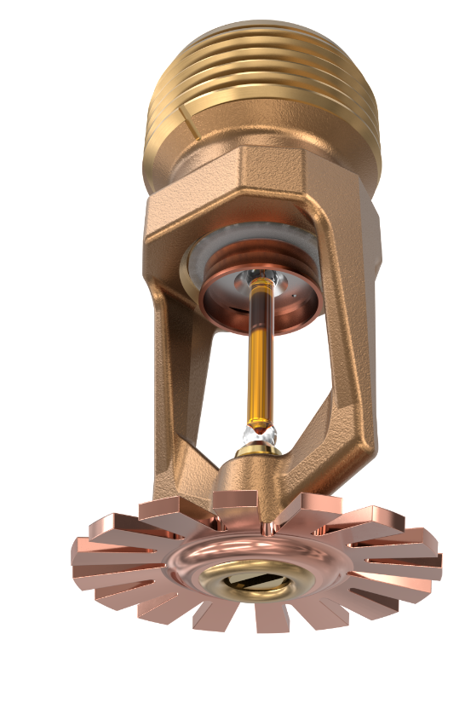
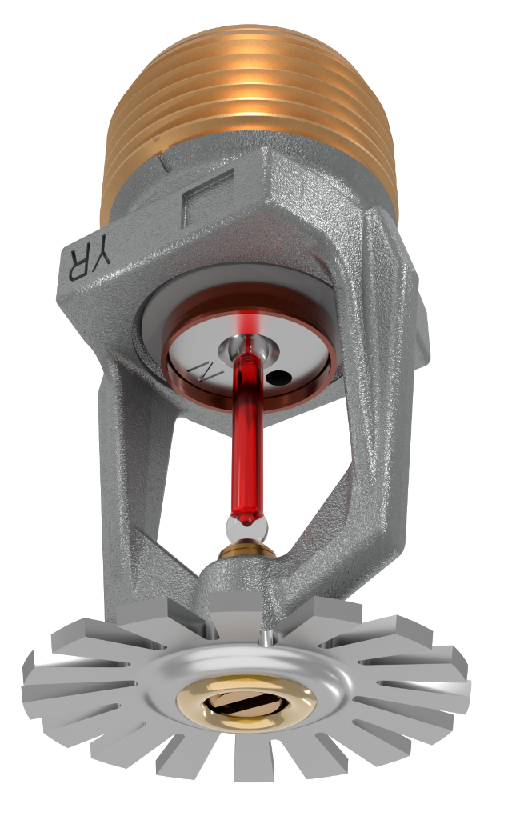
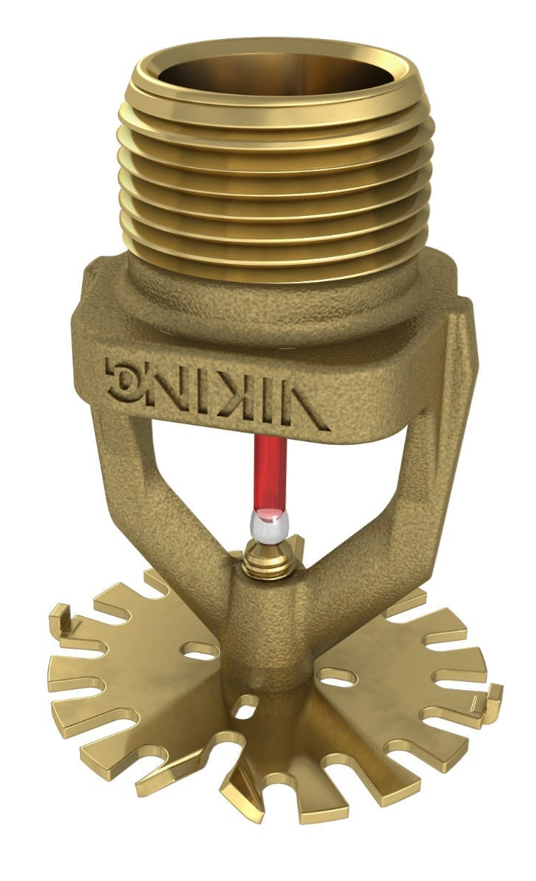
Manufacturing Areas – FMDS 3-26
K5.6 K8.0 K11.2 K14.0* K16.8*
*Approved storage sprinklers are also FM Approved for use as non-storage sprinklers.

Slide 13
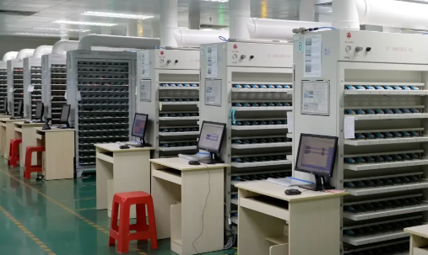
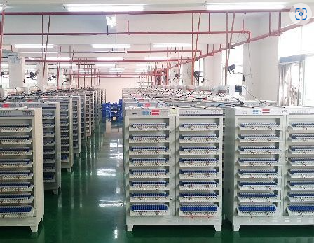
Formation & Aging Areas

Slide 14
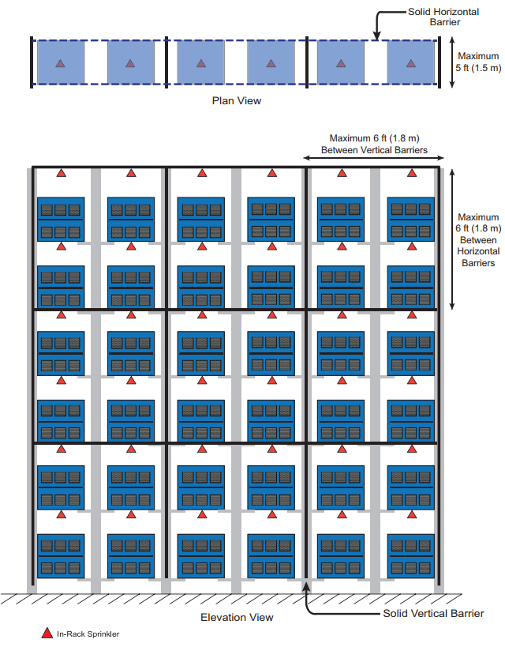
In-Rack Sprinkler Layout – Single Row Rack

Slide 15
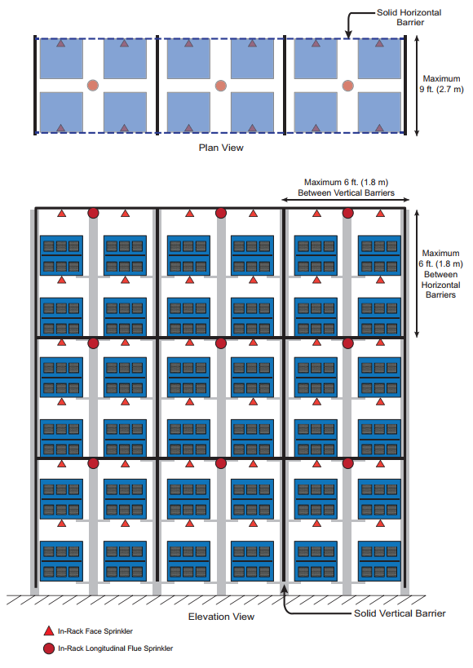
In-Rack Sprinkler Layout – Double Row Rack

Slide 16
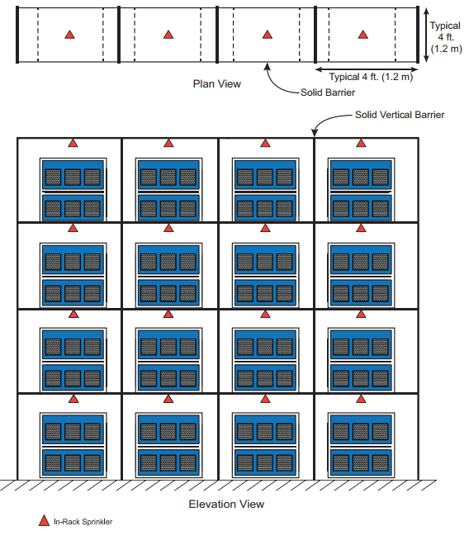
In-Rack Sprinkler Layout – Bin Box

Slide 17
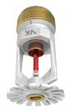
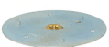
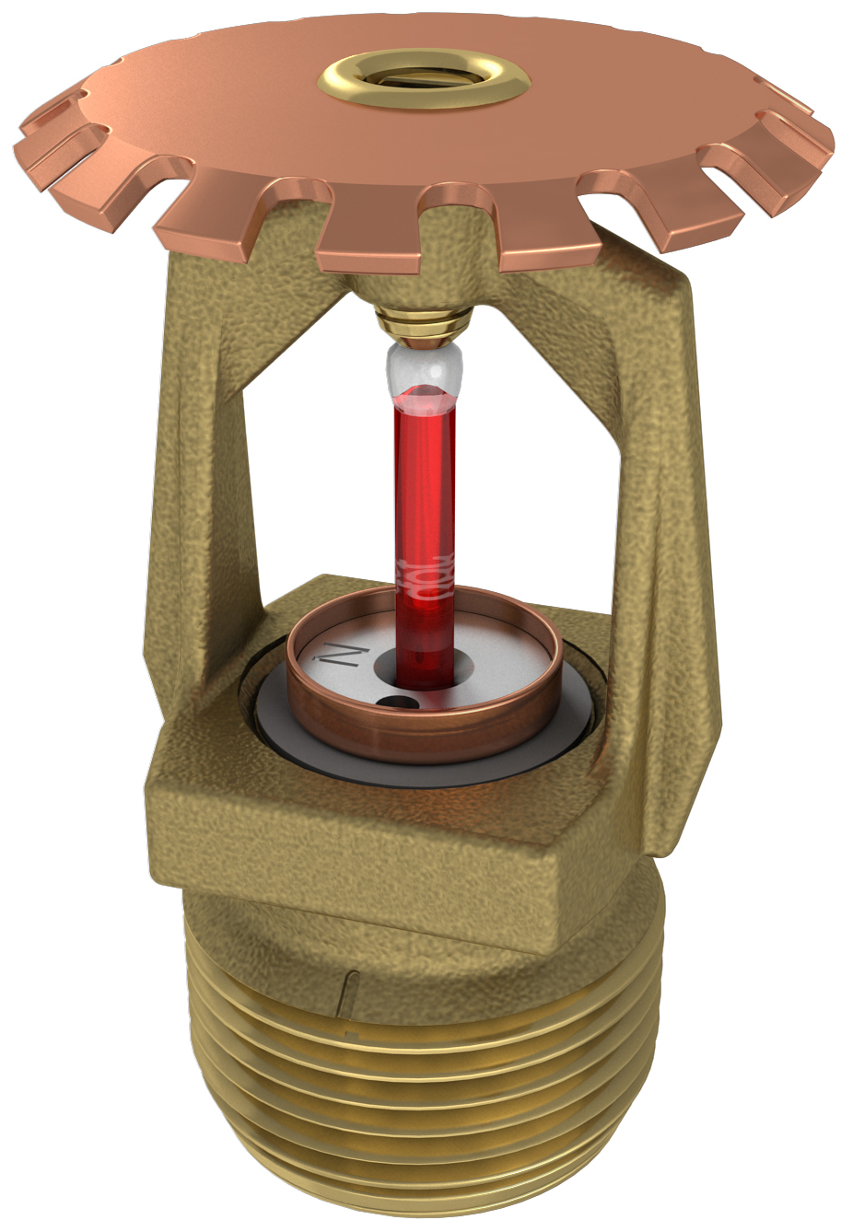
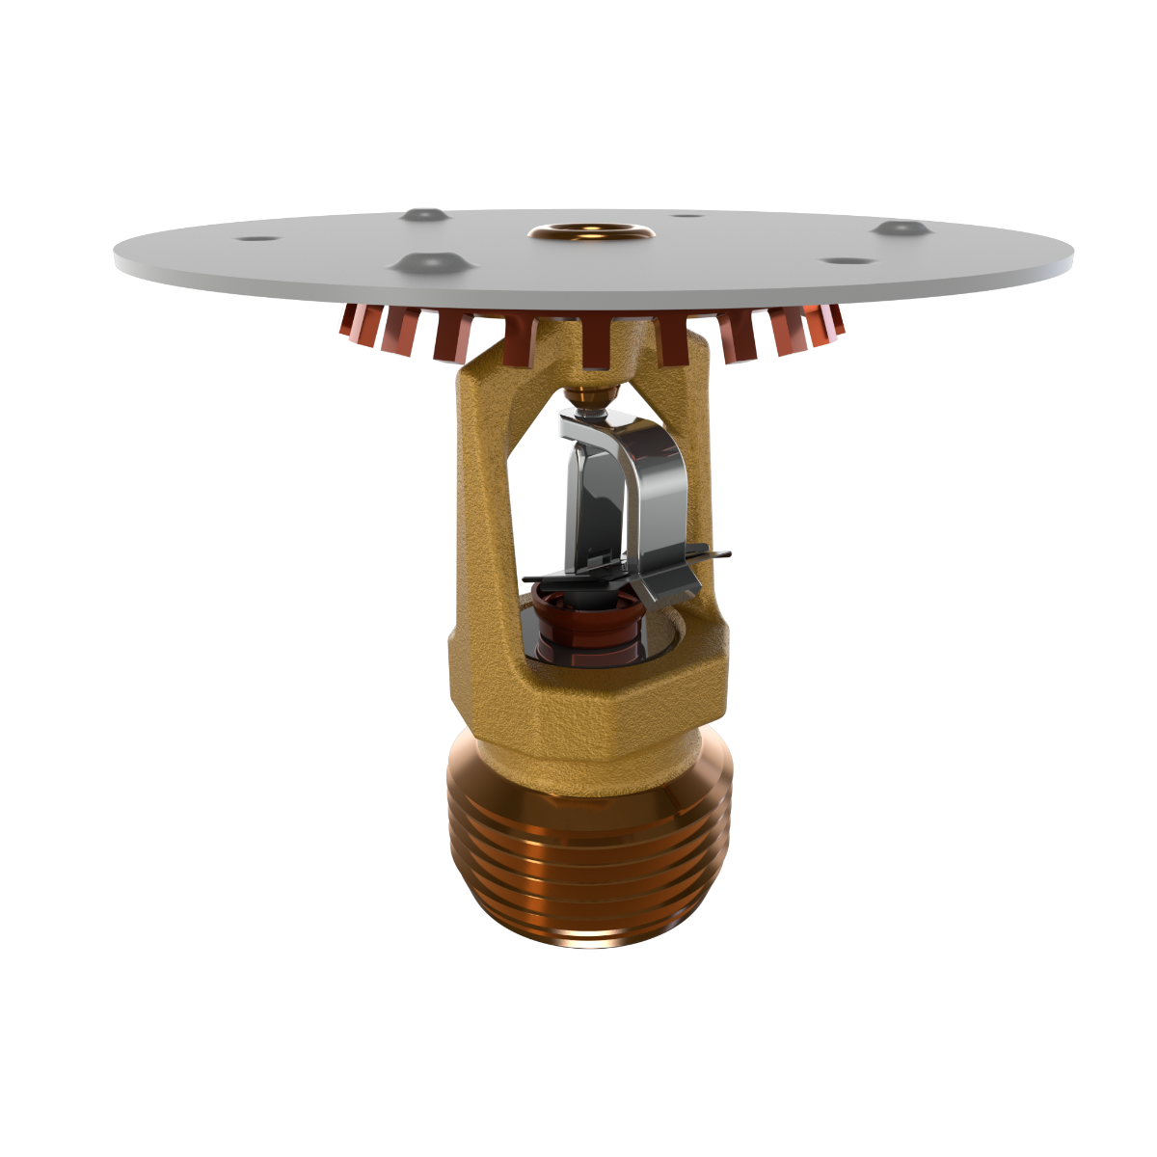
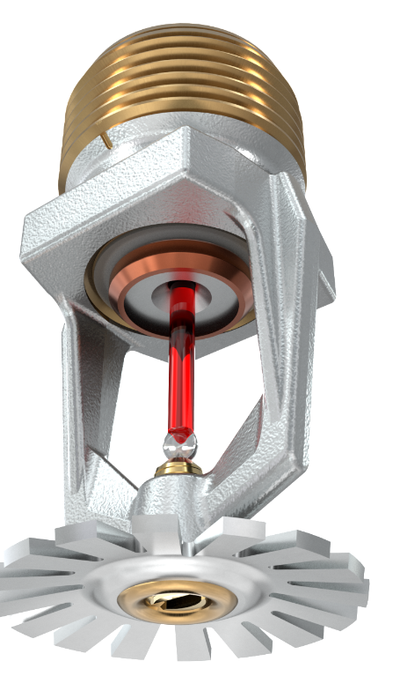
FM Approved In-Rack Sprinklers for FMDS 7-112
K-8.0
K-8.0
K-11.2
K-8.0

Slide 18
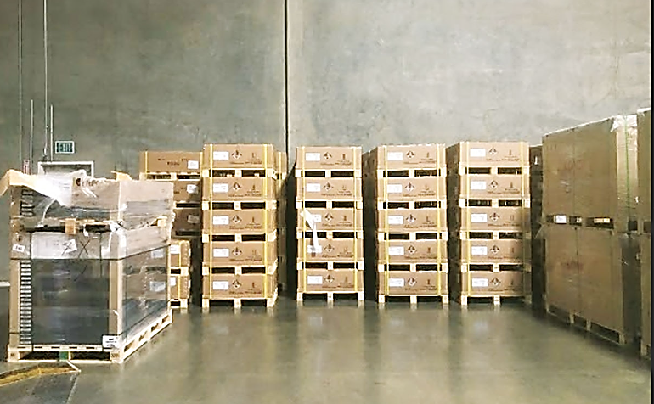
Incidental Storage
Cells/modules/batteries are stored in metal or cardboard boxes.
Storage area is limited to no more than 200 ft²
Storage height is limited to 6 ft.
Multiple storage areas are separated by aisles not less than 10 ft wide.
Battery state of charge is less than or equal to 60%.

Slide 19
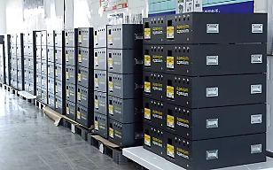
Incidental Storage
Cells/modules/batteries are stored in unexpanded plastic containers.
Storage area is limited to no more than 200 ft²
Storage height is limited to 6 ft.
Multiple storage areas are separated by aisles not less than 10 ft wide.
Battery state of charge is less than or equal to 60%.
Use Table 2.4.3.2

Slide 20
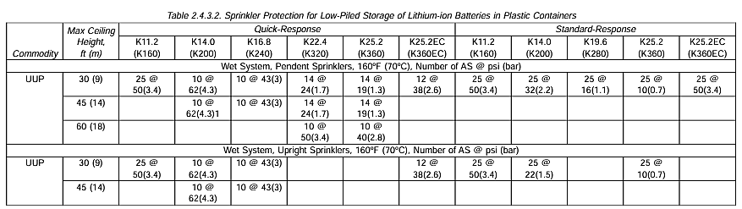
Table 2.4.3.2

Slide 21
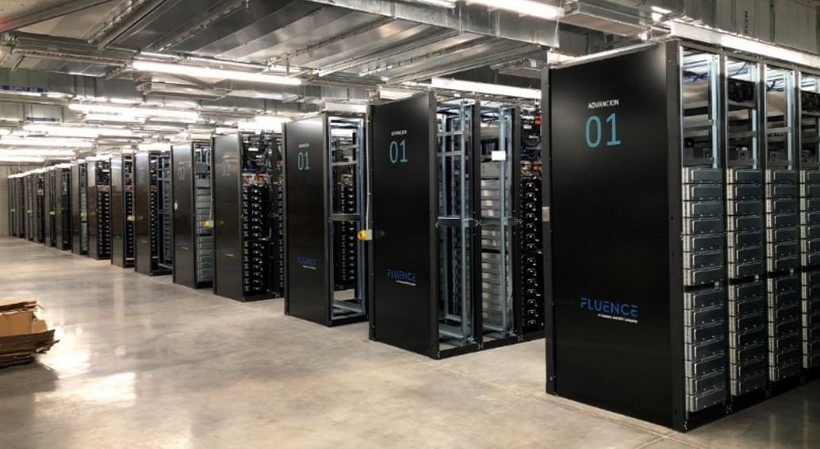
Finished Product Storage
Ceiling Height
Storage Height
Storage Arrangement
Packaging
State of Charge

Slide 22
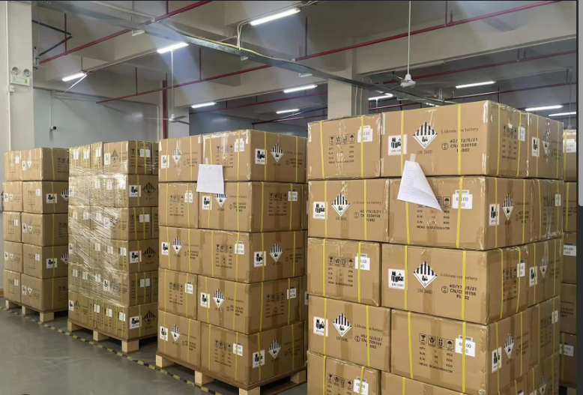
Finished Product – Solid Pile & Palletized

Slide 23
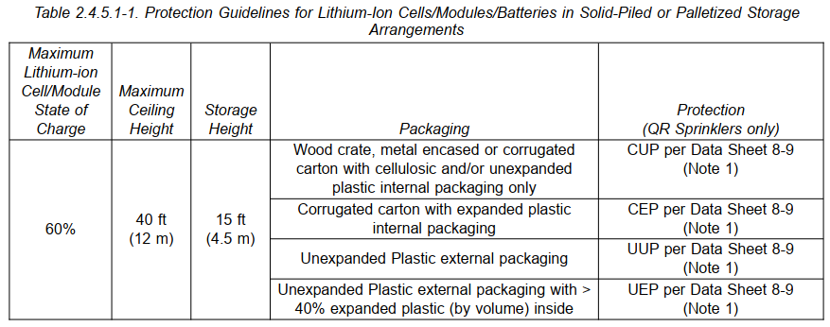
Finished Product – Solid Pile & Palletized
45ft
(13.5m)

Slide 24
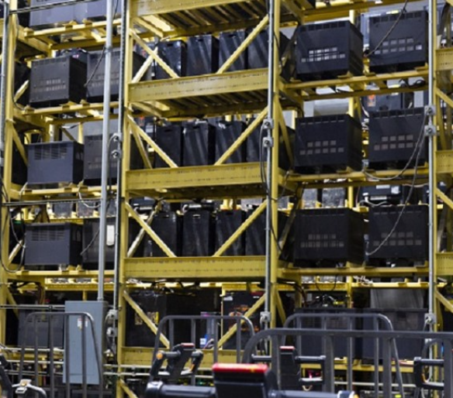
Finished Product in Open Racks

Slide 25
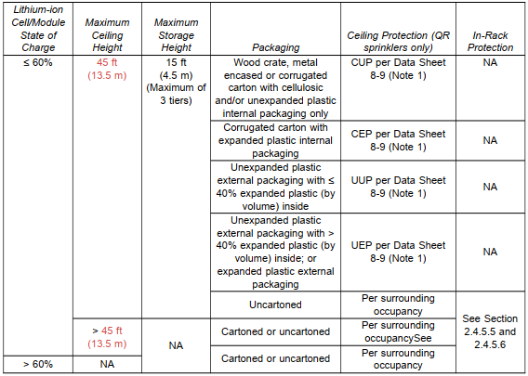
FMDS 7-112 Table 2.4.5.1.2

Slide 26
Scenario 1

Slide 27
Scenario 2

Slide 28
Scenario 3

Slide 29
Scenario 4

Slide 30
Scenario 5

Slide 31
Scenario 6

Slide 32
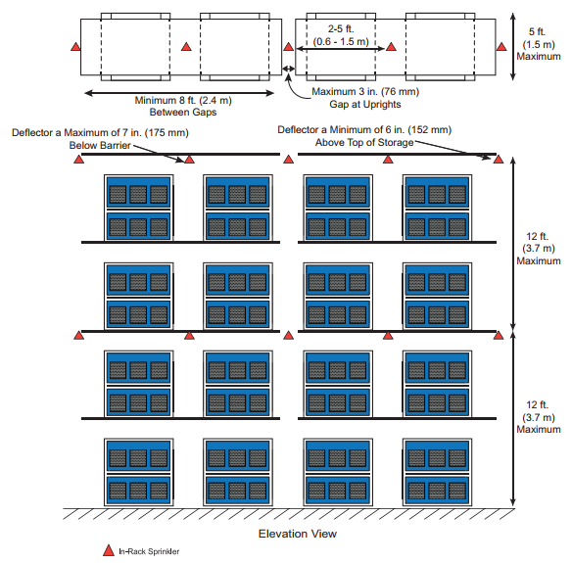
Single-Row Rack Storage

Slide 33
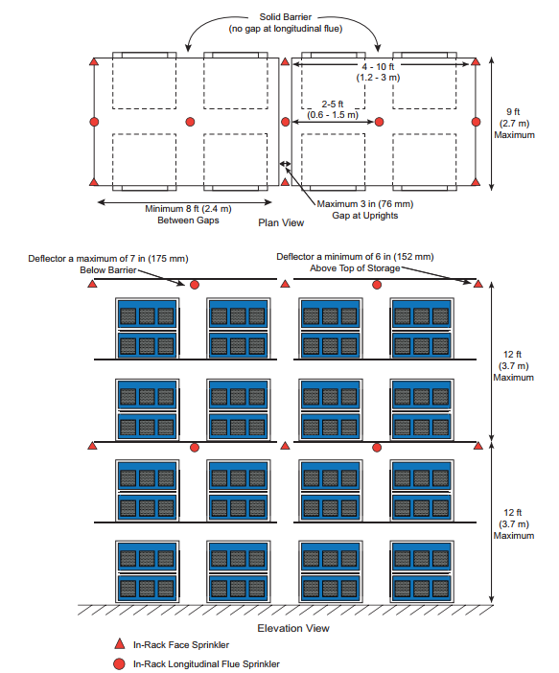
Double-Row Rack Storage

Slide 34
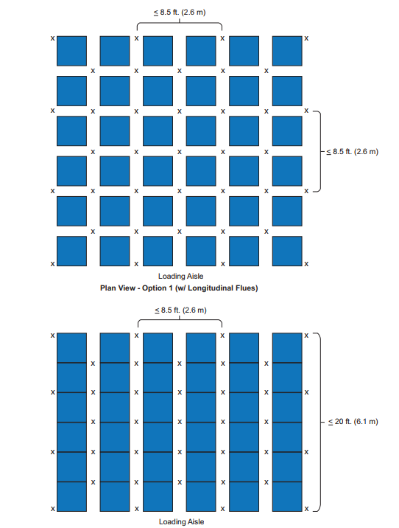
Multi-Row Rack Storage

Slide 35
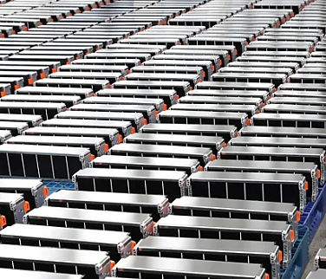
Returned/Defective/Damaged
Isolate
Storage outside
Separate
Cut-off Rooms
500gpm hose stream
2-hour water supply for sprinkler and hose demand

Slide 36
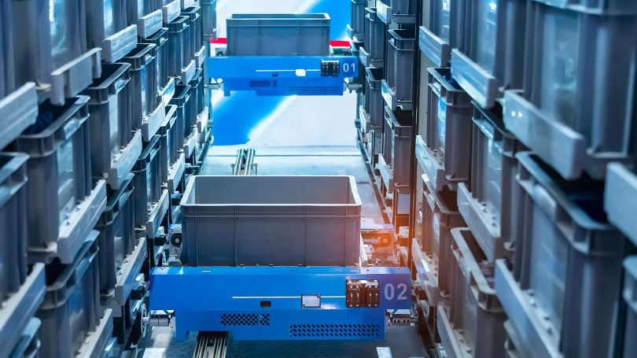
ASRS Protection
FMDS 8-34
Determine SOC
  <30%
  >30% <60%
  >60%

Slide 37
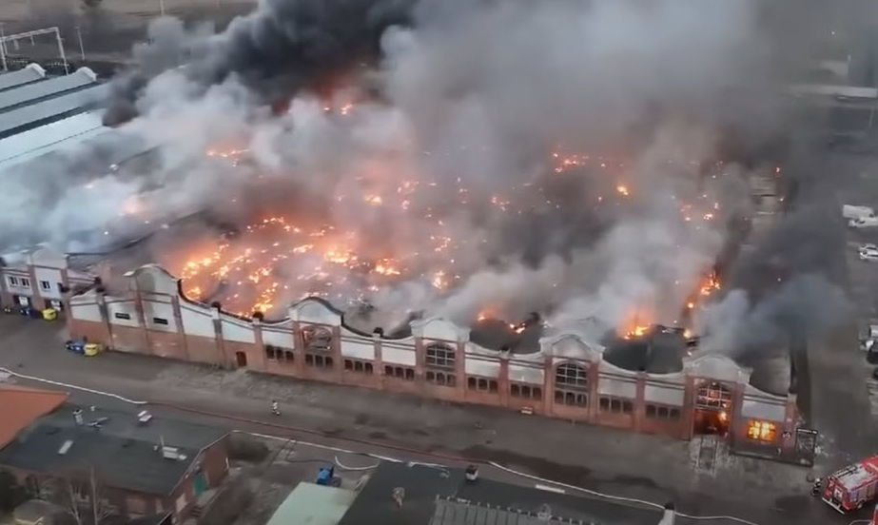
A Continuing Challenge

Slide 38
Current Status
Tests have been conducted at the module level to evaluate the performance of different fire suppressants such as water, wet chemical, and dry chemical. The tests concluded that water was the most effective fire suppressant.
Neither FM nor UL have any special tests or approvals for sprinklers protecting Lithium-ion cells or modules, but FM does provide specific guidance on how sprinkler systems are designed and supplied.
Sprinklers must be FM Approved and system design must meet all design requirements in FMDS 8-1 and 8-9 or related data sheets

Slide 39
Learning Outcomes.
Discuss the hazards presented by Lithium-ion battery manufacturing and storage.
Navigate the current published protection guidance.
Identify the fire sprinklers that are approved to provide protection

Slide 40


Contact —— .
James Lake
Director of Training IFSA
Email: jlake@ifsa.global
Phone: +1 617 372 6214
Web: www.ifsa.org

