Slide 1
GIS & Strategic Collaboration in the Fire Service
Britta Maddox,
Anoka County Fire Protection Council

Slide 2
Unlocking the Power of Data and Regional Partnerships through Collaboration.

Slide 3
Abstract
Unlocking the Power of Data and Regional Partnerships​
Discover how cutting-edge GIS technology and strategic collaborations are transforming the fire service. This dynamic session explores real-world applications of Geographic Information Systems (GIS) for smarter response, risk analysis, and resource management. Learn how departments are leveraging shared data, dashboards, and spatial tools to enhance operational readiness.​
We'll also dive into the growing impact of regional fire consortiums—collaborative models that break down silos, streamline training, and improve interoperability across jurisdictions.​
​
​
Empower your department. Connect your region. Lead with intelligence.​
Notes:
Hola, buenos dias. Me llamo Britta Maddox y trabajo para el Consejo de Protección contra Incendios del condado de Anoka, un consorcio de diecisés departamentos de bomberos y tres equipos especializados de rescate contra incendios. Es un honor para mí presentarles hoy. Yo apprendo español, pero yo continuaré en inglés para que me entiendas mejor.​ Okay? Venga conmigo.

Slide 4


Where is Anoka County? ———.
Notes:
I want to start by introducing where we are in the world.

Slide 5
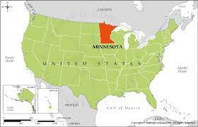
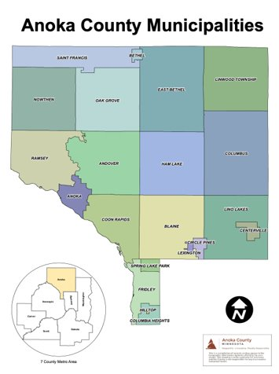
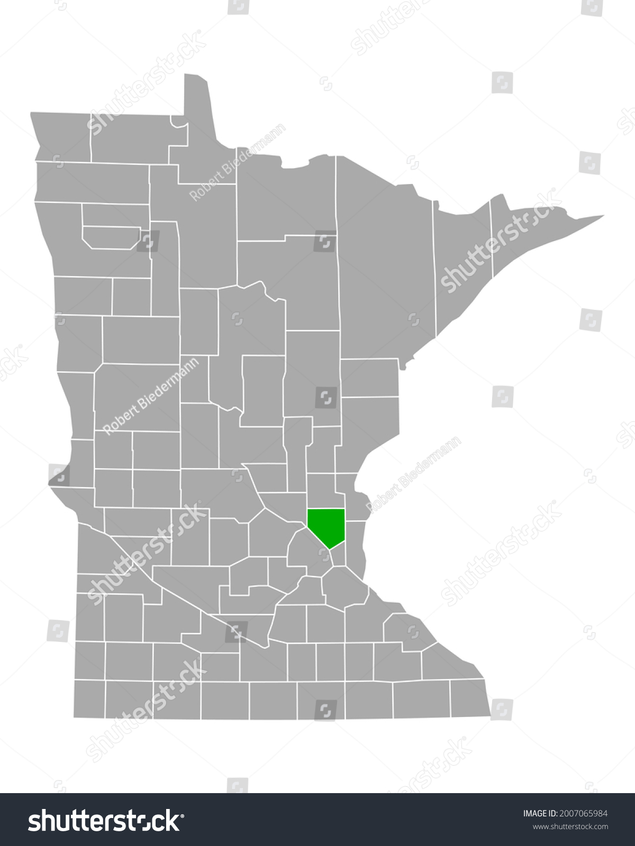
Notes:
Anoka County is a first-ring suburb in Minnesota just northwest of the Twin Cities of Minneapolis and St Paul. There are 16 fire departments serving the 21 cities of Anoka County plus covering two additional cities outside of our county. The Anoka County Fire Protection Council was created in 1977 to combine these 16 fire departments towards a common operating picture, shared goals and response patterns, and ultimately resource and data sharing.

Slide 6
Before the consortium ———.

Slide 7
Problem #1 - Department Size Difference.
Smaller departments can't afford new technologies and specialized rescue training
Problem #2 - No Data Standardization.
Lack of consistent and standardized data entry
Problem #3 - Unable to Compare Statistically.
- Lack of consistent and standard data meant no systematic way to statistically compare within the county
Pulling data from multiple systems also hindered that ability
Notes:
Initially, all 16 departments worked independently. Technology was acquired as needed, with smaller departments facing limitations on what was accessible to them due to financial considerations as well as simply size. With the plethora of systems, there was no way to standardize the data and without standards, comparing statistically was nearly impossible. Fields didn’t track the same values across systems. Certain departments interpreted the National Fire Information Reporting System standards differently than others. Responding for mutual aid was like walking into a new house with no electricity at night - there was no ‘light’ to see what you were walking into. And as time went on, citizens and government officials alike began demanding and expecting reliable data presented in up-to-date methods. Anoka County realized they could no longer hide behind the excuse that “we just don’t capture that information” any longer.

Slide 8
Establishing the consortium ———.
Notes:
In 1970, the Anoka County law enforcement departments felt the same way and established the Joint Law Enforcement Council. The fire departments saw this as an opportunity to elevate themselves to this same level and establish their own partner consortium.

Slide 9

Established 1977
Membership:
  16 fire chiefs
  1 elected official from each department's jurisdiction
  Non-voting member stakeholders
Opportunities to serve countywide
  ACFIT - Anoka County Fire Investigation Team
  CAT - North Metro Chemical Assessment Team
  SRT - Specialized Rescue Team
  Juvenile Intervention/Youth Firesetter Program
  Anoka County Fire Training Academy
Notes:
Established in 1977 the Anoka County Fire Protection Council (FPC) includes each of the sixteen fire department chiefs as well as an elected representative for each municipality with a fire department. The Anoka County FPC has been responsible for establishing and sustaining substantial public safety improvements within the county as listed on the screen.
Combining into the consortium opens up the purchasing power of each department and allows departments to support each other by contributing personnel, expertise, and equipment to these larger programs. Previously inaccessible to some, specialized training and ongoing learning opportunities become available to all as the county coordinates their efforts.

Slide 10
Anoka County Comprehensive Plan – Public Safety Chapter
Goal: “Provide for a safe and secure environment for residents through cooperative law enforcement, fire protection, and emergency management services.”
Council alignment:
  The ACFPC literally exists to coordinate fire inspection, training, and safety across multiple jurisdictions.
  Joint initiatives like mobile food truck reciprocity agreements align with “cooperative” and “efficient” services, and shared preplans make cooperative response on a common operating procedure possible beyond the municipality itself
Notes:
The Anoka County Fire Protection Council’s initiatives align directly with Anoka County’s vision of safe communities and the State of Minnesota’s strategic priorities for cooperative fire protection, regional preparedness, and resilience. By breaking down jurisdictional silos and fostering consistency in fire code enforcement, the Council advances the mission of its parent municipalities and supports statewide goals for public safety.
[read the slide]

Slide 11
Minnesota State Fire Marshal Strategic Goals
Enhance fire prevention and life safety programs statewide.
Strengthen partnerships with local fire and emergency services.
Promote consistency in fire codes and inspections across jurisdictions.
Council alignment:
  ITM (Inspection, Testing, Maintenance) standardization project directly supports consistency in fire codes.
  Regional coordination directly supports “strengthening partnerships.”
Notes:
[read the slide]

Slide 12
Minnesota Homeland Security Emergency Management (HSEM) Strategic Priorities (2024–2027)
“Strengthen regional preparedness and mutual aid.”
“Improve resilience of communities to disasters.”
“Support interoperable communications and shared resources.”
Council alignment:
  Our sister city partnership with Durango, Mexico directly reflects ACFPC’s desire to strengthen regional and international preparedness and improve resiliency
  Shared inspection tools = interoperability in public safety.
Notes:
[read the slide]
These are just some examples where the Fire Protection Council epitomizes the goals and beliefs of not only our cities and our county, but also the State of Minnesota, and greater public safety community. But, goals remain only good intentions until they are backed by deliberate, sustained action.

Slide 13
The Public Safety Data System ———.
Notes:
We had the foundation; now it was time for action. Attaining these strategic aims required more than policy agreements—they demanded a seamless way for multiple jurisdictions to share and access information in real time. Achieving true interoperability meant overcoming inconsistent formats, siloed databases, and communication gaps that slowed inspections, reporting, and emergency coordination. Thus, the Public Safety Data System was developed as a centralized, technology-driven platform capable of integrating public safety information across municipal boundaries. This system provided the common operating picture necessary for agencies to work together efficiently, ensure consistent code enforcement, and respond more effectively when lives and property are at risk.
The Public Safety Data System, or PSDS, is a shared records management system where the incident is called into dispatch, answered, triaged, processed, and sent to the appropriate responding authority - law, fire, and/or EMS. All technology related to the response, reporting, and analytics/statistics for the 11 law enforcement agencies and 16 fire departments in Anoka County are managed under the PSDS and forms the foundation of the solution to the other two problems pre-consortium - shared data, standardization, and the ability to accurately and statistically describe all of Anoka County’s public safety response.
With the purchasing power of a consortium, and a single point of contact for vendors to work with, leveraging new technology was no longer a barrier. Departments now can adopt new technology and open the opportunities for continuing education and participation in specialized response teams, interconnected at the nexus of the Public Safety Data System.

Slide 14
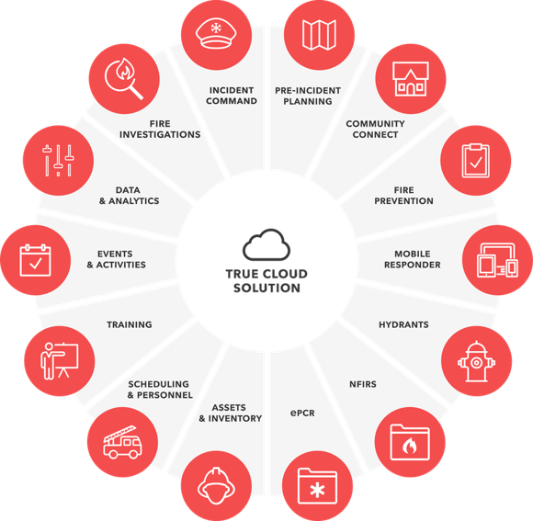

Notes:
In 2023 the consortium signed a contract with First Due as our Fire records management system. After a thorough proposal process and multiple system demonstrations, this platform ticked all the boxes to meet our needs for reporting capabilities, module availability, and forward-thinking technology. This was the first consortium-purchased software that had 100% countywide buy-in. All 16 departments agreed that in order for us to be successful we needed two key things - for all departments to agree to utilize the same RMS platform and to work together on standardization of the data.
With the adoption of First Due, I acted as project manager therefore providing a single point of contact for our partners at First Due when scheduling training and system configuration. From there, we created committees of module experts to create a standard operating procedures for each module and the system as a whole. Ultimately, our consortium model leads to fewer issue tickets as we harvest the hive-mind of all departments to creatively problem-solve, and presents a unified voice when we do approach First Due with an issue.

Slide 15
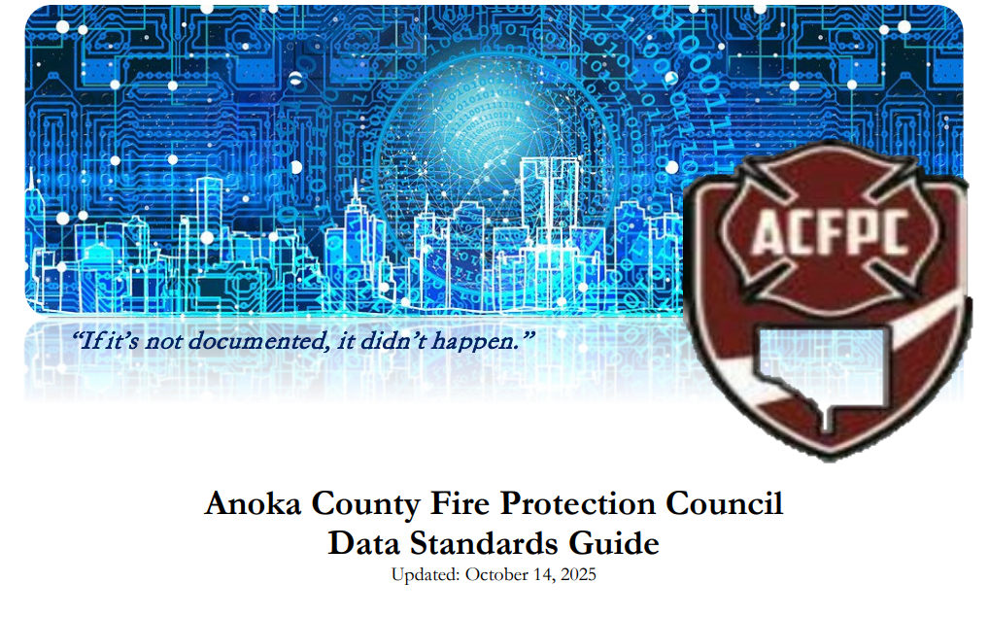

Notes:
Departments appoint members to serve on module or topic-specific committees. They are experts in their area of the system and also my vehicle for communication back to their full department.
One such committee is the Fire Data Standards Committee which works to standardize data input – creating the Anoka County language for incidents, preplans, inspections, and more.
In the United States, the fire service has an overall standard for incident reporting, currently called NFIRS - the National Fire Incident Reporting System. Outdated, NFIRS underwent a redesign and a new standard will be implemented January of 2026 called NERIS - the National Emergency Response Information System. While the federal standards form the basics of a common language, they don't cover everything that may be operationally relevant. So, we authored the Fire Data Standards Guide - effectively an SOP for how to operate within our shared data system.
Scanning the QR code on the screen will allow you to download a copy of our standard. Essentially, this is a guiding document telling departments about certain data types, fields that are required, and most importantly, the why. We found that the more staff understood why certain data was being required, the more likely we were to get compliance with filling in that data. For example, our departments require a first and last name, date of birth, and gender for any patient contact even though that is not a requirement of the national standard. With the emerging trends in the fire service pointing at increased levels of EMS response and the rising popularity of community paramedicine programs, this information is vital for tracking high-frequency 911 users that would receive the most benefit from additional resources and community services to help them and get them out of the cycle of reliance on 911. Helping them, helps responders by lowering call volume; therefore avoiding burnout and inefficient resource depletion. Once we explained that to the users, gathering those additional pieces of information made sense and compliance increased by over 50%.

Slide 16
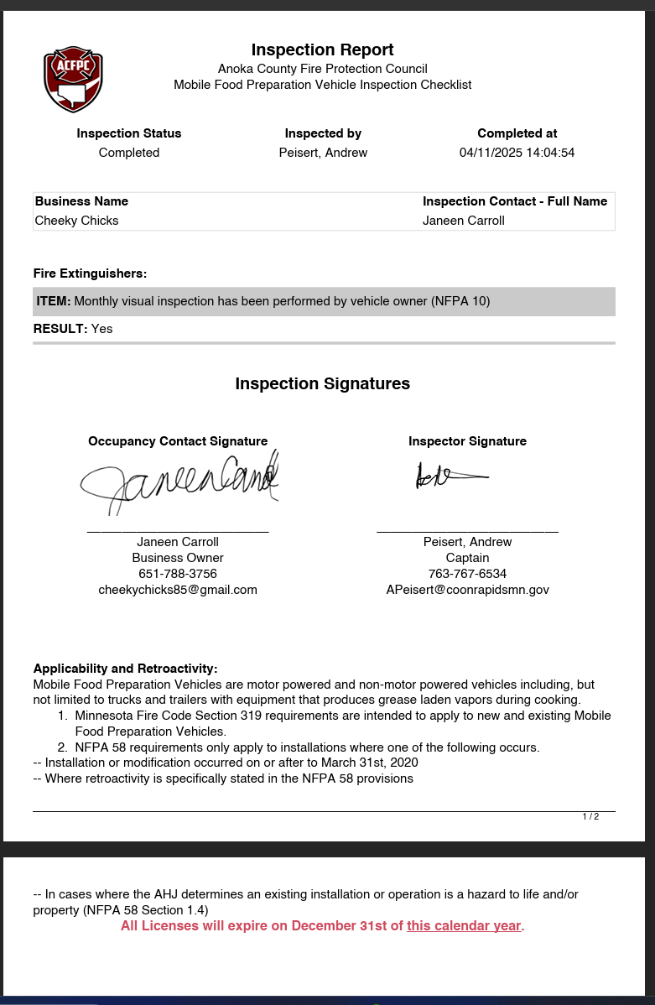
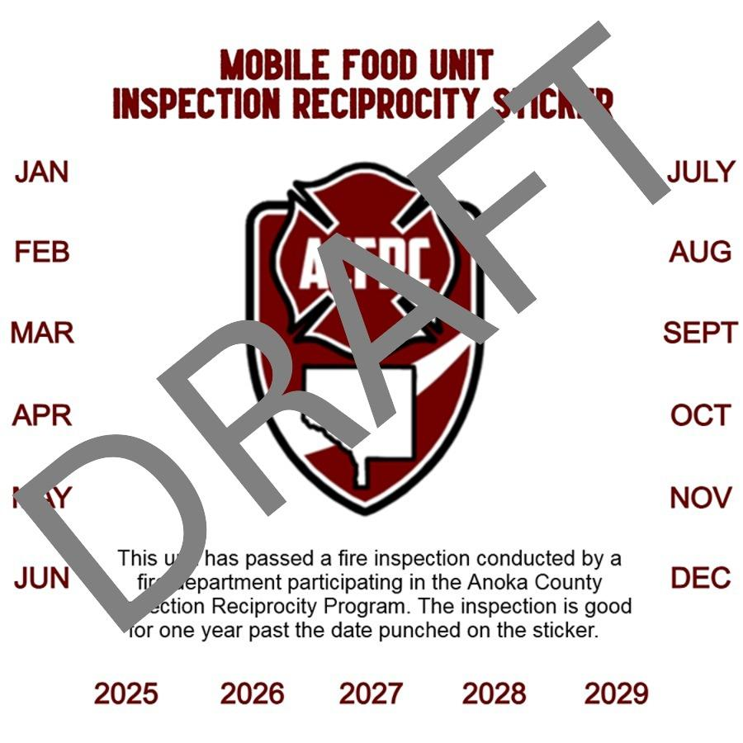
Notes:
Another module user group centers around Inspections and consists of the countywide inspectors and fire marshals. We utilize the First Due Inspections module for all of our inspections and in 2025, we started two new countywide initiatives: Mobile Food Unit Inspection reciprocity and ITM, or Inspections-Testing- and Maintenance, for compliance submissions.
The Mobile Food Unit Inspection Reciprocity started out of feedback from our community partners - it is burdensome to own a food truck and move throughout cities in a county having to get a new operations permit AND fire safety inspection for each city. In Minnesota, our weather is only conducive to food trucks for about six months or less, so food truck owners want to maximize their time serving great food and minimize the amount of time spent on repeat fire safety inspections. Our Inspectors user group met, and through the technological advances within First Due’s Inspection module, we were able to create an inspection checklist that mirrors our State Fire Marshal’s inspection checklist for mobile food trucks. Since we are operating on the same platform conducting the inspection, departments agreed that we would offer reciprocity to our food trucks - get inspected in one city within Anoka County at the start of your food truck season and pass and you will receive an inspection sticker indicating a successful fire safety inspection that will be accepted across all cities in Anoka County, requiring food truck vendors to only seek operational permits through the city and avoid time-intensive fire safety inspections while still ensuring the safety of each food truck and code compliance. With First Due, we were also able to create a report that emails out to all the inspectors countywide each Friday with a list of food trucks that have been inspected for their reference, and additional detailed inspection information is available through data sharing within First Due if needed. This year, the pilot year of our program, inspectors in Anoka County inspected 136 of the 250 trucks registered with the Food Truck Association of Minnesota.
Our state fire marshal’s office has considered creating a statewide reciprocity agreement for food trucks for years with no success. They don’t have access to a shared platform to make the exchange of information simple and efficient, and certain entities don’t trust other departments will inspect to the same standards as they do. With our consortium model, we negate those hurdles by offering joint training for the use of the mobile food unit checklist and reciprocity agreement - ensuring all inspections are held to the same high standard whether the food truck starts its journey in the small town of East Bethel or the major suburb of Fridley. First Due’s system puts efficiency in motion through its progressive data sharing technology, and we hope to continue expanding our borders of reciprocity and help build a path for statewide reciprocity that the State Fire Marshals Division can learn and benefit from.

Slide 17
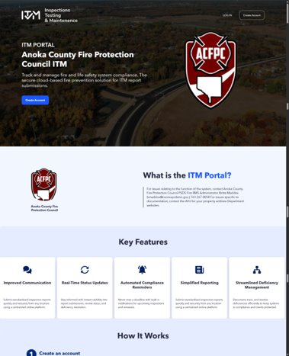
Notes:
The Inspectors user group found another place where coordinating efforts could increase efficiencies when considering their inspection-testing-maintenance, or ITM, platform. Historically departments were either utilizing one of multiple vendors for contractors to submit their compliance documentation for suppression system maintenance, installation, and testing, or worse yet, 14 out of 16 departments weren't using anything to capture this information. That's a critical information gap. Responders going to these businesses had to look at the call information on one system, the preplan and occupancy data within First Due, and another vendor’s ITM software if available for a full picture of the building they were walking into - wasting critical initial incident response time.
Effective January 1st, we will now be using our shared records system platform to accept and process these compliance documents. The benefits? A single platform for all vendors servicing any property anywhere in Anoka County - simplifying their user experience and ultimately saving them money in submission fees. It also feeds this critical information to the shared pre-plan and response module. Now, as a responder headed to the scene of a structure fire, I can know at a glance on my way to the scene that the sprinkler system that should be in this warehouse was marked out of service yesterday and is not functional, potentially dramatically changing my operational strategy on scene to increase the probability of saving lives and property.

Slide 18
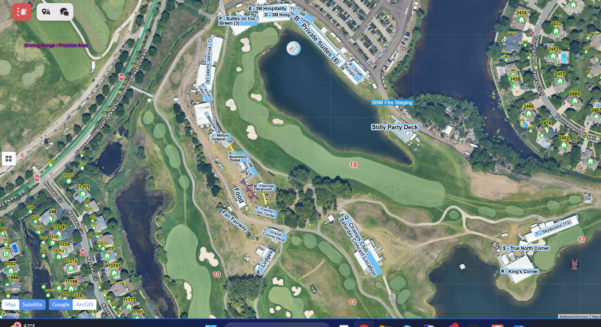
Notes:
As you may have noticed through these examples we don’t just create standards together - we operate together. Many of you operate regularly with mutual and automatic aid partners with whom you have little to no interconnectivity - you don’t know how they’re trained, what level of support you’re getting, if they’ll understand your shorthand or lingo for response tactics, and often, when or how many response units you’re getting - and at a critical incident, there’s no time to request that information over the radio. You need it at your fingertips. You need to know before you arrive on scene that your aid partners are going to understand what is needed and operate effectively as an extended branch of your own department.
Accepting these unknowns as a hazard of doing business wasn’t acceptable to our departments, our elected officials, or our citizens we strive to protect. Early on in the life of the consortium the Anoka County Fire Training Academy was established to ensure shared educational standards between departments. We can now rely on the fact that when we are receiving aid from any department within our county, regardless of the size, we know that the foundational building blocks received were the same. And now, with the adoption of a shared countywide records system, we can take that one step further with a platform to support our aid response, putting us fully on one common operating procedure. Not only that, but with First Due’s platform of shared pre-plans and our standard language for icons, annotations, and mapping countywide, we have ensured that all of our responders, regardless of the city they are responding to or the department they serve with, have the same critical pre-incident plans, hazard information, and location contacts walking into a scene. This also saves us critical seconds and minutes when receiving new aid partners on a larger incident. The incident commander doesn’t have to sit at the edge of the scene and greet each new arriving unit and assign them a spot. Instead, the IC can be out and about doing a size-up or assisting with laying hose all while the additional responding units reference the shared pre-plan for staging areas and required tasks needing to be filled.
Spring Lake Park-Blaine-Mounds View Fire Department, or SBM for short, utilized regional pre-plan layers this summer during their annual PGA 3M Open golf tournament, a premier professional golf tournament held annually in Blaine, Minnesota at the TPC Twin Cities course. As part of the PGA TOUR, the 3M Open draws top golfers from around the world to compete in a scenic, challenging setting just north of the Twin Cities. The tournament blends elite-level golf with vibrant community engagement, including interactive fan zones, local food vendors (food trucks), and charitable initiatives and has become a summer highlight and a key stop on the PGA TOUR calendar. SBM relies heavily on mutual aid partnerships to ensure the safety of everyone involved with this event. This year, First Due’s regional pre-plans were implemented. Because we worked together to create a common language through a pre-plan data standard, the 3M Open was able to be laid out strategically and geographically, giving all those involved - whether it’s their first time assisting with the event or they’ve been with it since its inception in 2019 - a common operating picture and shared language for coordinated, efficient operations.
It’s worth mentioning that one piece doesn’t work without the other - a shared records management system is great but it’s useless if you aren’t also collaborating on how it’s used. If a red square tile is a sprinkler zone for Coon Rapids but indicates a hazmat spill radius to Linwood, we are not going to have the desired effect of efficient and coordinated response. The standard, and willingness to adhere to it, are essential along with the technological advances, and these examples of why this works are what drives decision-makers to understand the importance of both.

Slide 19
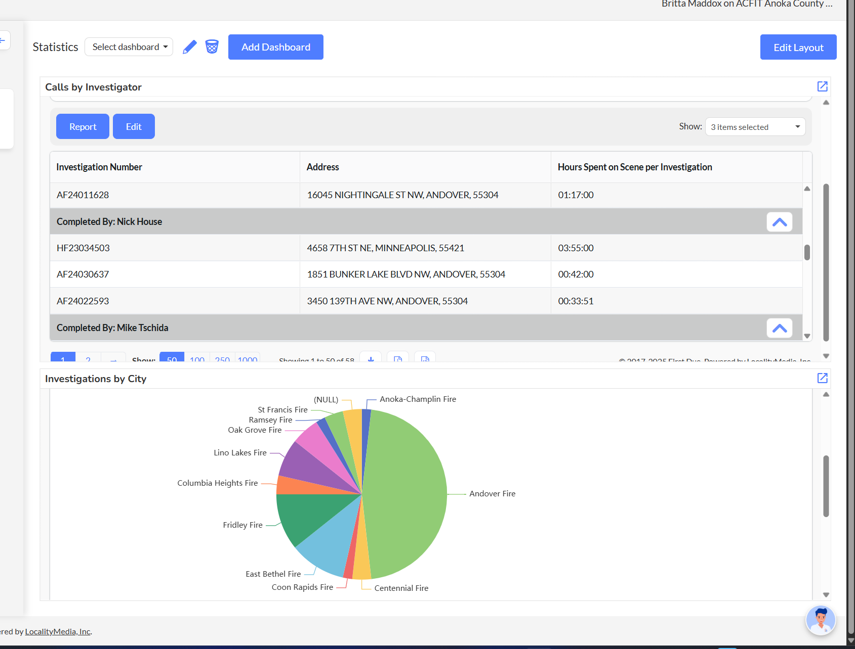
Notes:
A shared platform and common language pave the road for leading with intelligence – through statistical analytics and regional collaboration.
As an example of both we have the Anoka County Fire Investigation Team, or ACFIT. Currently, 28 firefighters from departments across Anoka County contribute time and energy to ACFIT. As a specialized response unit, ACFIT members are paged out to any department in need of fire or arson investigation. Historically, ACFIT members utilized the records management system of their home department - meaning providing investigation reports to other departments, chiefs, community members, and insurance providers or attorneys was a hassle, and the quality of report you received was entirely dependent on the responder. There was no consistency or standard expected. Even though the National Fire Protection Association has a standard for fire investigation documentation, there was no guarantee of adherence to it.
Now, with a shared records system, ACFIT has its own account where investigations are completed and securely stored. Since it’s a unique 'department' in First Due, multiple users can work together on the same investigation (which couldn't happen before) and the template used by all investigators is now standard. No matter which investigator responds, the printed form and content of the investigation is the same (ensured through the use of required fields) and that same template is shared back to each individual department for any in-house investigations. Attorneys love to hate us now - they can’t pick apart our inconsistencies on the stand anymore, but it also makes their job easier. With a single source of information, and with the implementation of a records management process that has a single user responsible for the dissemination of reports, copies can be easily provided to anyone requesting them after confirming their completeness, and best of all, since all the investigative information is in one place, we can keep statistics on investigations which was never before possible.
To that end, we recently had some chiefs concerned that the bulk of the investigations were being handled by only a few of the ACFIT members. To address these concerns, I created the Investigations Dashboard you see here with reports indicating the number of investigations per city and the hours spent on each investigation. Through the power of analytics, we were able to quickly address these concerns with facts, contributing to accountability and transparency, and ultimately this informed our decision to change our approach to ACFIT response. Earlier this month, a direct result of statistical analysis of our responses, we moved to a team model where our 28 ACFIT members are divided into 3 teams, each responsible for 4 months out of the year. Previously it was an 'all hands on deck' call-out, leading to either a TON of extra unnecessary bodies on scene, or the same 4 people showing up each time. Now, with investigators having an accountability month, it will divide the labor evenly between the investigators, easing the burden of responses on any one individual and ensuring newer investigators have the chance to respond with and learn from more experienced partners.

Slide 20
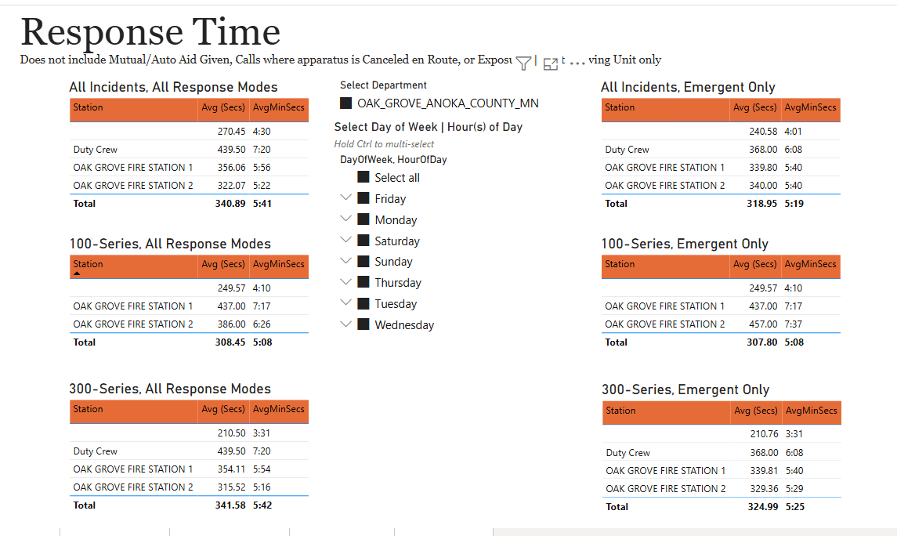
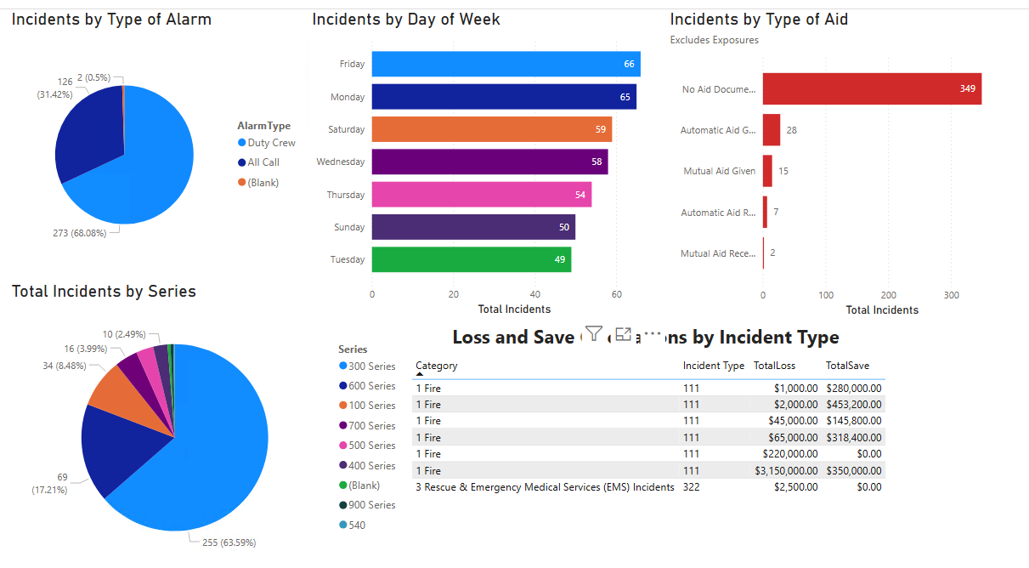
Power BI
Notes:
Microsoft’s Power BI expands our ability to report statistically within departments and across the county. We have created a Fire Protection Council Report Summary which encompasses many of the 1710 and NFPA (National Fire Protection Agency) standardized reports required for grants and ISO ratings within the United States, a few screenshots from which are above. The power of Power BI is that you can do more, simply. The Response Time graph above, for example, lists out average response times by station for each department with the ability to filter for day of week and time of day. Previously, these were all independent reports but now in one go, a chief can easily adjust filters to determine the average response time difference when duty crew is on shift (Monday - Friday 0600-1800) versus when they aren’t (perhaps, Monday - Friday 1800-0600 and the weekends) in order to justify expanding duty crew hours or even justify transitioning to a full-time staffing model. For Anoka County, because we are a consortium that shares our data, you can also compare your department to another department with a different staffing model but perhaps similarly sized in population to show the expected improvement in response times if you were to move to that staffing model, or decline depending.

Slide 21
Breaking Down Borders ———.
Notes:
Because we stand on a strong foundation of data and a unified way of operating, we have the power to break down barriers—across regions and nations—and rise as a model of excellence, building resilience not just for ourselves, but for those who will one day depend on us when disaster strikes.

Slide 22

Regional
North Metro Chemical Assessment Team
F.A.S.T. - Fire Administrative Support Team
MEMA - Metro Area Emergency Manager’s Association
AMEM - Association of Minnesota Emergency Managers
MnGAC - Minnesota Geospatial Advisory Council
Notes:
Regionally, we have the North Metro Chemical Assessment Team, supported through our Fire Protection Council. Firefighters from a variety of departments work together as HAZMAT response experts throughout Anoka County and in other surrounding counties. Specialized training and additional response capabilities would not be possible for a single department. It was an easy first step to breaking down borders for many who were unsure of where to start. A common goal, a narrow specialty, a united pact for safety.
F.A.S.T. - the Fire Administrative Support Team which offers quarterly meetings and trainings specific to those who work in the administrative functions of the fire department. 65 statewide departments participate as well as our Minnesota State Fire Marshal Division to help train on NERIS standards, payroll and percentage considerations, wellness initiatives, and many other topics.
MEMA and AMEM are two more related examples of regional sharing. These are groups of emergency managers trying to work together during this time of uncertainty at the federal level and create local resilience that can support and expand beyond its borders.
The Minnesota Geospatial Advisory Council has a focus on geospatial data and looks to curate and share geospatial data to open up the world of understanding and to enhance emergency response and public safety. I am the chair of the Emergency Preparedness Committee of the Geospatial Advisory Council. Our main goal this year is to liaise with our state public safety partners and help them understand the importance of us working together informed by geospatial intelligence.
But for the Anoka County Fire Protection Council, regionally wasn’t enough. We had more to give, more to learn, and a broader impact to make.

Slide 23
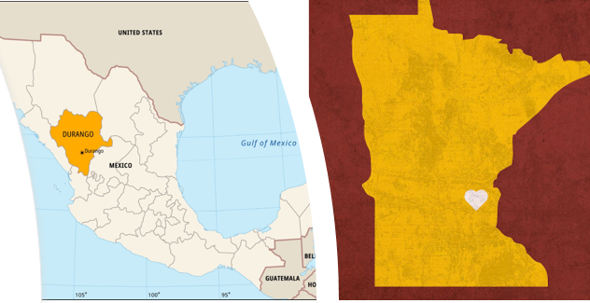
International
Sister-city Durango, México
….and we are just getting started!
Notes:
The Anoka County Fire Protection Council’s international aspirations for one global fire service began this year with the adoption of Durango, Mexico as our sister-city.

Slide 24
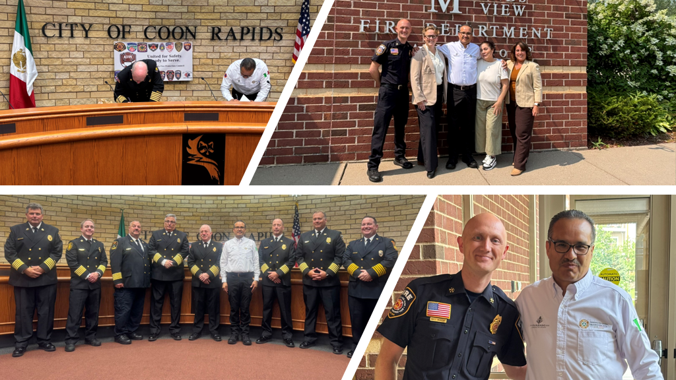
Notes:
July 29, 2025 we made history when we adopted Durango, Mexico Civil Protection as our sister-city. This is the first public safety international partnership in Minnesota. Coordinador Arturo Galindo and his wife, Evangelina Martinez, drove over 2000 miles to visit us in Minnesota, officially sign the Memorandum of Agreement, and pick up the donations we had…which in preparations we thought was going to be 28 WiFi-enabled tablets...

Slide 25
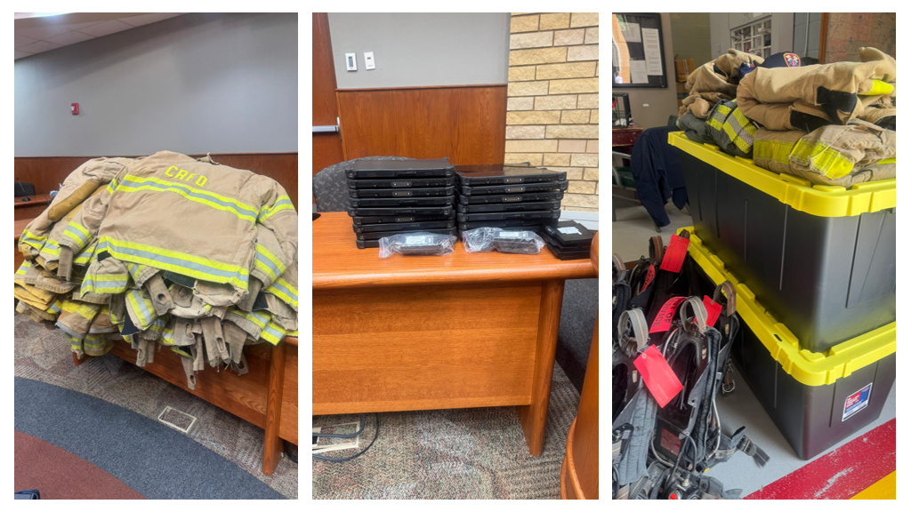
Notes:
Turned out to be 31 tablets, approximately 26 sets of turnout gear, and 6 SCBA tank packs. Start small. Big things will come.

Slide 26
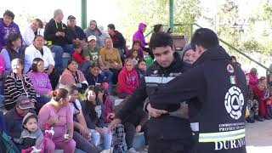
Notes:
I’d like to share with you a short video created by Durango after our official ceremony. [play video]

Slide 27
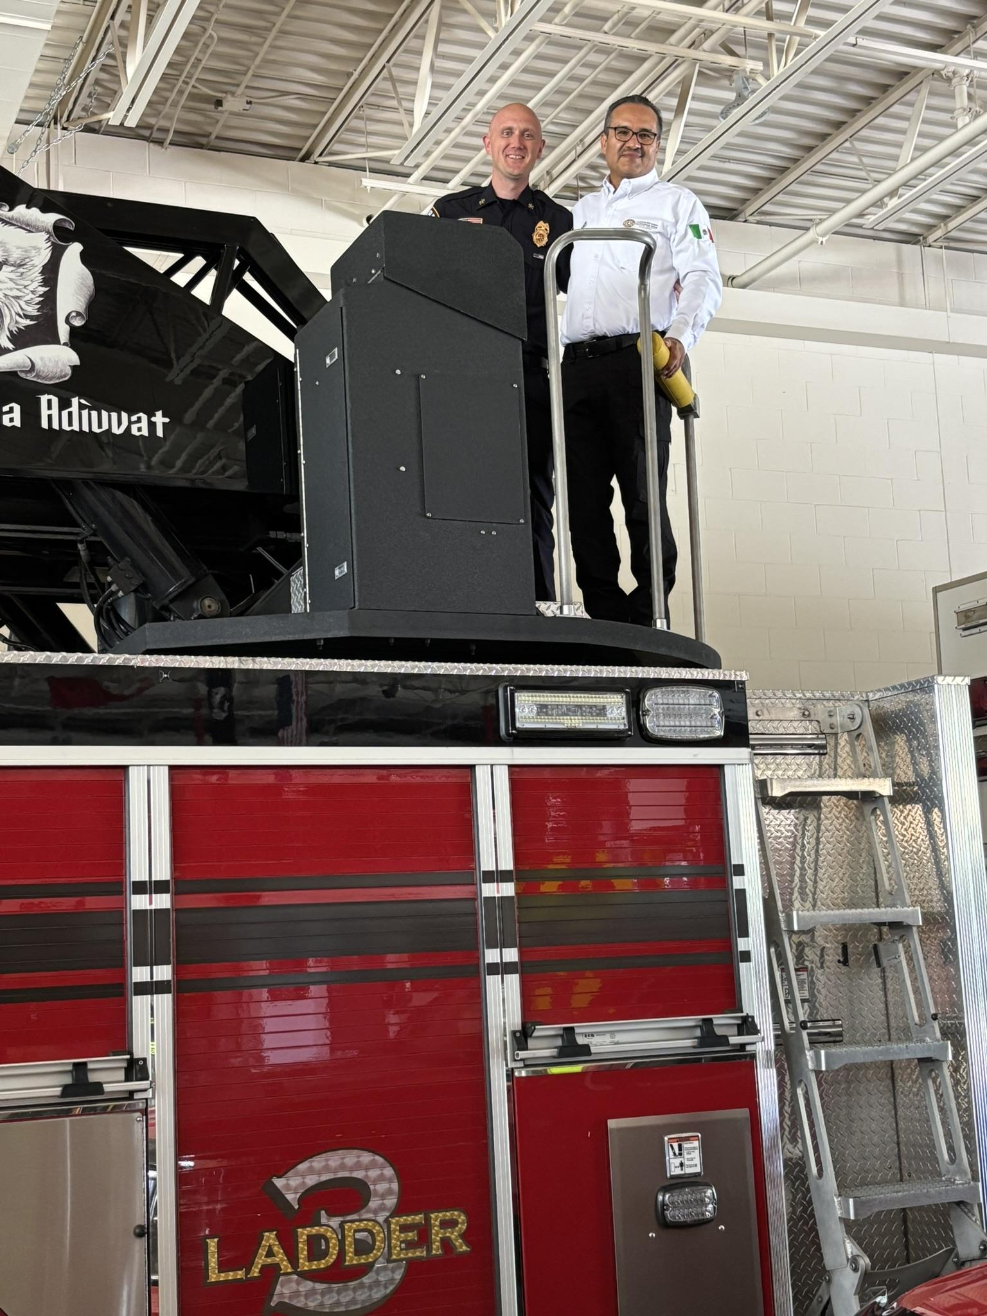
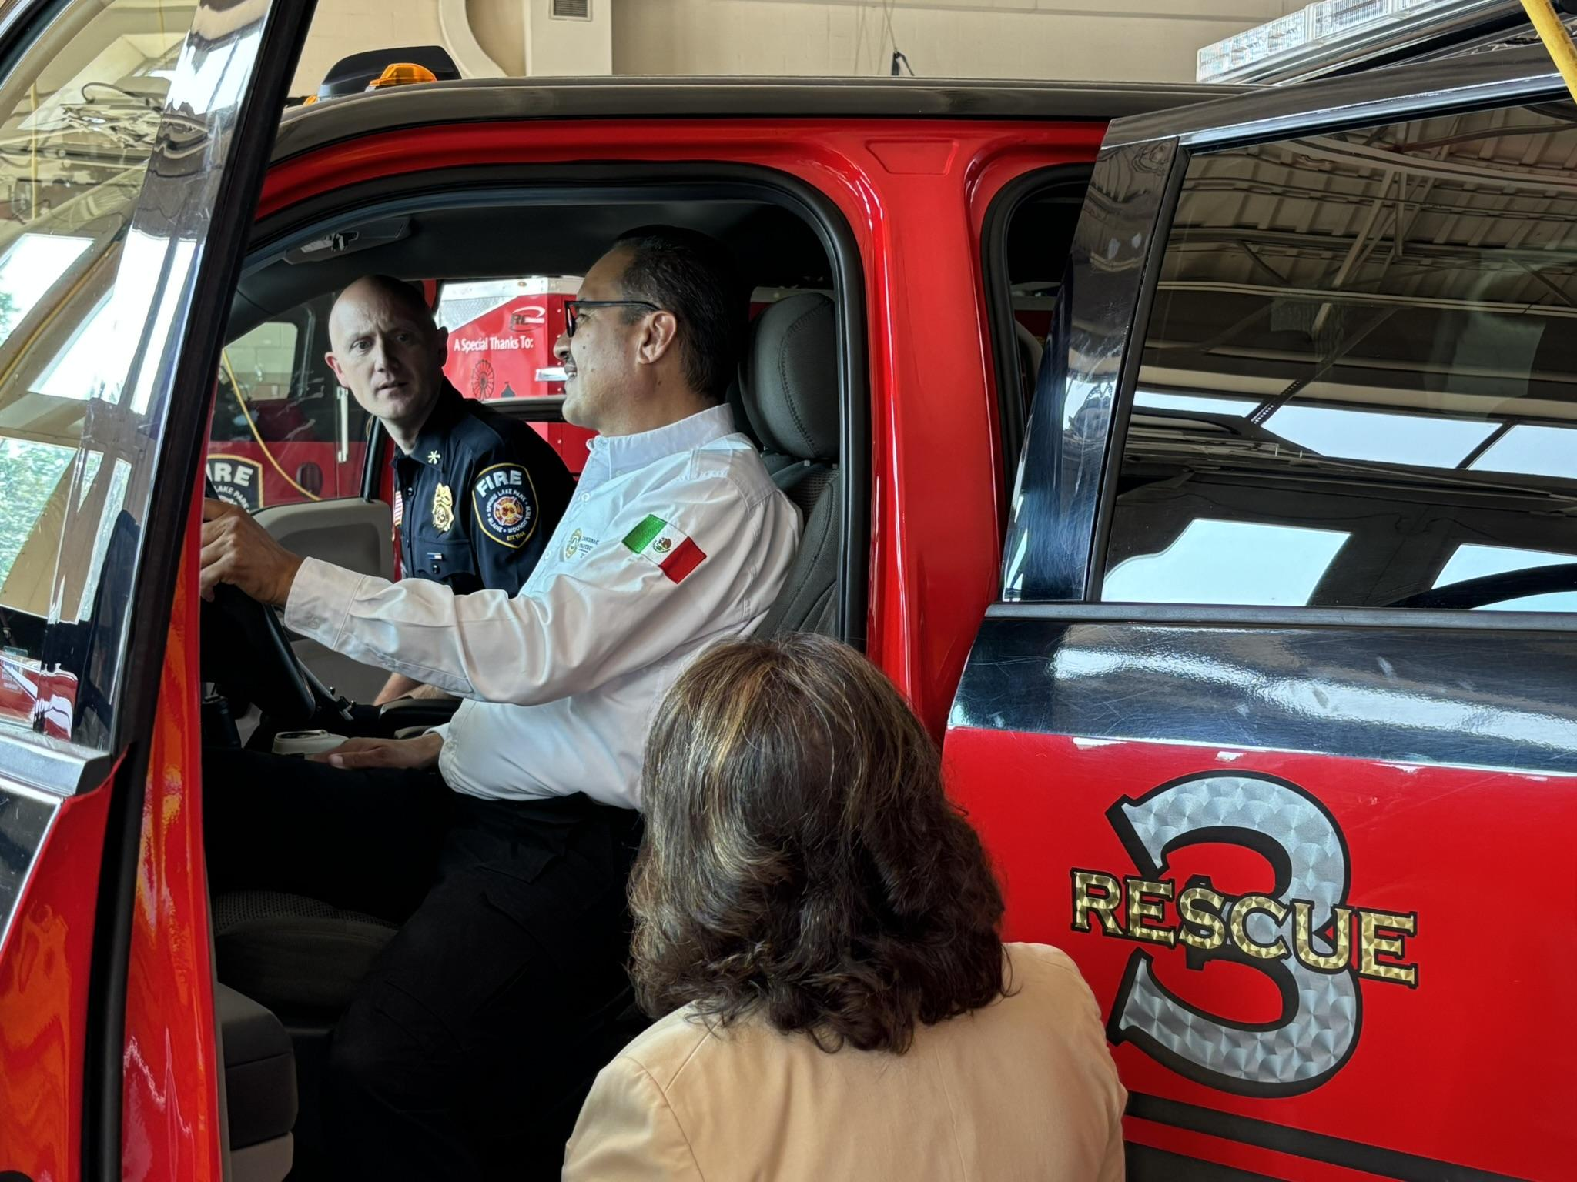
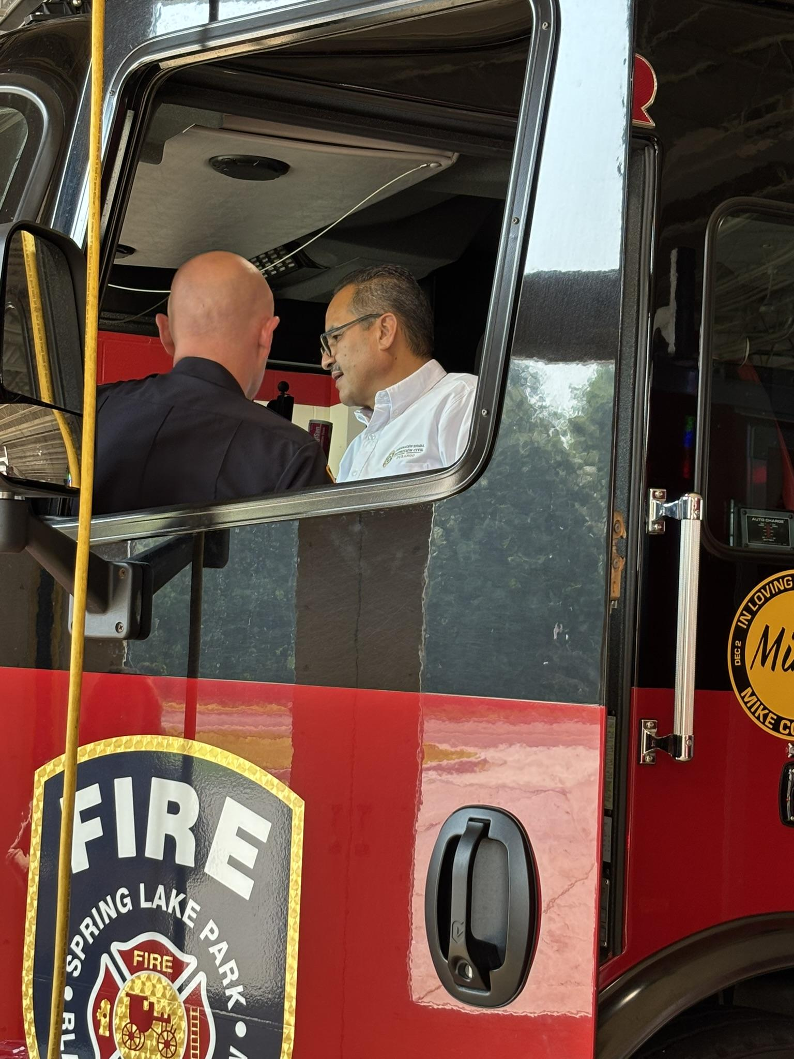
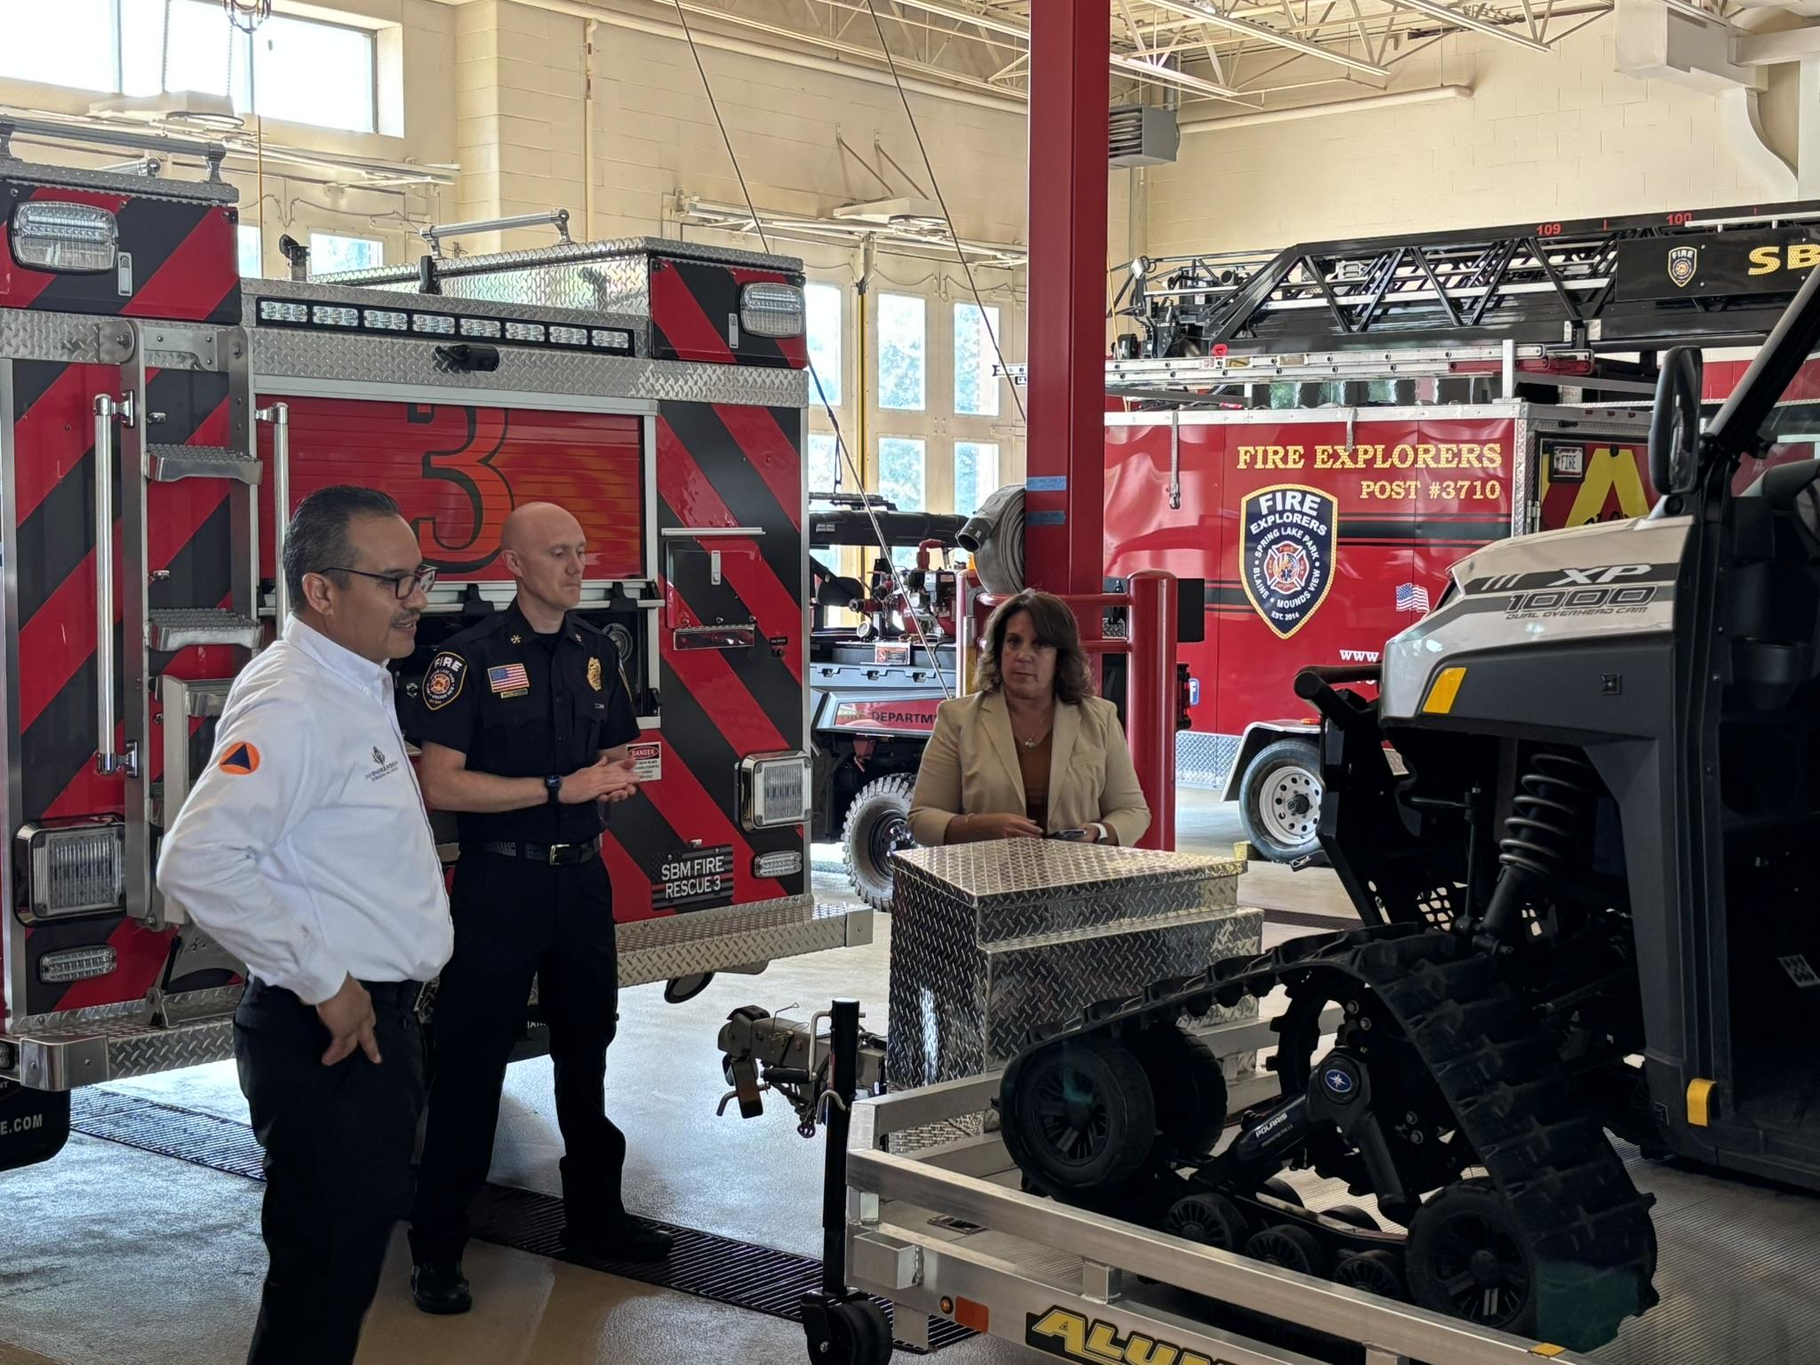
Notes:
And we continue to work together with our ongoing Action Plan for continued partnership which includes:
Establishment of a Firefighter Exchange Program
Opportunities will include:
Attending incident scenes as an observer with a variety of fire departments
Attending and participating in training exercises, to include specialized training for search and rescue, investigations, chemical assessment, live burns, etc.
Visits with other Minnesota fire departments and the State Fire Marshal’s Office and the equivalent in México, providing a wide variety of experiences
Establishing the program requirements, itinerary, and objectives aims to be achieved by January 1, 2026, with hopefully the first participants exchanging later that year
All with the goal to learn about the fire service in that country, build global partnerships and cultural understanding, and a develop a vision of how to bring new ideas back to your country
Establish a method of ongoing donation for used turnout gear, SCBAs, lifesaving and EMS equipment and supplies, apparatus, and other equipment with the Resource Donation app from Canmore Company
Quarterly webinars with officials from both entities covering a wide range of topics for information and idea sharing, creative tabletop problem-solving and exercises, and mutual training opportunities
Topics may include fire inspections, wildland fire, community outreach and fire prevention, incident/scene management challenges and best practices, standardization and best practices for data collection and sharing, search and rescue, investigations, fire inspections, the role of humanitarian efforts within the fire service, etc.

Slide 28
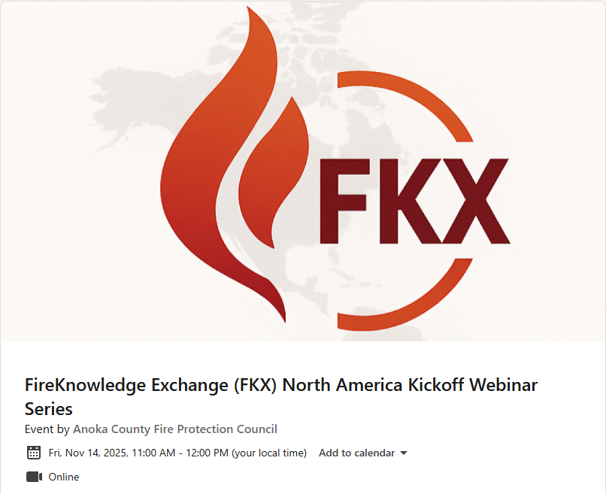

Notes:
I am excited to announce the kickoff of the FireKnowledge Exchange North America - a community of fire service professionals dedicated to a passion for global fire service innovation and resiliency. Webinars will be offered quarterly and cover a wide variety of topics - from fire prevention strategies to technology and data standards, as well as table-top and hands-on training exercises in fire rescue, specialized rescue, emergency management and more. The very first webinar will be held Friday November 14th at 1100 Central Time. Scan the QR code to join!

Slide 29
Empower your department.
Connect your Region.
Lead with Intelligence.
Impulsa a tu departamento.
Conecta a tu región.
Lidera con inteligencia.
Notes:
In closing, the Anoka County Fire Protection Council empowers its departments, unites jurisdictions, and leads with intelligence through standardized practices and partnerships, directly advancing county and state priorities for safe, resilient, and well-prepared communities in the areas where we serve and with our international partners.

Slide 30


Contact —— .
Britta Maddox.
PSDS Fire RMS Administrator
Email:
bmaddox@coonrapidsmn.gov
Phone: 1.763.367.0058
Scan the QR code to visit the Anoka County Fire Protection Council LinkedIn page
Notes:
Es un honor hablarles hoy. Muchas gracias por tu tiempo. ¿Ahora, que preguntas tienes?

