Slide 1

An Introduction to Emergency Communication and Mass Notification Systems
Richard Roberts
Honeywell
National Electrical Manufacturers Association (NEMA)

Slide 2

Learning Objectives
  MNS Defined
  Origin of ECS and MNS
  History of MNS in NFPA 72®
  Distinction Between MNS and ECS
  Intelligibility Understood
  NFPA 72® Risk Analysis
  Changes to the 2015, 2018 and 2024 Model Codes

Slide 3
Defining Mass Notification
  Mass notification is a relatively new development in life safety
  Mass Notification System (MNS) involves an integrated effort to save lives and minimize injuries during emergency situations, such as weather emergencies, terrorist threats, acts of violence and biological or chemical emergencies
Mass notification can be defined as "a technology that provides real-time information and instructions to people in a building, area, site, or installation using:
    Voice messages
    Visible signals
    Digital textual signage
    Text or email
    Tactile or other communication methods

Slide 4
Origin of ECS and MNS
  June of 1996: United States building (Khobar Tower) in Saudi Arabia was bombed by a truck carrying approximately 5,000 pounds of explosives.
  1998: Defense Threat Reduction Agency was ordered to protect US troops at home and abroad from terrorism.
  2002: U.S. Department of Defense (DoD) created the Unified Facilities Criteria (UFC) 4-021-01:
    4-021-01 defines the design, operation, and interfaces required for mass notification systems on Military Bases within and outside the United States
    Unified Facilities Criteria (UFC) Program:
    http://www.wbdg.org/references/pa_dod.php

Slide 5

History of ECS and MNS in NFPA 72
In June of 2003, the Air Force Civil Engineering petitioned NFPA to establish a mass notification project because:
    Fire Alarm systems are regulated and reliable
    The rules, testing procedures and installation practices are already established
    First responders are already familiar with the fire detection equipment, many with years of hands-on experience
This was the genesis of adding mass notification requirements to NFPA’s fire alarm standard

Slide 6
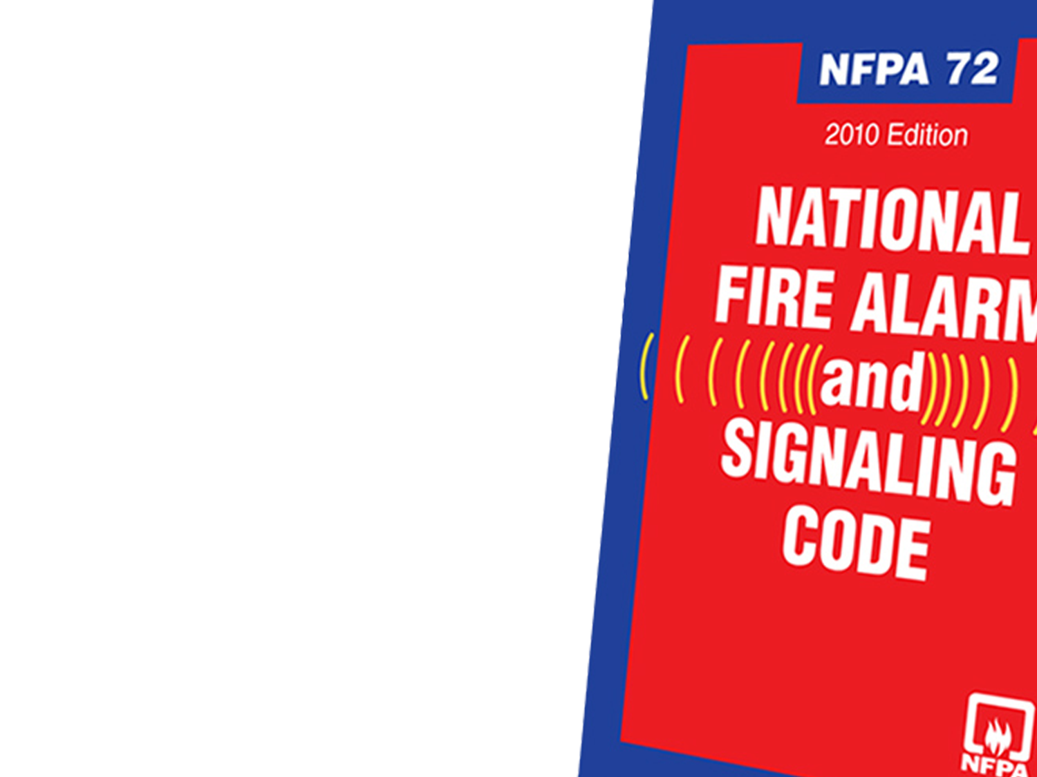
History of ECS and MNS in NFPA 72
2007 edition of NFPA 72 mass notification appeared in annex E
2007 a new Technical Committee was formed to begin work on the development of a new chapter for the 2010 edition of NFPA 72
2010 edition of 72 contains a new chapter 24 called Emergency Communication Systems (ECS)
Chapter 24 covers requirements for the installation and performance of ECS for in-building fire emergency voice/alarm communications systems (EVACS) and other communications systems

Slide 7
Distinction Between ECS and MNS
MNS and ECS cover all types of emergencies such as fire, severe weather, workplace violence, terrorist acts
Mass Notification System (MNS) is a system that provides one-way info to people using:
    Voice messages
    Visible signals
    Text messages
    Tactile
    Other communication methods
In addition to one-way communications, Emergency Communications Systems (ECS) provide two-way info to emergency responders to communicate with each other and building occupants in a single system or as an interconnection of several control systems such as:
  Two-way fire fighter communications
  Two-way area of refuge communications

Slide 8
Distinction Between ECS and MNS
Emergency Communications Systems (ECS)
One-Way
ECS
Two-Way
In-Building ECS
Info. Command and Control
In-Building
Fire EVACS
Two-Way Wired Emerg Svcs ECS
In-Building
MNS
Two-Way Radio Enhancement System
Combination
ECS
Wide-Area
MNS
Area of Refuge
Interfaces with MNS
Distributed Recipient MNS
Elevator ECS
PA Systems Used for ECS

Slide 9

One-Way ECS
One-way ECS: Intended to broadcast info to people in one or more specified indoor or outdoor areas and shall be conveyed either by audible, visible, or textual means, or any combination thereof
    In-building fire EVAC: A system distributing voice instructions and evacuation signals pertaining to a fire emergency, to occupants of a building
    In-building MNS: A system used to provide information and instructions to people in buildings or other spaces using voice messages and including visible signals, text, graphics, tactile
    Wide-area MNS: Provides real-time information to outdoor areas and other notification systems provided for a campus, military base, municipality, or similar single or multiple contiguous areas
    Wide-area DRMNS: A distributed recipient mass notification system is intended to communicate directly to targeted individuals and groups that might not be in a contiguous area

Slide 10

Two-Way ECS
Two-way ECS: Provides a reliable method for emergency responders to communicate with each other and building occupants.
    Two-Way Wired ECS: Two-way telephone communications service is normally used because fire department handheld radios may be ineffective in buildings with a great deal of structural steel.
    Two-Way Radio ECS: Fire Department handheld radio system.
    Area of Refuge: Areas that have direct access to an exit, where people who are unable to use stairs can remain temporarily in safety to await further instructions or assistance during emergency evacuation or other emergency situation.

Slide 11


Disclaimer
Comments and opinions during the presentation are exclusively the presenter and do not reflect an official position of the International Code Council (ICC), National Fire Protection Association (NFPA), its employees, or any of the Technical Committees
This presentation will not cover all the revisions, editorial changes, details, requirements or exceptions
Highly recommend purchasing a copy of the ICC or NFPA Code or the Handbook for all the changes, requirements and details:
  www.nfpa.org
  www.iccsafe.org

Slide 12
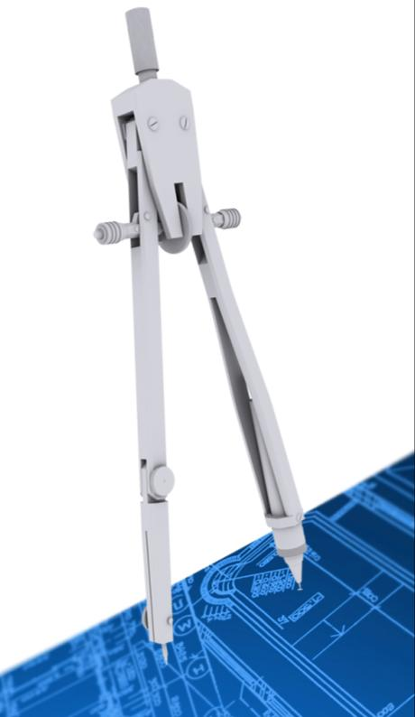
NFPA 72 – Intelligible Voice Messages
3.3.6* Acoustically Distinguishable Space (ADS). An emergency communications system notification zone, or subdivision thereof, that might be an enclosed or otherwise physically defined space, or that might be distinguished from other spaces because of different acoustical, environmental, or use characteristics, such as reverberation time and ambient sound pressure level.

Slide 13
NFPA 72 – Intelligible Voice Messages
18.4.12* Voice Intelligibility. Within the acoustically distinguishable spaces (ADS) where voice intelligibility is required, voice communications systems shall reproduce prerecorded, synthesized, or live (e.g., microphone, telephone handset, and radio) messages with voice intelligibility.
18.4.12.1* ADSs shall be determined by the system designer during the planning and design of all emergency communications systems.
18.4.12.2 Each ADS shall be identified as requiring or not requiring voice intelligibility.
24.3.1.1* Emergency communications systems shall be capable of the reproduction of prerecorded, synthesized, or live (e.g., microphone, telephone handset, and radio) messages with voice intelligibility in accordance with Chapter 18.

Slide 14
NFPA 72 – Intelligibility Measured
18.4.12.3 Unless specifically required by other governing laws, codes, or standards, or by other parts of this Code, intelligibility shall not be required in all ADSs.
18.12.4 Where required by the authority having jurisdiction governing laws, codes, or standards; or other parts of this Code, ADS assignments shall be submitted for review and approval.
18.4.12.5 Quantitative measurements shall not be required.
18.4.12.6 Quantitative measurements shall be permitted (see D.2.4)
D.2.3 Subject test methods

Slide 15
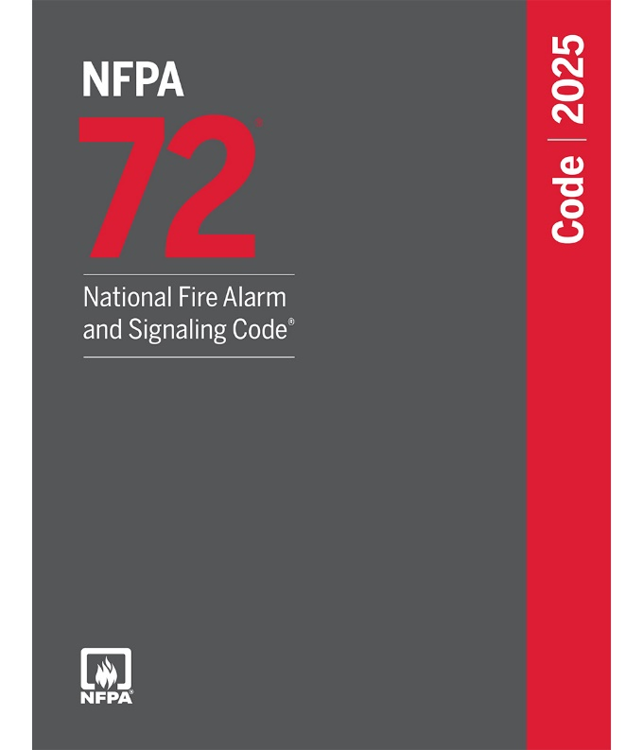
NFPA 72 – Risk Analysis
24.3.12.1* Each application of a mass notification system shall be specific to the nature and anticipated risks of each facility for which it is designed.
24.3.12.2 The designer shall consider both fire and non-fire emergencies when determining risk tolerances for survivability for the mass notification system.
24.3.12.10 The risk analysis shall be used as the basis for development of the ECS provisions of the facility emergency response plan.
3.3.243 Risk Analysis. A process to characterize the likelihood, vulnerability, and magnitude of incidents associated with natural, technological, and manmade disasters and other emergencies that address scenarios of concern, their probability, and their potential consequences.

Slide 16
NFPA 72 – Risk Analysis
24.3.12* Emergency Response Plan Elements. A well-defined emergency response plan shall be developed in accordance with NFPA 1660 as part of the design and implementation of a mass notification system.
7.3.6* Risk Analysis Documentation.
7.3.6.1 When a risk analysis is required to be prepared, findings and considerations of the risk analysis shall be documented.
7.3.6.2 When determined by the stakeholders, security and protection of the risk analysis documentation shall be in accordance with 7.3.7 and Section 7.7.
7.3.6.4 Risk analyses for mass notification systems shall be documented in accordance with 7.3.6 and 24.3.12.

Slide 17
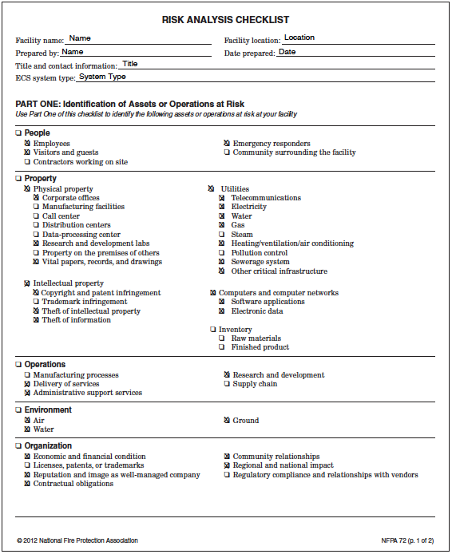
NFPA 72 – Risk Analysis
A.7.3.6 Risk Analysis Check List

Slide 18



NFPA 72 – Risk Analysis
Emergency Response Planning Requires a Commitment From All Stakeholders
Facilities
Management
EH&S

Slide 19
NFPA 72 – Voice Message Priority
24.5.13 Voice Message Priority.
24.5.13.1* The priority of mass notification messages shall be established using the emergency response plan.
24.5.13.2 The local building mass notification system shall have the ability to override the fire alarm system with live voice or manual activation of a higher priority message, but only where that message and operation are approved under the emergency response plan.
24.5.13.3 All other messages shall also be prioritized by using the emergency response plan.
24.5.13.4 When identified by the emergency response plan, messages from the mass notification systems shall be to take priority over fire alarm messages and signals.

Slide 20

UL – Control Units for Mass Notification
NFPA 72® Control Units for Mass Notification
24.3.10* Control Unit Listing for Mass Notification Systems. Control units installed as part of a mass notification system shall be listed in accordance with applicable product standards such as UL 2572, Mass Notification Systems.
UL 2572 Published in October of 2011
    1.2 The products covered by this standard are intended to be used in combination with other appliances and devices to form an emergency communication and/or mass notification system.
    1.4 Audible notification appliances are to be assessed to the Standard for Audible Signaling Appliances, UL 464, UL 1480, UL 1971, or UL 1638

Slide 21

Key Changes to 2015 Edition of IFC/IBC
Emergency Voice Alarm Communication (EVAC)
907.2.3 Group E. A manual fire alarm system that activates the occupant notification signal utilizing an emergency voice/alarm communication system meeting the requirements of Section 907.5.2.2 and installed in accordance with Section 907.6 shall be installed in Group E occupancies. When automatic sprinkler systems or smoke detectors are installed, such systems or detectors shall be connected to the building fire alarm system.

Slide 22


Key Changes to 2018 Edition of IFC/IBC
Emergency Voice Alarm Communication (EVAC)
907.2.12.3 Multiple-channel voice evacuation. In buildings with an occupied floor more than 120 feet (36 576 mm) above the lowest level of fire department vehicle access, voice evacuation systems for high-rise buildings shall be multiple-channel systems.

Slide 23
Key Changes to 2018 Edition of IFC/IBC
Risk Analysis for Mass Notification Systems
SECTION 917 MASS NOTIFICATION SYSTEMS
917.1 College and university campuses. Prior to construction of a new building requiring a fire alarm system on a multiple-building college or university campus having a cumulative building occupant load of 1,000 or more, a mass notification risk analysis shall be conducted in accordance with NFPA 72. Where the risk analysis determines a need for mass notification, an approved mass notification system shall be provided in accordance with the findings of the risk analysis.

Slide 24


Key Changes to 2024 Edition of IFC/IBC
Mass Notification Risk Analysis
917.2 Group E Occupancies. Prior to construction of a new building containing a Group E occupancy requiring a fire alarm system having an occupant load of 500 or more, a mass notification risk analysis shall be conducted in accordance with NFPA 72. Where the risk analysis determines a need for mass notification, an approved mass notification system shall be provided in accordance with the findings of the risk analysis.

Slide 25

Key Changes to 2018 Edition of NFPA 101
Risk Analysis for Mass Notification Systems
9.14.1.1 Where required by Chapters 11 through 43, a risk analysis for mass notification systems shall be provided in accordance with the requirements of Chapter 24 of NFPA 72 and the provisions of 9.14.2 through 9.14.4.
9.14.1.2 Where a mass notification system is required by the risk analysis in 9.14.1.1, the system shall be in accordance with the requirements of Chapter 24 of NFPA 72.
9.14.3.1 The emergency action plan, risk assessment report, and accompanying documentation shall be submitted to the authority having jurisdiction by the registered design professional (RDP). The format and content of the documentation shall be acceptable to the authority having jurisdiction.

Slide 26
Key Changes to 2018 Edition of NFPA 101
Risk Analysis for Mass Notification Systems, continued
High-Rise Buildings
11.8.4.3 Risk Analysis for Mass Notification Systems. For high-rise buildings with a total occupant load of 5000 or more persons, or where the floor of an occupiable story is greater than 420 ft (128 m) above the lowest level of fire department vehicle access, a risk analysis in accordance with Section 9.14 shall be performed to determine whether a mass notification system is required.

Slide 27
Key Changes to 2018 Edition of NFPA 101
Risk Analysis for Mass Notification Systems, continued
New Assembly Occupancies
12.3.4.5 Risk Analysis for Mass Notification Systems. A risk analysis in accordance with Section 9.14 shall be performed for new assembly occupancies with an occupant load of 500 or more to determine whether a mass notification system is required.
New Educational Occupancies
14.3.4.5 Risk Analysis for Mass Notification Systems. A risk analysis in accordance with Section 9.14 shall be performed to determine if a mass notification system is required.

Slide 28
Key Changes to 2018 Edition of NFPA 101
Risk Analysis for Mass Notification Systems, continued
Dormitories
28.3.4.4.1 A risk analysis in accordance with Section 9.14 shall be performed for grades K through 12, college, or university dormitories with an occupant load greater than 100 to determine whether a mass notification is required.
28.3.4.4.2 Applicable portions of an existing risk analysis shall be permitted to be used when a new building is added to the campus.

Slide 29
Key Changes to 2018 Edition of NFPA 101
Risk Analysis for Mass Notification Systems, continued
New Mercantile Occupancies
36.4.4.7.5 Risk Analysis for Mass Notification. A risk analysis in accordance with Section 9.14 shall be performed for new mall structures to determine whether a mass notification system is required.
College and University Occupancies with Classrooms
38.3.4.5* Risk Analysis for Mass Notification. A risk analysis in accordance with Section 9.14 shall be performed for business occupancies containing a classroom where the building is owned, rented, leased, or operated by a college or university to determine whether a mass notification system is required.

Slide 30
Key Changes to 2018 Edition of NFPA 101
Risk Analysis for Mass Notification Systems, continued
New Mercantile Occupancies
36.4.4.7.5 Risk Analysis for Mass Notification. A risk analysis in accordance with Section 9.14 shall be performed for new mall structures to determine whether a mass notification system is required.
College and University Occupancies with Classrooms
38.3.4.5* Risk Analysis for Mass Notification. A risk analysis in accordance with Section 9.14 shall be performed for business occupancies containing a classroom where the building is owned, rented, leased, or operated by a college or university to determine whether a mass notification system is required.

Slide 31
Resources
System Sensor Application Guide: Voice Evacuation Systems
NFPA: Designing Mass Notification Systems
NFPA 72: Annex D
NEMA Standards Publication SB 50-2014: Emergency Communications Audio Intelligibility Applications Guide

Slide 32



Presentation
NEMA Resources

Slide 33

Contact —— .
Richard Roberts
Honeywell
Industry Affairs Manager
Email: richard.roberts@systemsensor.com
Phone: 630-338-7025

