Slide 1
Design Challenges in High-Rise Buildings
Chris Jelenewicz, PE, FSFPE

Slide 2

Introduction
CEO at Society of Fire Protection Engineers (SFPE)
SFPE for 20 Years
BS from University of Maryland in FPE
PE in California
Chair NFPA 101 Fundamentals
Principle Member NFPA 550 & 551
SFPE Liaison ISO TC92.SC04
Former Volunteer Fire Chief

Slide 3


Mission: To define, develop, and advance the use of engineering best practices; expand the scientific and technical knowledge base; and educate the global fire safety community, to reduce fire risk

Slide 4





SFPE Chapters

Slide 5
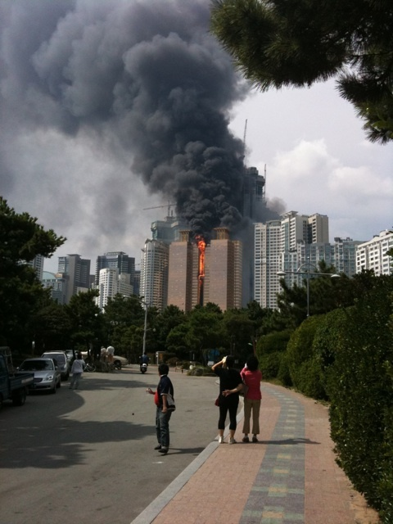
Unique Features
Vertical city/mixed occupancies
Height beyond reach of F/F ladders
Limited fire service access
Occupant egress issues
May have considerable stack effect
Water supply limitations
Communication/Notification
Iconic nature

Slide 6
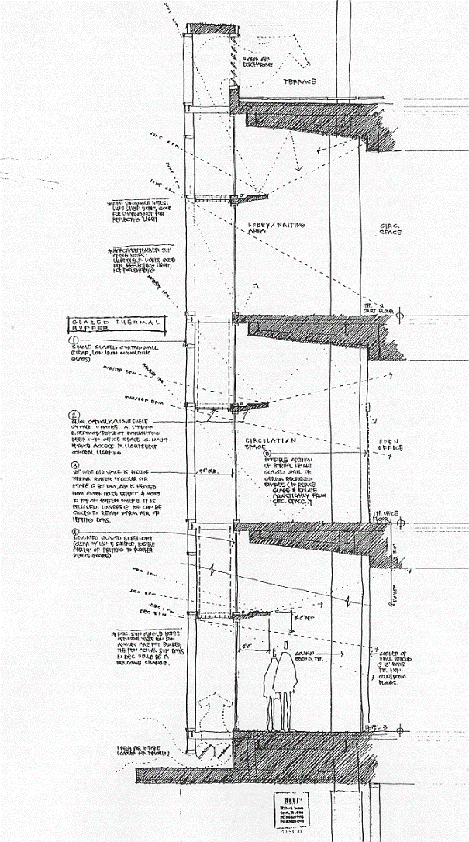
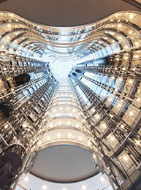
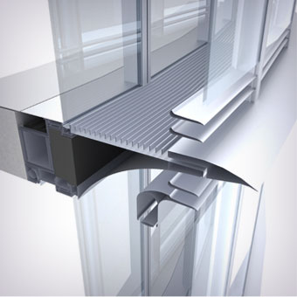
Other Features
Additional Challenges
"Green" features
Local factors
Fireworks
Amusement rides
Helicopters
Observation decks
Energy Storage

Slide 7
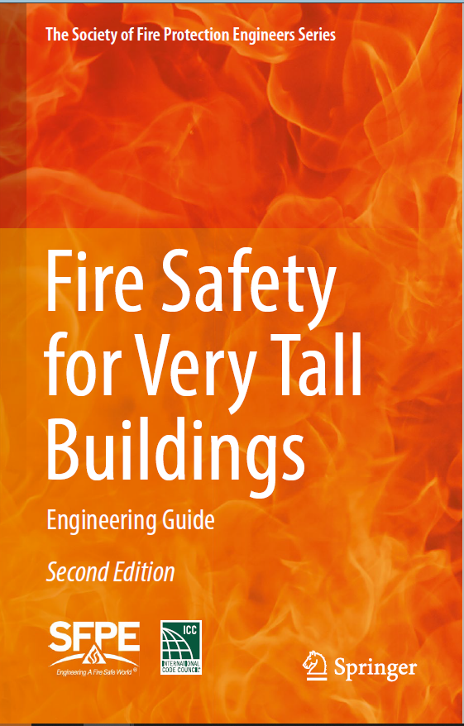
The SFPE Guide to Fire Safety in Very Tall Buildings, 2nd Edition
Available from Springer – Print and Electronic Format (springer.com)
Purchase Individual Chapters in E-format
Is part of Springer’s SFPE Series
First draft received over 250 public comments

Slide 8
Case Studies
15 Nov. 2010
SHANGHAI APARTMENT TOWER FIRE, SHANGHAI, CHINA
25 Nov. 2014
LACROSSE FIRE, MELBOURNE, AUSTRALIA
31 Dec. 2015
THE ADDRESS DOWNTOWN HOTEL FIRE, DUBAI, UAE
21 Feb. 2015
TORCH TOWER FIRE, DUBAI, UAE
14 June 2017
GRENFELL TOWER FIRE, LONDON, ENGLAND

Slide 9
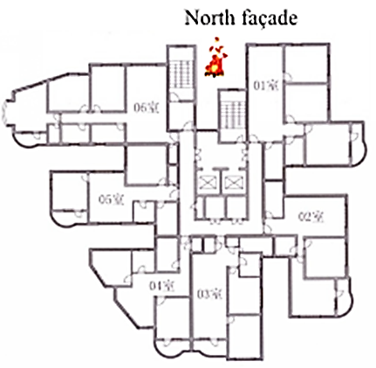
SHANGHAI APARSHANGHAI APARTMENT TOWER FIRE, SHANGHAI, CHINA NOVEMBER 15, 2010, APARTMENT TOWER FIRE, SHANGHAICHINA NOVEMBER 15, 2010
Façade Renovation – Welding on 10th Floor
58 deaths
Both Exits Blocked by Fire
Notes:
28-story building
Welder ignited combustible and spead to combustible scaffolding

Slide 10
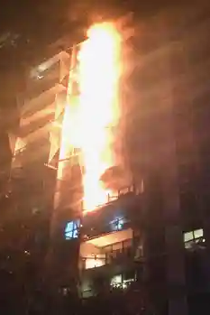
LACROSSE FIRE, MELBOURNE, AUSTRALIA NOVEMBER 25, 2014
23-story residential
Fire started on 8th floor balcony
Fire damage floors 6 through 21
Heavy fire loads on some balconies
No sprinklers on balconies
No injuries or deaths

Slide 11
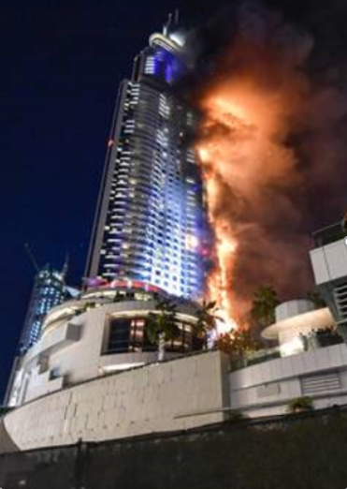
THE ADDRESS DOWNTOWN HOTEL FIRE, DUBAI, UAE DECEMBER 31, 2015
Involved most of building envelope, 65-story building
Electrical short on spotlight near 14th floor
Water supply to sprinklers & standpipes depleted
15 injured and one death from heart attack

Slide 12
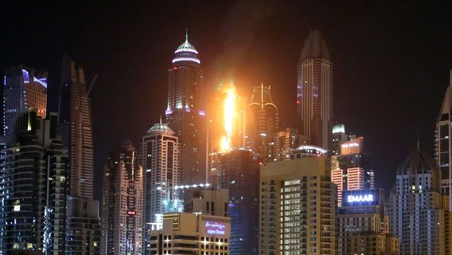
TORCH TOWER FIRE, DUBAI, UAE FEBRUARY 21, 2015
Exterior fire damaged 60 floors of 87-story building
Aluminum composite panels
Fire started on other side by wind
Sprinkler prevented damage inside building
Second fire on August 4, 2017, damaged 38 unites
Notes:
Fire speard to other side when wind pushed burning debris to other side of the building

Slide 13
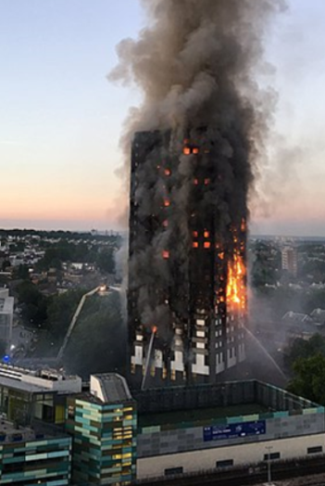
GRENFELL TOWER FIRE LONDON, ENGLAND
JUNE 14, 2017
24-story, primarily residential
No sprinklers
No fire alarm
Single exit
Defend-in-Place
72 deaths, 74 injuries
Short in 4th floor refrigerator
Extension to exterior cladding
Extensive Investigation
Notes:
Total break-down of fire protection system – design, through construction, through emergency operations
Defend in place
Change discussion of fascades
Not much talk about sprinklers

Slide 14
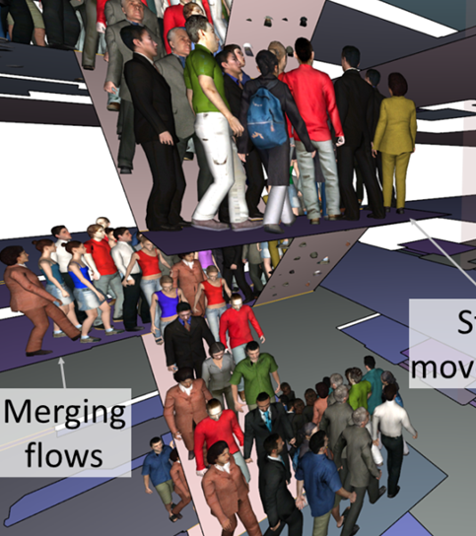
Emergency Egress
Understanding Evacuation Times
How Evacuation Models are Applied to Very Tall Buildings
  Movement on Stairs
  Use in Comparison in Evacuation Strategies
Occupant Evacuation Elevators
Defend-in-Place

Slide 15
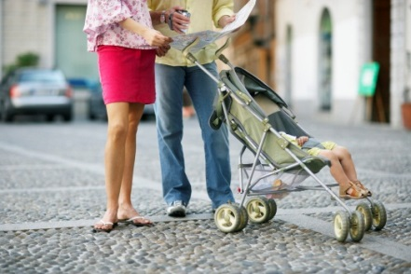
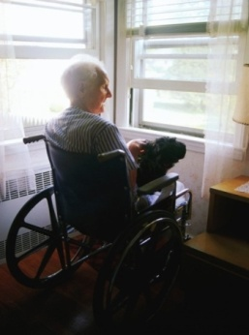
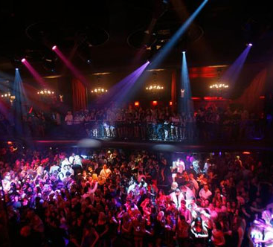


Occupant Characteristics
Occupant load, density, distribution
Age, ability, physical / mental condition
Awake or asleep or impaired
Familial or dependency relationships
Behavior / response factors

Slide 16
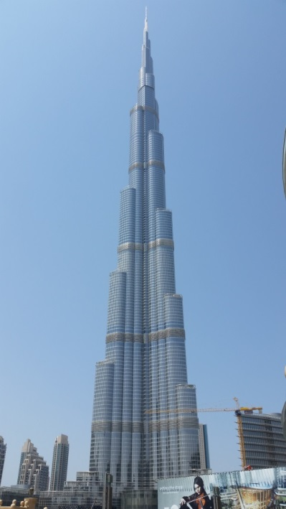
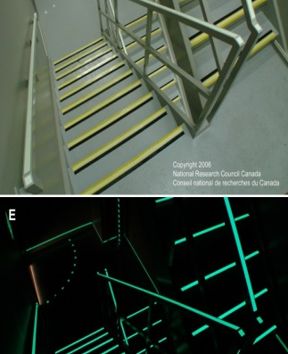
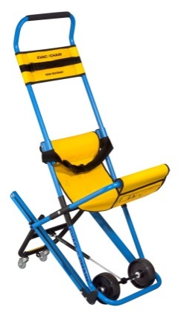
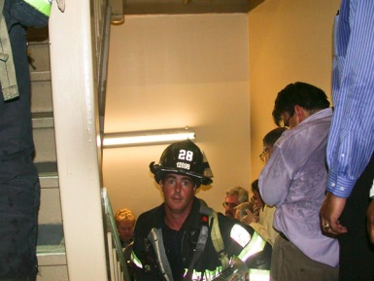
Building factors that affect egress time
Notification system
Height (speed, fatigue)
Occupancy types (demographics)
Exit availability
Horizontal stair transfers
Defend-in-Place
Signage
Counter flow
Security
Notes:
Landmark structures (threats from terrorism)
Multiple tenants
Use of CCTV
Locking of stair doors
Security barriers vs FD access

Slide 17
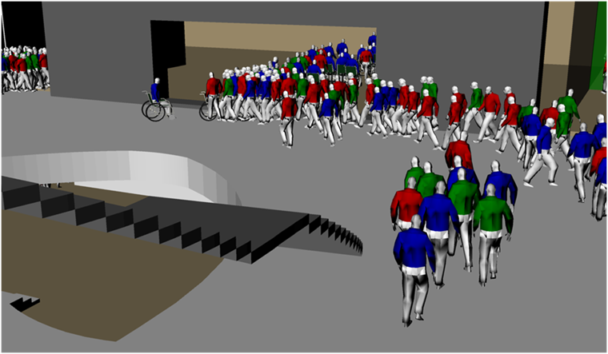
Evacuation Time
Timed egress analysis needed
What is an acceptable result?
Consideration for multiple floor evacuation
Occupant evacuation elevators?

Slide 18
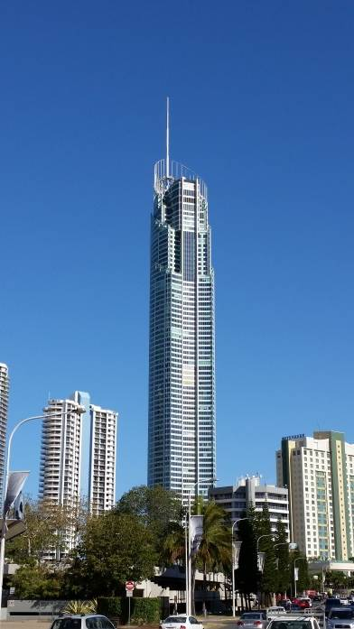
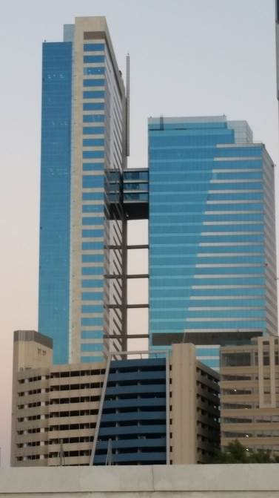
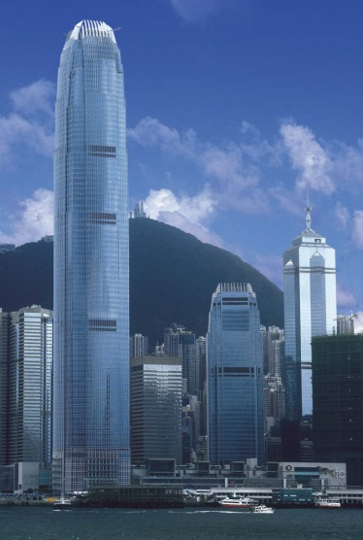
Evacuation Strategy
Simultaneous
Phased
Defend-in-place
Refuge areas / floors
Sky bridges
OEE
Alternative means
Combination

Slide 19
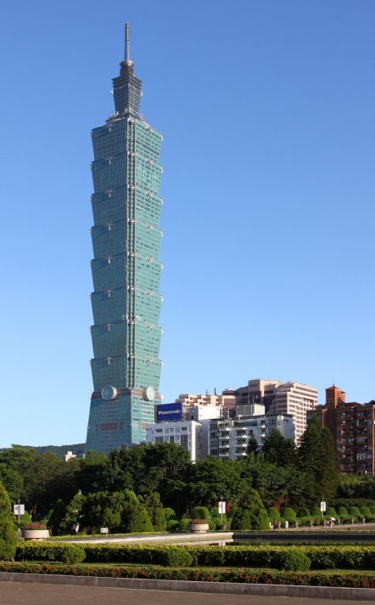
Simultaneous Full Building
Popular after 9/11/01
Many buildings built before were designed for phased evacuation
Helpful for benchmarking for fire and non-fire events
Time-consuming if only using stairs
Notes:
An evacuation of Taipei 101 in 2004 gave a total evacuation time in the region of 2.5 hours when using only the egress stairs. Use of lifts reduces time to on the order of 1 hour

Slide 20
Phased Evacuation
Advantages
  Efficient use of egress features
  Evacuate those in most danger first
Tall Buildings
  Fire floor + one / two floors above and below

Slide 21

Refuge Floors
Refuge floors required by regulation in some parts of the world
Intent is to provide occupants with area to rest and take refuge without needing to evacuate whole building
Different configurations: open / enclosed, only for people / shared with mechanical, various FP

Slide 22
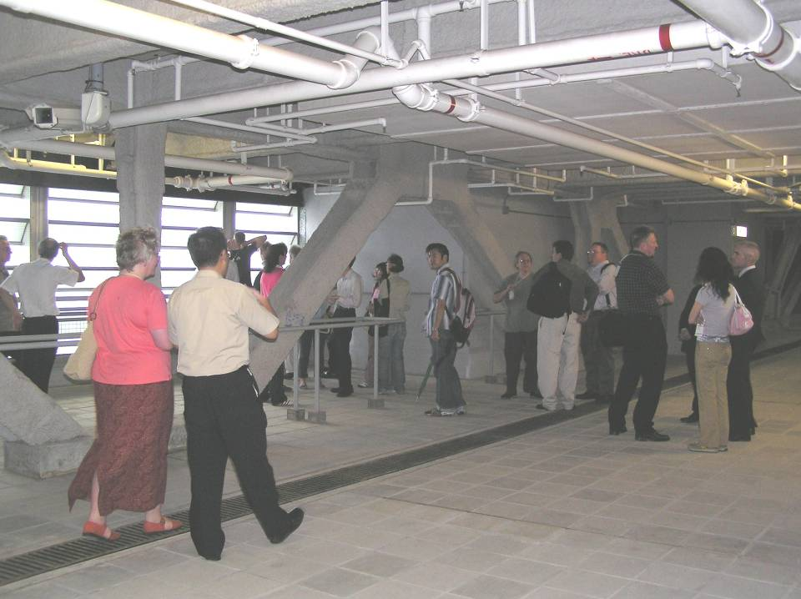
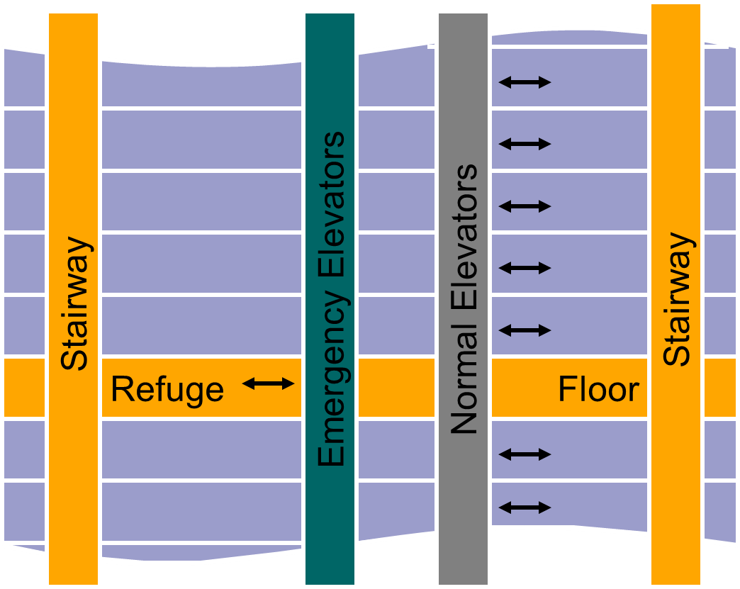
Original SFPE Guide: Safety for Very tall Buildings
REFUGE FLOORS

Slide 23
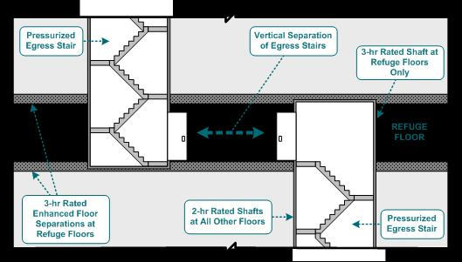
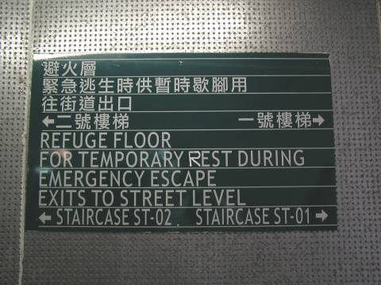
Refuge Floors

Slide 24
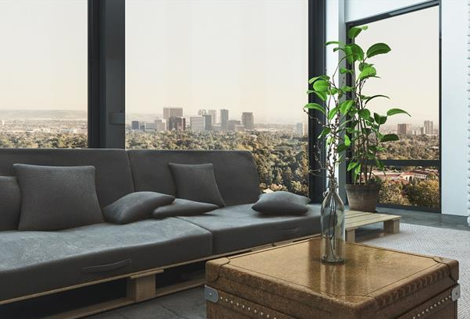
Defend-in-Place
Notes:
Occupant response during a residential high-rise fire -- Proulx

Slide 25
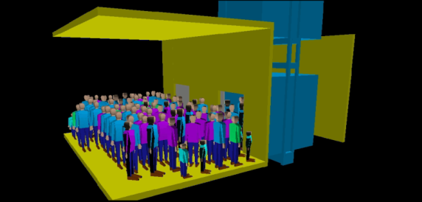
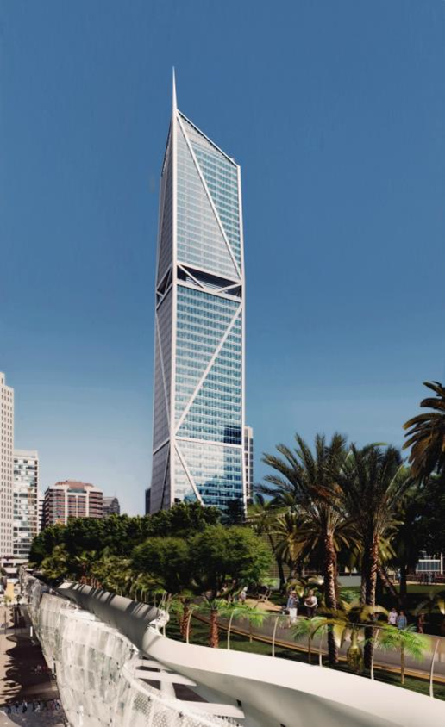
OEE
Tenability for duration of egress
Fire Resistant Assemblies
Smoke infiltration
Water infiltration
Controls & Operations
Monitor from fire command center
Complex control system
Robust power and control protection
Communication
Display in lobbies
Communicate to fire command center (car and lobby)
Status indicator to fire command center
Training

Slide 26
Occupant Evacuation Elevators
Model Considerations
Can not assume all behaviors are the same
% those willing to use the elevators
Different scenarios
Those willing to wait
Should represent:
Elevator accelerators/deceleration, and speed
Maximum load, number, and type of doors
Opening and closing times, and floor dispatch strategies
Behavioral factors -- usage of the elevators, waiting times, behavioral itineraries, and elevator loading time

Slide 27
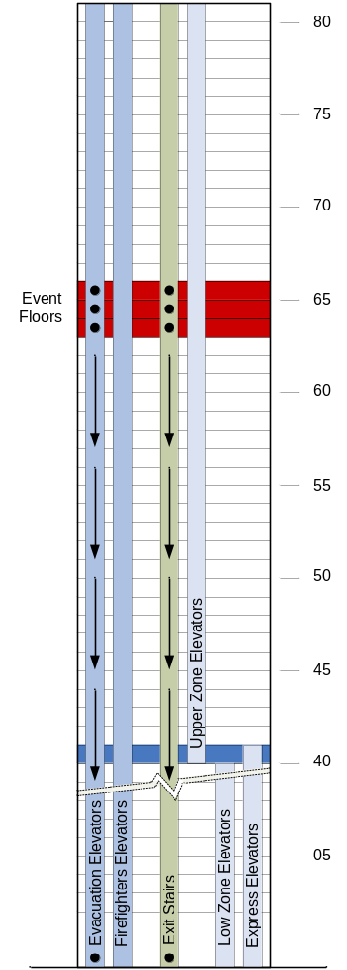
Evacuation Planning
Where will the occupants go when exiting the building – will it affect the fire department?
How are occupants being accounted for during an evacuation? Who is responsible?
If elevators are used, do the evacuation features automatically activate?
Do they need be activated manually, and if so, who makes the decision on site to activate?

Slide 28
Situation Awareness
Occupants will make risk-based decisions about how best to provide for their own safety based on the information they receive.
Discussion on Internet, Social Media & Smartphones
How is this connected to egress strategies:
Defend-in-place
Refuge Floors
Occupant Egress Elevators
Relationship to Notification

Slide 29
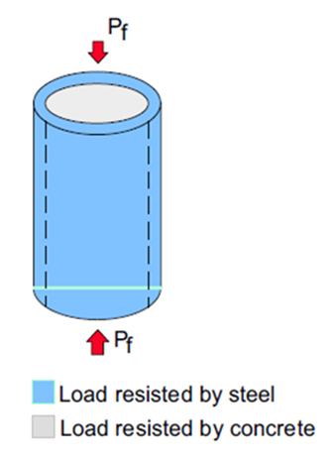
Fire Resistance
Unique Structural Systems in Very Tall Buildings
Large complex atria,
Large open floor plates,
Large structural members,
Long structural spans,
Innovative and/or complex structural systems and geometries
Innovative use of structural materials (e.g. mass timber, very high-strength concrete)
Protecting Egress (Defend-in-Place, Refuge Floors, Full Evacuation)
Performance Approach Should Be Considered in Very Tall Buildings

Slide 30
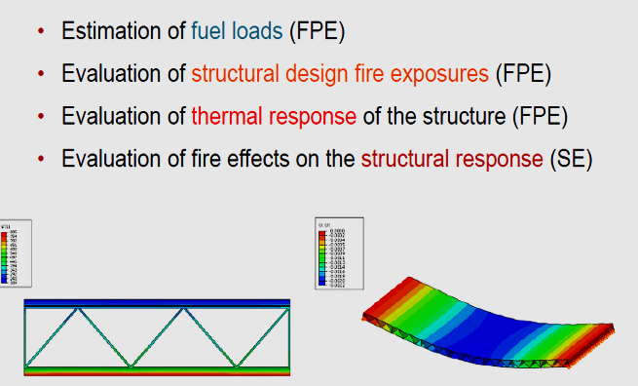
Performance Approach

Slide 31
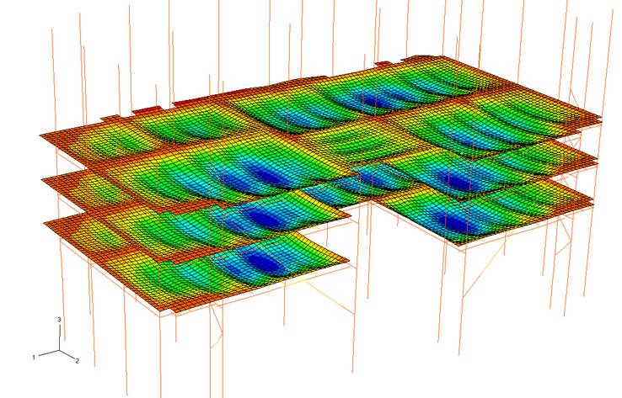
Fire Resistance
Performance Approach
Types of Analysis (single element vs advanced methods)
Fire Scenarios
Cooling phase (decay)

Slide 32
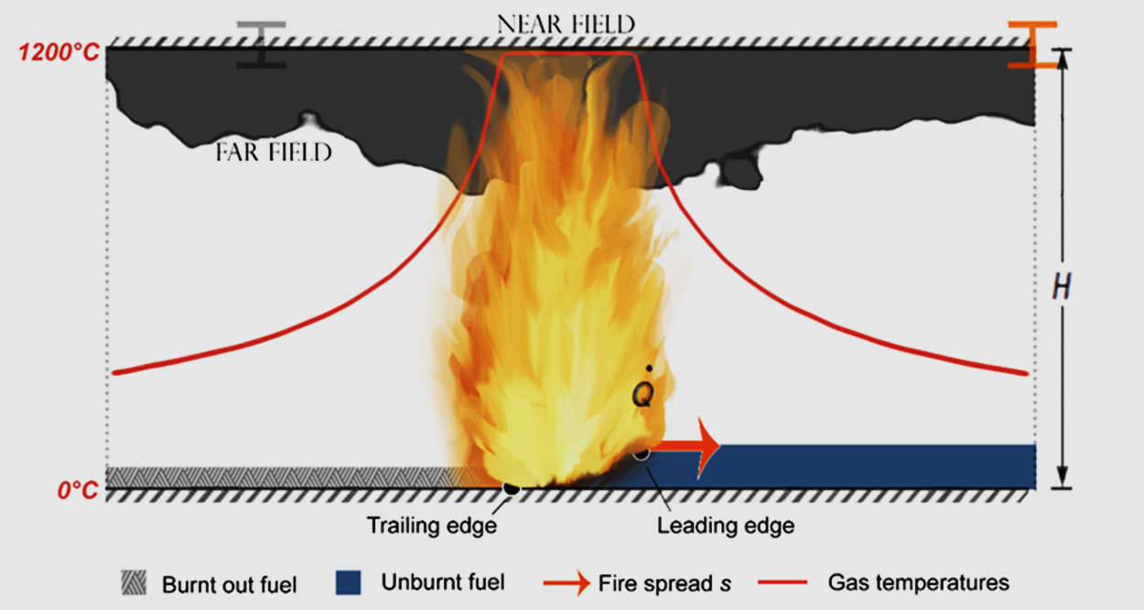
Traveling Fire Methodology

Slide 33

Building Envelope
Changed Name of Chapter (from Facades)
Many of the Fires Since First Edition Related to Building Envelope (See Revised History Chapter)
Broader Discussion on Risk Assessment Methods including EFFECT, (Exterior Façade Fire Evaluation and Comparison Tool, www.nfpaeffect.com
Now Includes discussion about:
  LED display screens
  Photovoltaic (PV) Systems
  Vegetative walls

Slide 34
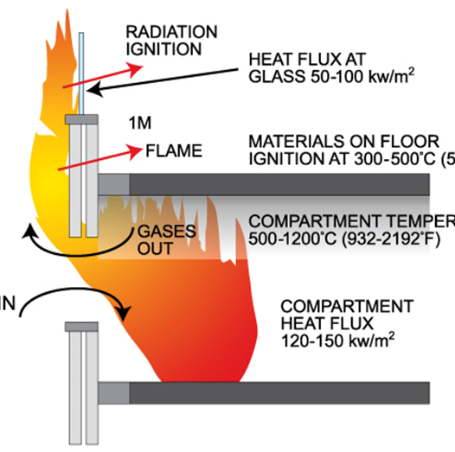
Building Envelope (Fire Dynamics)
Mechanisms of Fire Spread
Fire Initiating events
  Interior Fire
  Exterior Fire
  Fire Starts in Cavity
After initiating event
  Fire spread to the interior of floor above via openings
  Fire spread via combustible materials found on exterior balconies
  Flame spread over the external surface of the wall
  Flame spread within an interval vertical cavity /air gap
  Heat flux impacts cause degradation/separation of non‐combustible external skin
  Secondary external fires initiated at lower (ground) floors arising from falling burning debris.
  Secondary external fires initiated on adjacent property arising from falling burning debris.

Slide 35
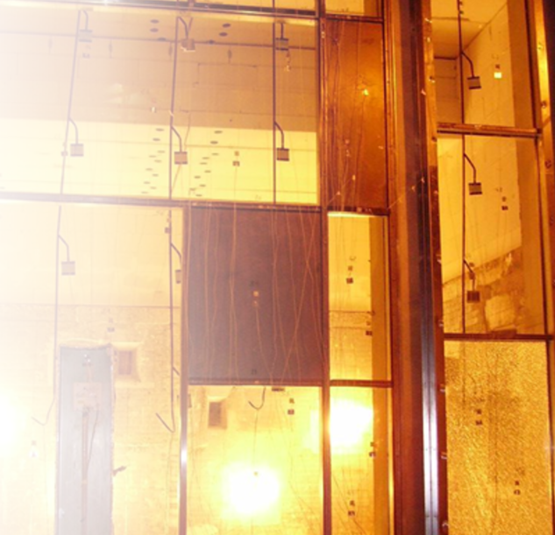
Building Envelope (Fire Testing)
Now Includes Expanded Discussion on Fire Testing of Building Envelope Systems:
Reaction to fire tests of the constituent materials of the building envelope.
Fire resistance testing of perimeter fire barrier systems with or without fire rated spandrels or the entire glazing system if the façade is to be fire rated.
Large scale fire testing of the façade system.
Large scale testing of the roofing system.

Slide 36
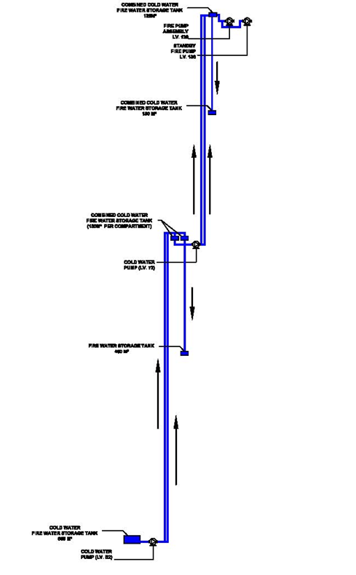
Suppression Considerations for Tall Buildings
Strategies to increase reliability
  Multiple public supply connections
  On-site water storage
  Multiple points of supply for floor sprinkler systems
  Alternating floor supplies from different risers
  Electronic supervision of floor control valves and other critical components
  Rigorous, frequent maintenance and inspection programs
  Gravity source of water supply for sprinklers
  Cross-connecting standpipe/sprinkler risers at multiple points vertically with control valves arranged to permit shut down of one riser without shutting down the other
  Re-evaluating design and arrangement with tenant changes

Slide 37
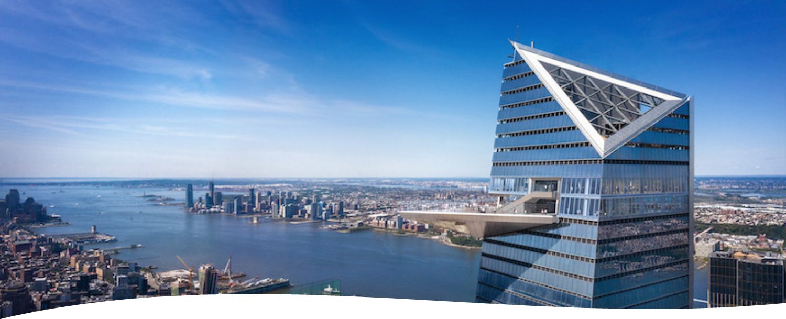
Special Features & Attractions
New Section
Discusses Life Safety Systems, Fall Hazards & First Responder Considerations Related to:
  Observation Decks, Restaurants, Night Clubs, Pool Decks
  Amusement/Entertainment Thrill Features
  Fireworks

Slide 38
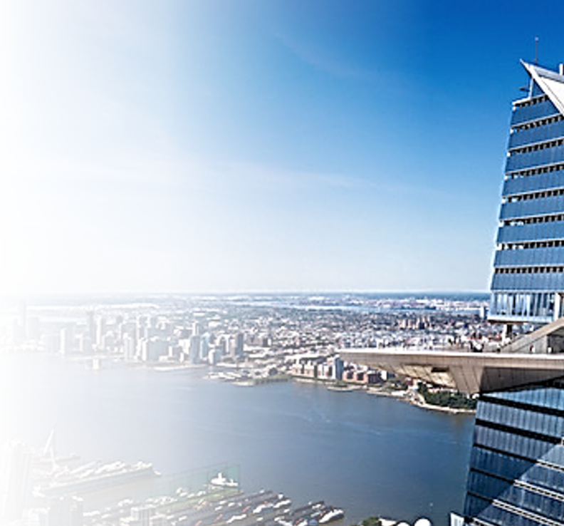
Observation Decks / Restaurants / Night Clubs / Pool Decks
Can include indoor and outdoor spaces
Glass floors
Significant occupant load
  Occupant load monitoring
  Time ticketing strategies
  Horizontal exit strategies

Slide 39
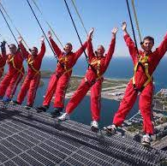
Amusement / Thrill Features
Includes:
Tilt panels
Ledge walks
Roof climbs
Zip wires
Lift devices
Amusement Rides
Fire Safety Issue -- Occupant evacuation when the ride is down or becomes inoperable

Slide 40

Life Safety Consideration
Special Features & Attraction
Special fire safety and evacuation plan
Notification?
Suppression on moving objects?
Interface with the life safety systems
Compartmentation considerations
Fall hazards (individual & objects)
Fire service considerations:
  Access
  Special knowledge
  Special equipment
  Training

Slide 41
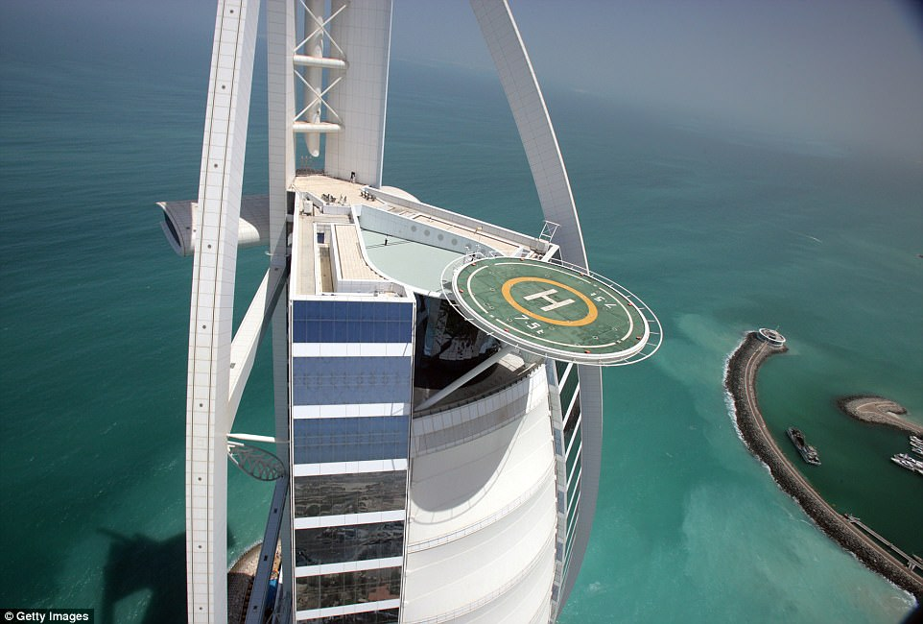
Aerial Vehicle Platforms
Traditionally long-term
Temporary drop-off/pick-up (Uber)
UAVs (unmanned aerial vehicles) (Amazon)
Fire hazards risk assessment

Slide 42
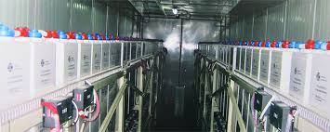
ESS
Part of Green Movement to Conserve Energy
Codes & Standards Not Fully Developed in this Area
Description of Technology & Hazards
Fire Safety Considerations

Slide 43
Existing Building Considerations
Many tall buildings constructed before technological advancements over the past 30 years
Cities have enacted regulations to improve fire safety in these existing buildings.
Projects can be complicated
Include asbestos abatement
Historic preservation issues
Reasonable fire safety should include:
  A means to detect the presence of a fire;
  A means to notify the occupants and emergency forces of the fire;
  Protected pathways for occupants to exit the building or reach an area of rescue assistance; and,
  A means to control the spread of the fire.
Adaptive Reuse & Change of Occupancy

Slide 44


Chris Jelenewicz, PE, FSFPE
CEO SFPE
Email: Chris@sfpe.org
Web: www.sfpe.orf

